Slide 1
Minimum Information for Plant Phenotyping Experiments (MIAPPE)
Data standards for plant research data in Phenomic and beyond

Slide 2
Plant Data StandardS : Overview
MIAPPE, Crop ontology, MCPD

Slide 3
Plant Data standards
Technical
Data integration and sharing
Interoperability : tools and systems
GA4GH
Breeding API www.brapi.org
Computer scientist driven
Structure
Formatting and Organizing
Data
Dataset description & Metadata
Data Models, templates
Phenotyping Variable, Biological Material
Standards : VCF, GFF, MIAPPE, etc…
Biologist & Computer scientist driven
Persistent Unique Identifiers
Cultivars, Accessions, MCPD, …
Semantic
Description of the data
Controlled vocabularies: term name and definitions
Phenotyping Variables (trait+method+scale)
Ontologies: semantic links between terms
Biologist driven

Slide 4
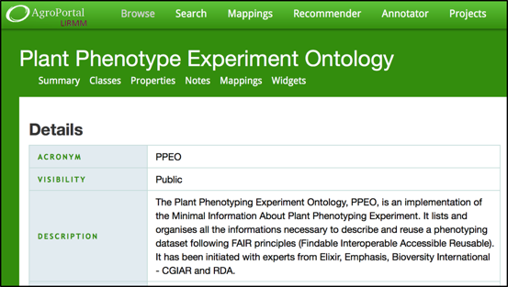
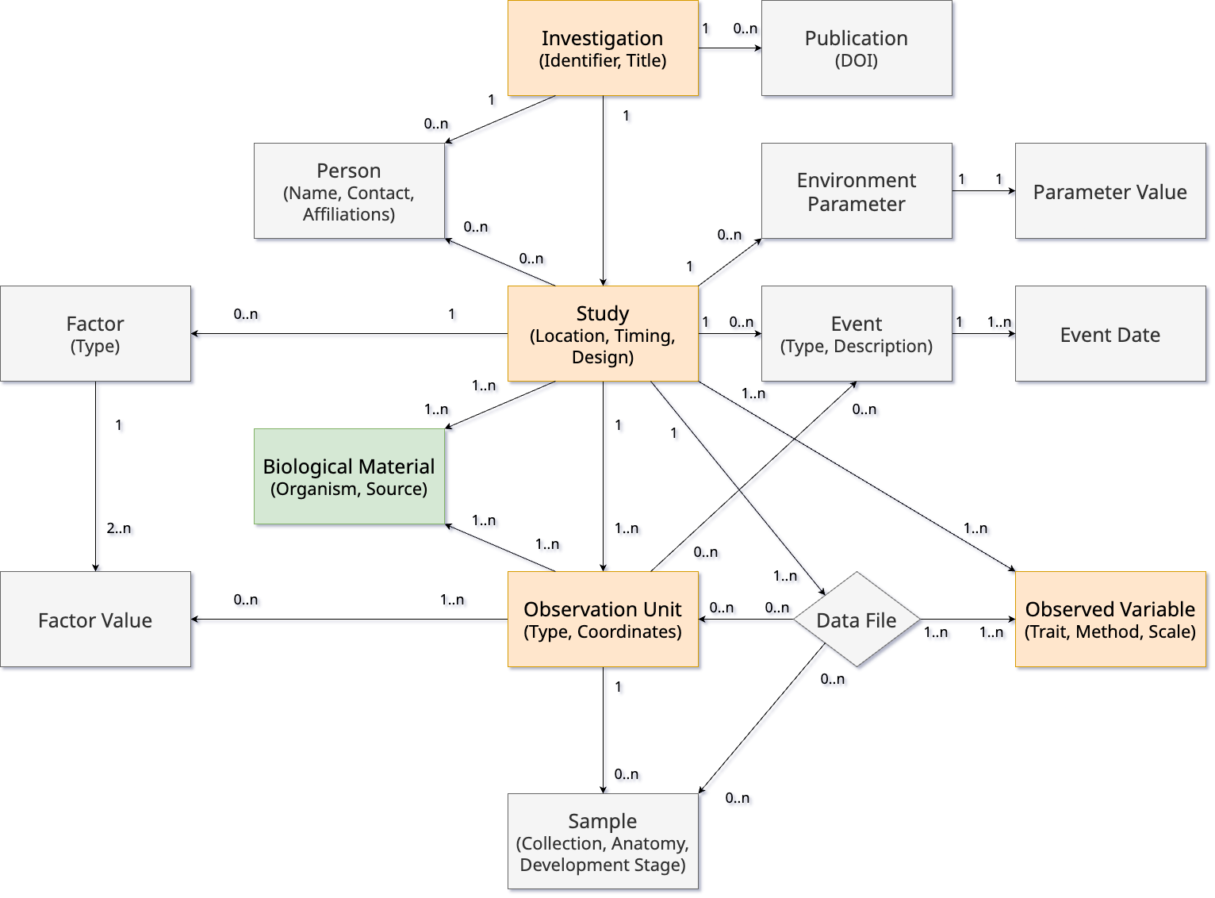
Plant Structure Standard
Biologist Friendly
Definitions and clear examples
Excel templates
Trainings
Minimum and sufficient list of metadata
Computer scientist friendly
Explicit data model: ISA-Tools and Breeding API (BrAPI) compatibility.
Validation framework and toolbox
Includes established standards
MultiCrop Passport Descriptors (MCPD): plant material identification
Crop Ontology: description of measurement and calculation methods
Specification with several implementations

Slide 5
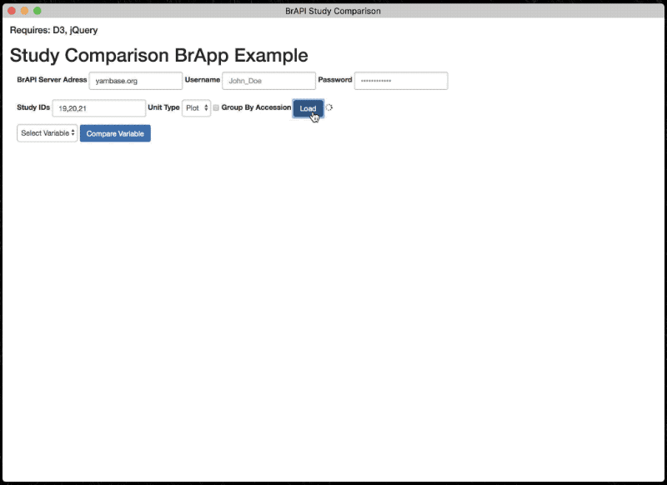
MIAPPE Implementations & Technical Standards
Databases and data repositories
Any Breeding API (BrAPI) compliant DB (GnpIS, PHIS, PIPPA, …)
Generic data repositories (Dataverse, Zenodo, e!Dale, …)
Web Services
Breeding API www.brapi.org
International collaboration
Standard Open Web Service API
Information Exchange, Main target: Breeding
ELIXIR, EMPHASIS, Excellence in Breeding platform (CGIAR, Cornell Peter Selby)
File Exchange
MIAPPE XLSX Templates https://github.com/MIAPPE/MIAPPE/Templates
Project workflows
ISA Tab: data + metadata
RO Crate
Ontology, OWL Implementation
https://github.com/MIAPPE/MIAPPE-ontology
http://agroportal.lirmm.fr/ontologies/PPEO
Data model representation, Formal concepts and constraints

Slide 6
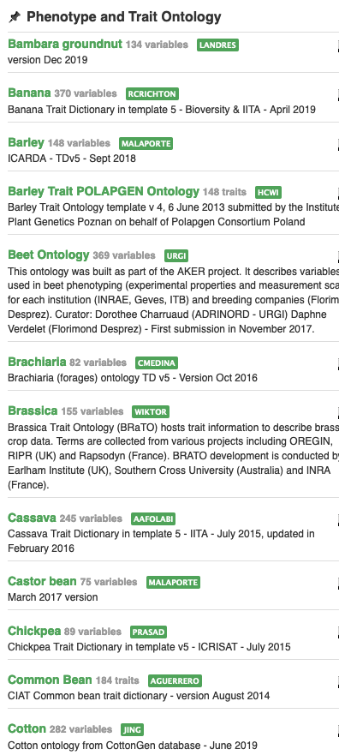
Phenotype Semantic Standard: Ontologies
Description of plant traits and characteristics
www.cropontology.org
Representation model, ie Framework
Trait + Method + Scale
Scale: unit, rating scale
Feature: Entity (e.g. leaf) + Characteristic (surface)
Collection of ontologies by species
Ontology creation by Community/Project possible
Recommended in certain cases
Solves : Potentially time-consuming contribution to ontologies
Publication
Agroportal
https://entrepot.recherche.data.gouv.fr/dataverse/vo-inrae
Vitis Organ ontology
Wheat Crop Ontology
Walnut Trait Ontology
Woody Plant Ontology

Slide 7
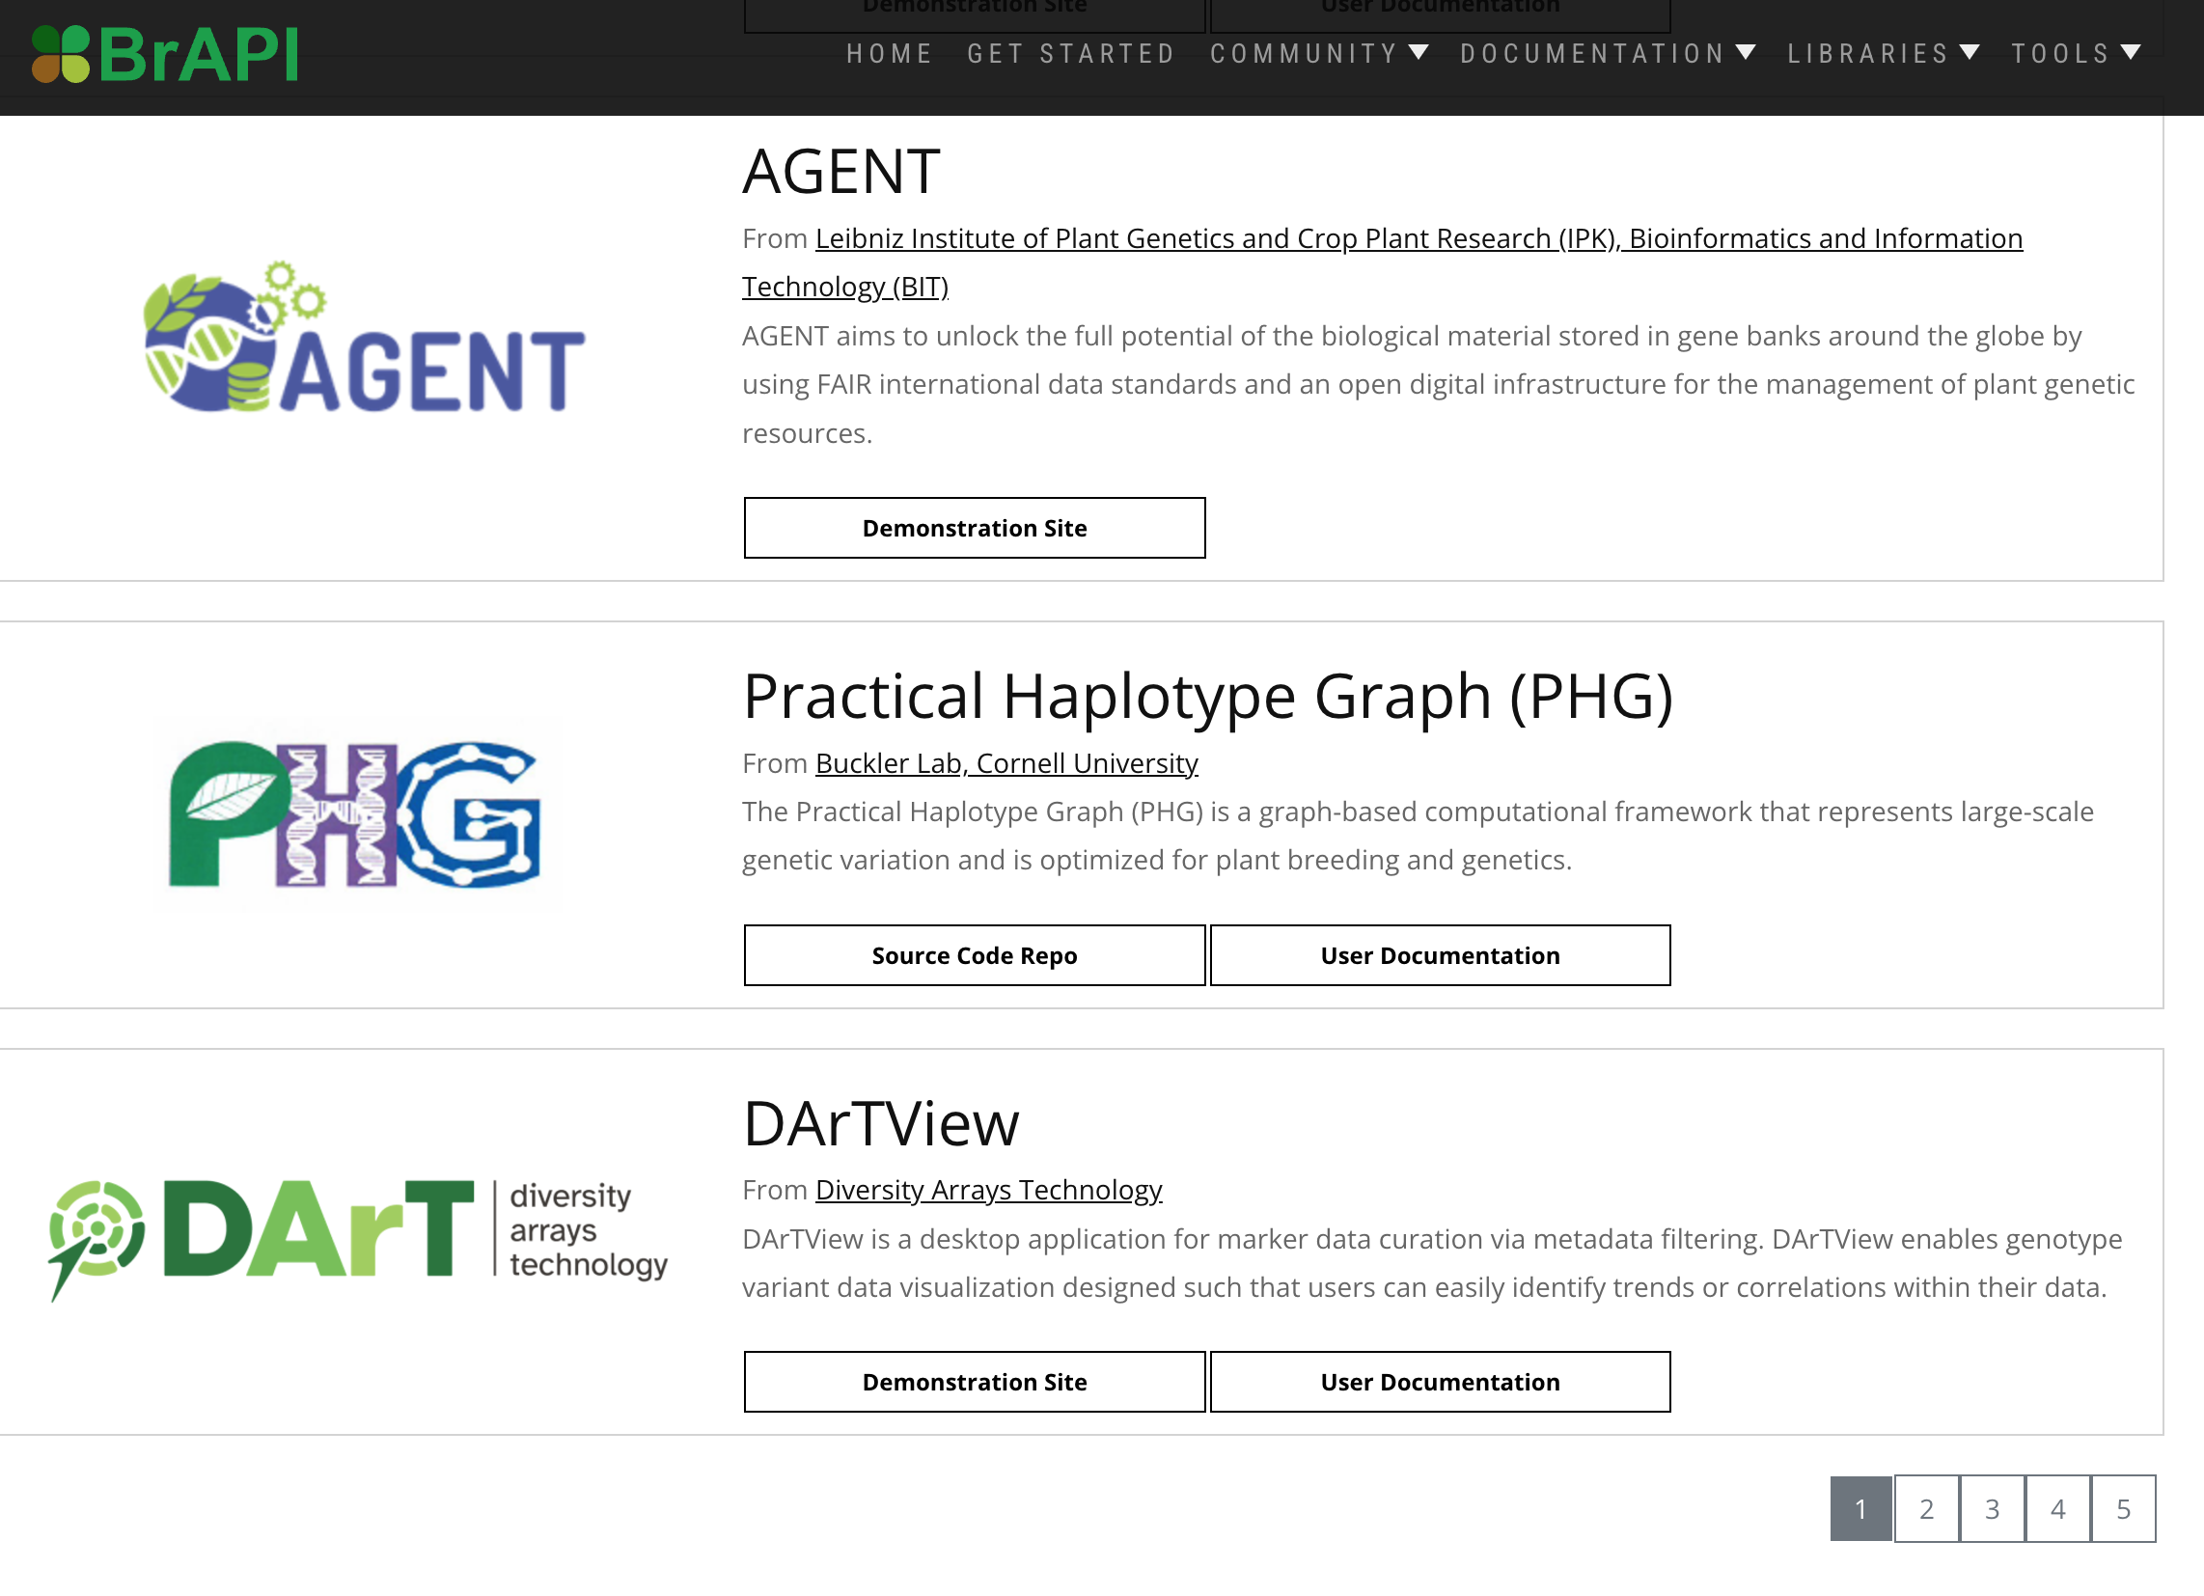
MIAPPE & BrAPI ADOPTION
Transparent for users
Using data standards without noticing it
BrAPI Implementation = MIAPPE Compliant
Databases
FAIDARE (incl GnpIS)
PHIS/Sixtine
European SI ELIXIR and EMPHASIS
VIB, NIB, ITQB, WUR, ...
CGIAR
Breedbase
Solegenomics
...
FAIRDOM-Seek
Generic data repositories (Dataverse, Zenodo)
BrAPi tools
https://brapi.org/compatibleSoftware
ELIXIR, EMPHASIS

Slide 8
MIAPPE Specifications

Slide 9
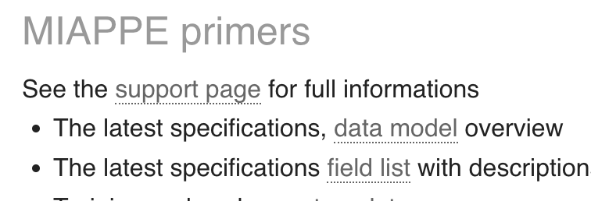
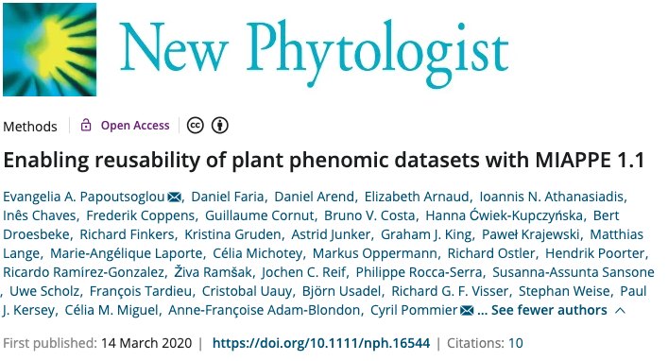
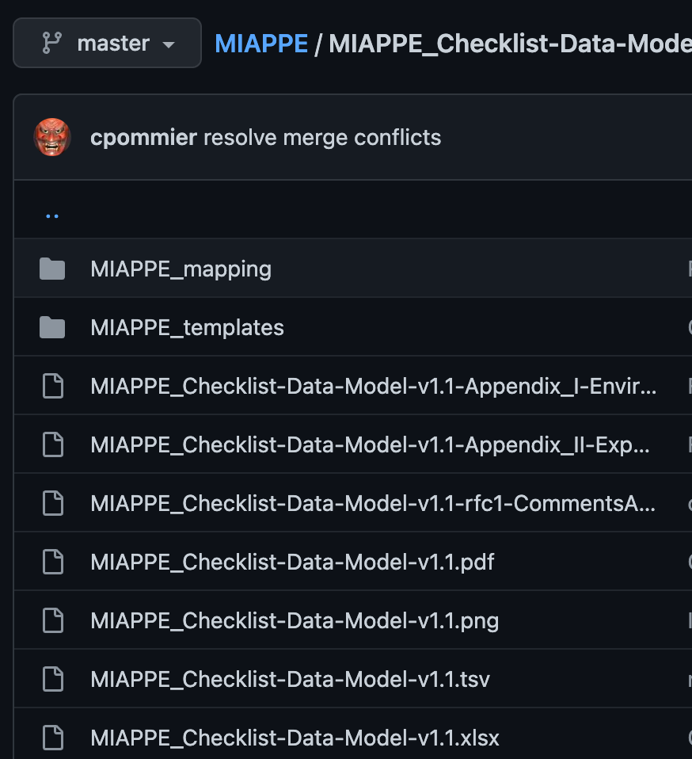
MIAPPE Specifications
www.miappe.org
Github
https://github.com/MIAPPE/MIAPPE/tree/master/MIAPPE_Checklist-Data-Model-v1.1

Slide 10
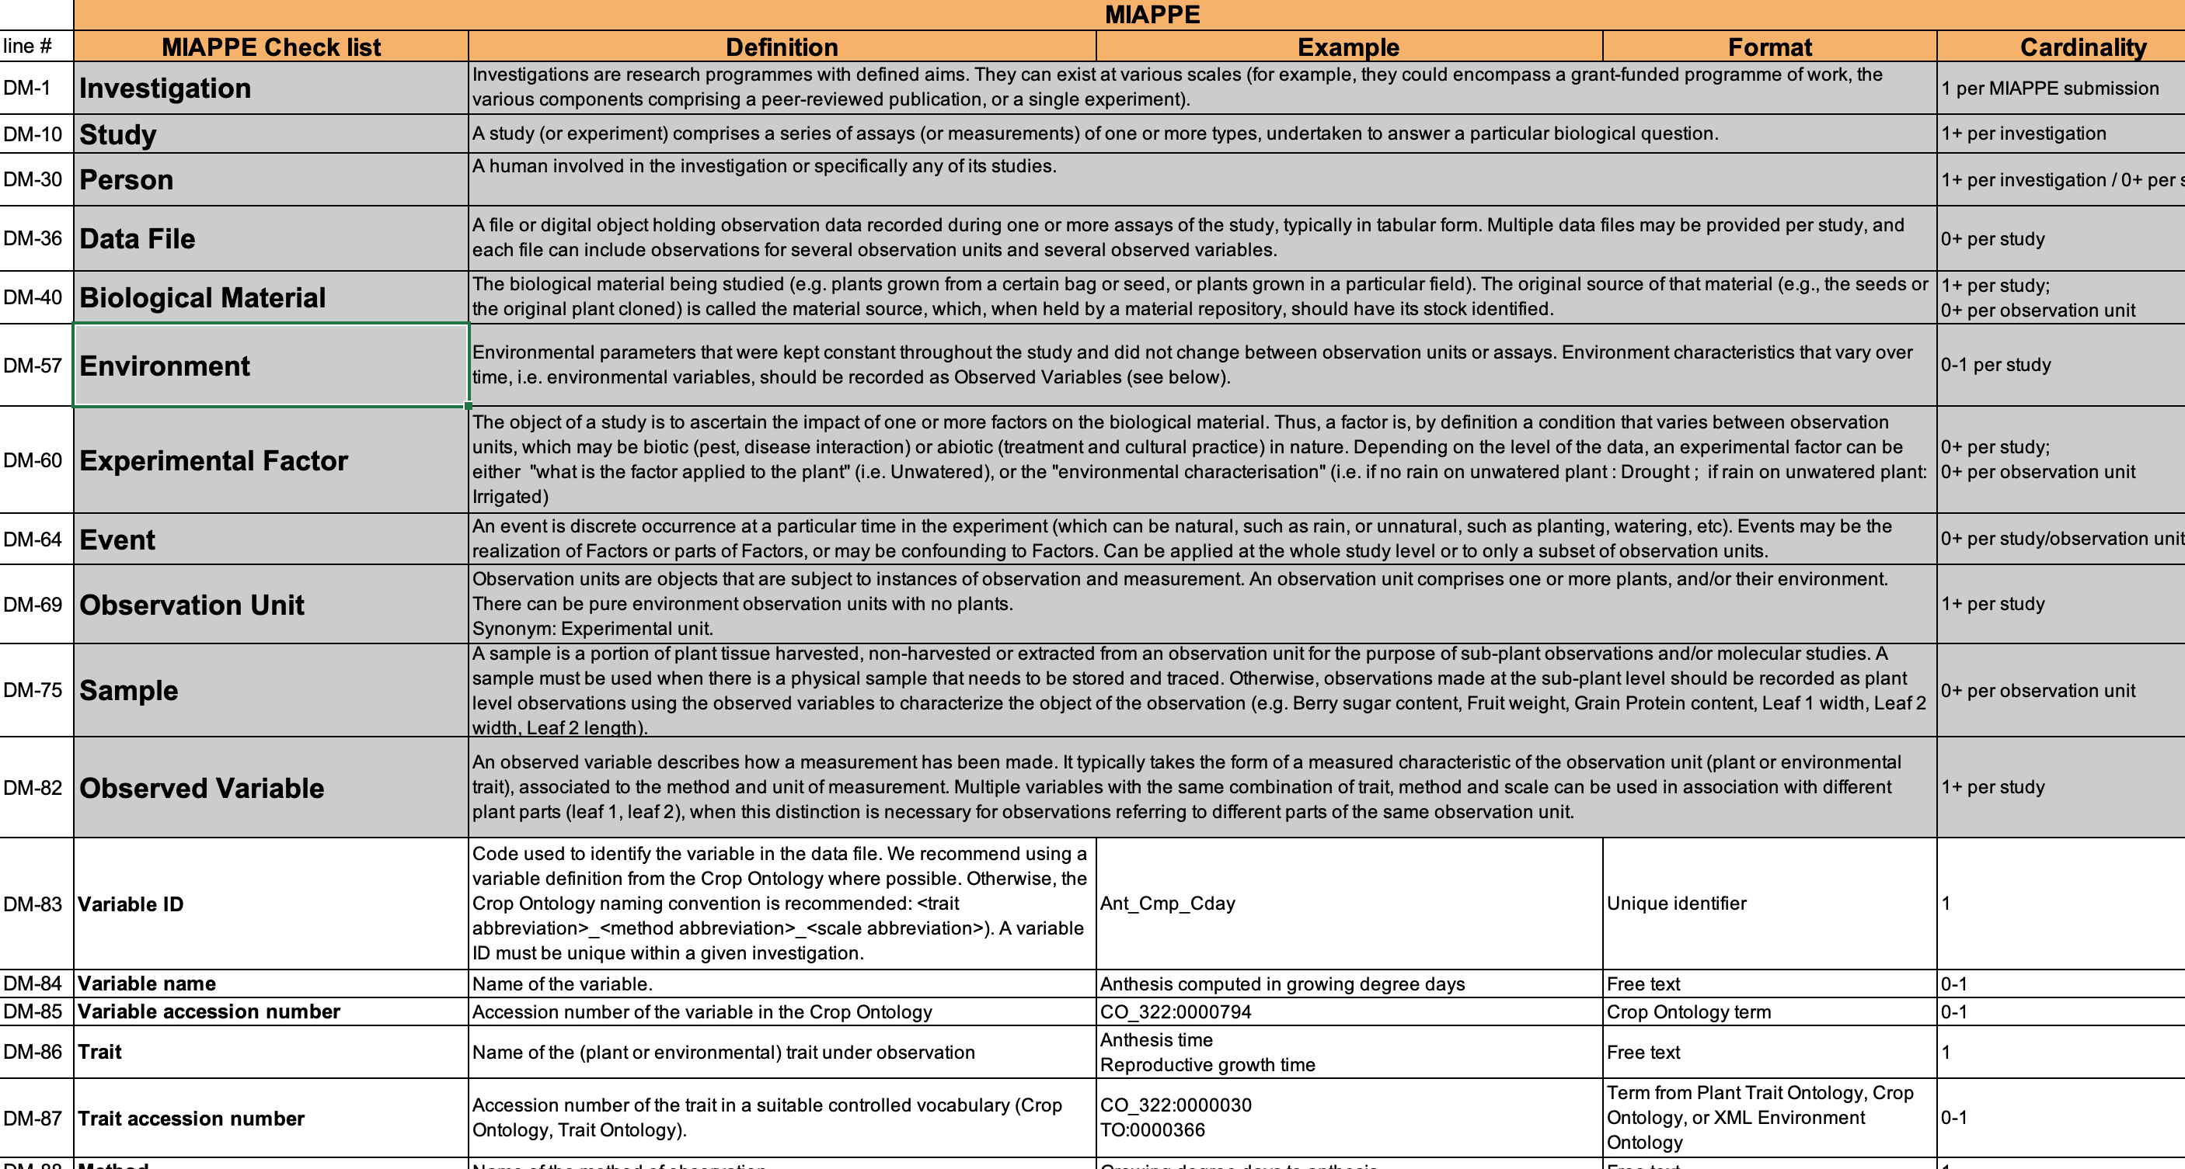
MIAPPE Specifications
Specifications table
11 Sections
Metadata Fields
Definitions
Examples
Cardinalities

Slide 11
MIAPPE Specifications
Specifications table
11 Sections
Metadata Fields
Definitions
Examples
Cardinalities
Data model : Links between sections/concepts

Slide 12
MIAPPE overview
Investigation: full dataset
fields, greenhouse, ...
One to many location
One to many years
Study: experience
One location/site
One or more years
Assay:
trait or indice (Pheno or Env)
Trait + Method + Scale/Unit
Investigation = Dataset
Study A
France
2013
Study B
Italy
2013-2014
Study C
Germany
2018-2024
Plant Measures
Plant Measures
µPlot Measures
Pot Measures
Trait
+
Method
+
Scale
Variable C
Variable A
Variable B
OR
Community specific

Slide 13
Examples in MIAPPE
Two illustrations showing the experimental phenotyping documentation:
MAIZE: [1] Millet et al. 2019 (https://doi.org/10.15454/IASSTN): A multi-site experiment in a network of European fields for assessing the maize yield response to environmental scenarios.
POPLAR: [2] Monclus et al. 2012 (http://dx.doi.org/10.1186/1471-2229-12-173): Integrating genome annotation and QTL position to identify candidate genes for productivity, architecture and water-use efficiency in Populus spp.

Slide 14
Millet et al 2019 [1] - Material&methods section on phenotyping experiments
A panel of 256 maize hybrids was grown with two water regimes (irrigated or rainfed).
Location: seven fields in 2012 and 2013, plus one site in Chile in 2013
This resulted in 29 experiments defined as the combination of one year, one site and one water regime, with two and three repetitions for rainfed and irrigated treatments, respectively.
A detailed environmental characterisation was carried out, with hourly records of micrometeorological data and soil water status, and associated with precise measurement of phenology.
"grain.yield": yiel adjusted at 15% grain moisture, in ton per hectare (t ha-1). "grain.number": number of grain per square meter. "grain.weight": individual grain weight (mg). "anthesis": male flowering (pollen shed), in thermal time cumulated since emergence (d20°C). "silking": female flowering (silking emergence), in thermal time cumulated since emergence (d20°C). "plant.height": plant height, from ground level to the base of the flag leaf (highest) leaf (cm). "tassel.height": plant height including tassel, from ground level to the highest point of the tassel (cm). "ear.height": ear insertion height, from ground level to ligule of the highest ear leaf (cm).

Slide 15
Monclus et al 2012 [2] - Material&methods section on phenotyping experiments
3 Field trial established in April 2003 located in France (Ardon, 47°49'41''N, 1°54'39''E, 110 m),Italy Cavallermaggiore ((44° 43' 0'' N) , (7° 41' 0'' E)), UK Headley ((51° 7' 0'' N) , (-1° 10' 0'' W) )
The biological material consisted of a cloned 336 F1 progeny from an interspecific cross between the female Populus deltoides (Bartr. Ex Marsh.) '73028-62' from Illinois and the male P. trichocarpa (Torr. and Gray) '101-74' from Washington State.
The trial was established from 25 cm- homogenous hardwood cuttings planted at a plant density of 6670 trees per ha. The trial was and consisted in 6 randomized complete blocks where each F1 genotype and each parent was represented by one replicate.
Circumference and stem height were measured at the end of the first (winter 2003-2004) and second (winter 2004-2005) as described in Dillen et al. Forest Ecol Manag. 2007, 252 (1-3): 12-23). Growth increment in height and circumference during the second growing season were calculated.
Leaf traits where measured in 2003: one fully illuminated mature leaf was collected on each tree according to Monclus et al. http://doi.org/10.1111/j.1469-8137.2005.01407.x ). Six calibrated discs of lamina were cut from this leaf, dried at 50 °C during 48 °C and weighed, and specific leaf area (SLA, cm² g⁻¹ ) was computed. Leaf discs were ground to fine powder for analysis of leaf carbon isotope composition (δ¹³ C), carbon (C_{M} ) and nitrogen (N_{M} ) contents. One-milligram subsamples of ground material were used for measuring the CO₂ produced by combustion and its¹³ CO /₂¹² CO₂ ratio by a continuous flux isotope ratio mass spectrometer. The discrimination between atmospheric CO₂ and plant material was calculated.

Slide 16
Experimental design
Typical Dataset: Monclus et al, 2012, [2]
Populus deltoides
INRA:73028-62
doi:10.15454/1.4921786081024297E12
Data file
Data file
Data file
Data file
6 randomized blocks
1 observation unit = one tree
No treatment
6 replicates defined by their position in each block: row and column

Slide 17
MIAPPE Data file
Free format(Near Infra Red Spectrum, Images, Image Archives references, ....)
But a recommended tabular format is currently being validated, see github issue 71.
Mainly tabulated
MIAPPE Metadata on each column heading

Slide 18
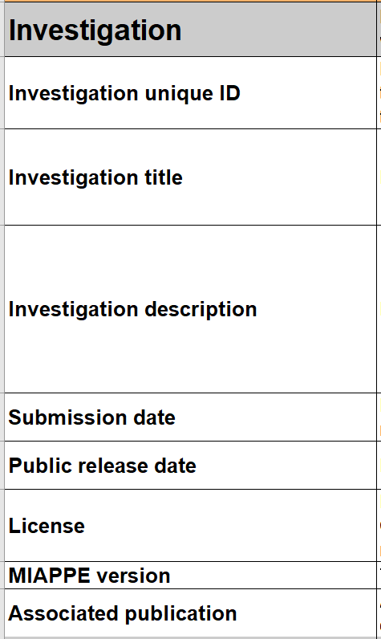
Mandatory MIAPPE sections - Investigation
Investigations = Dataset
Or Research programmes with defined objectives.
Examples:
Single experiment,
Multilocal network
Full project results
=> An investigation contains one or more studies.
Metadata: Publication information for papers or datasets:
=> title, description, keywords, authors, DOI, ...
Examples:
MAIZE [1]: set of multilocal experiments.
POPLAR [2]: Set of multilocation measurements over three years

Slide 19
Mandatory MIAPPE sections - Study
« study » (or experiment)
Includes assays (ie analyses or measurements)
One study = one location
Metadata: description of the entire experiment
=> timing, location, statistical design, cultural practices, etc...
Examples:
MAIZE [1] : 29 studies => 2 years x 7 locations x 2 treatments (Gaillac 2012 rain, Gaillac 2013 watered, ...)
POPLAR [2] : 6 studies => 3 locations over 2 years (Ardon_2003-2004, Ardon_2004-2005)

Slide 20
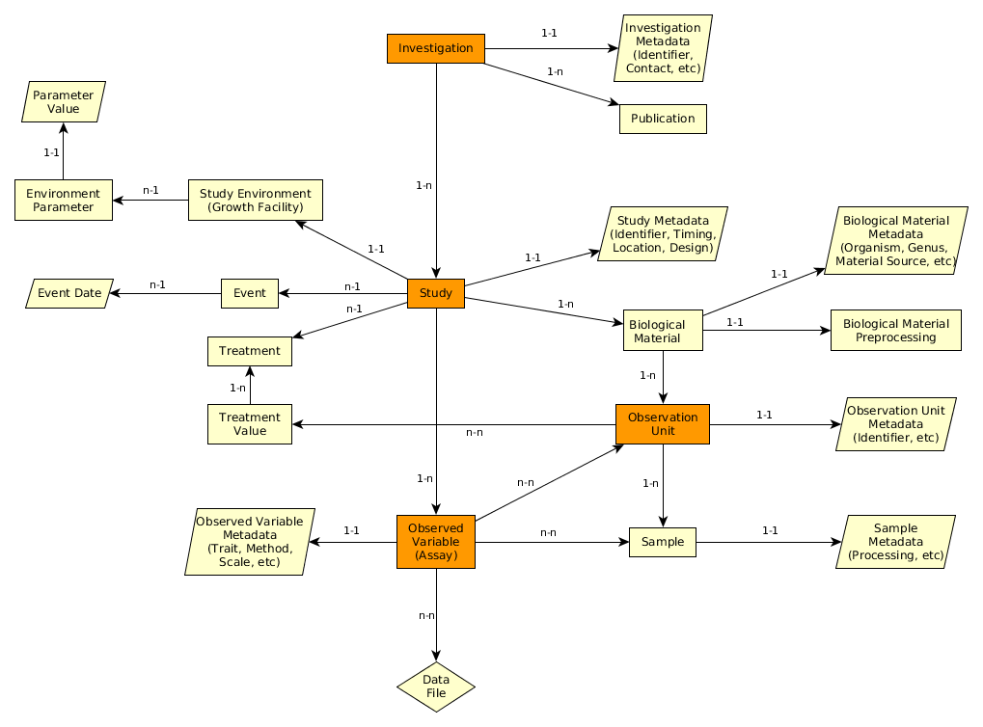
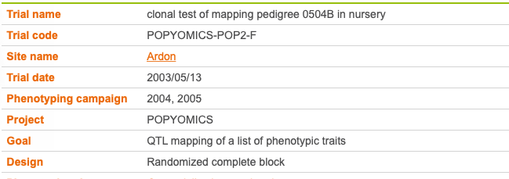
Mandatory MIAPPE sections - Study Metadata
Poplar Study
Study = Trial
Study
Notes:
Replaced by explicit examples

Slide 21
Mandatory MIAPPE sections - Biological material
Varietal list, accessions, varieties, ...
Plant material identification is complex
Taxonomy: Species, Sub Species, (Botanical Varieties?)
Cultivar = cultivated varieties
Possibly registered in national catalogs, depending on species
Wheat Renand, Chinese Spring, Apache, …
Apples: Golden, Fuji, …
Maize: B73
Problem
Stable phenotype
But possible genetic variation
Genebank Accessions
A variety in a genebank
Maize: B73_INRAE, B73_USDA
Problem
Accession has to be regernerated → risk of genetic variation
Genebank Seed lots, Cutting, Tree, …
Seeds or plants for a given accession
Maize: B73_INRAE_2022_01

Slide 22
Mandatory MIAPPE sections - Biological material
Varietal list, accessions, varieties, ...
Identifier plus source (stock centre, gen bank, etc.).
Crucial for integrating pheno-genomic or genetic data
Metadata
Minimum fields in the standard Multicrop Passport Descriptor (MCPD)
GPS location for forest tree / in situ material provenance
Material source: accession, cultivar/variety, region of provenance, laboratory cross, ...
MCPD identification system:
Genebank/Lab + Species + accession number (mandatory)
DOI
Biological material: seed lot, cuttings, plant in the study, ...
Lab + internal accession number (mandatory)
URI
Plant Samples: part removed from a plant, detached leaves, ...
Lab + internal accession number (mandatory)
BioSample ID

Slide 23
Important MIAPPE sections - Observation Unit & Samples
Example: Monclus et al, 2012, [2]
Populus deltoides
INRA:73028-62
doi:10.15454/1.4921786081024297E12
[observation unit: Block1-Row4-Col4
Set of samples
One leaf
For each tree of each block
= for each observation unit
6 leaf disks
Different types of processing of the leaf disks depending on the measurement: can be captured by different sets of samples (e.g. if subsampling generates repetitions) or in the method of the observed variable.
Notes:
Leaf traits where measured in 2003: one fully illuminated mature leaf was collected on each tree according to Monclus et al. http://doi.org/10.1111/j.1469-8137.2005.01407.x ). Six calibrated discs of lamina were cut from this leaf, dried at 50 °C during 48 °C and weighed, and specific leaf area (SLA, cm² g⁻¹ ) was computed. Leaf discs were ground to fine powder for analysis of leaf carbon isotope composition (δ¹³ C), carbon (C_{M} ) and nitrogen (N_{M} ) contents. One-milligram subsamples of ground material were used for measuring the CO₂ produced by combustion and its¹³ CO /₂¹² CO₂ ratio by a continuous flux isotope ratio mass spectrometer. The discrimination between atmospheric CO₂ and plant material was calculated.

Slide 24
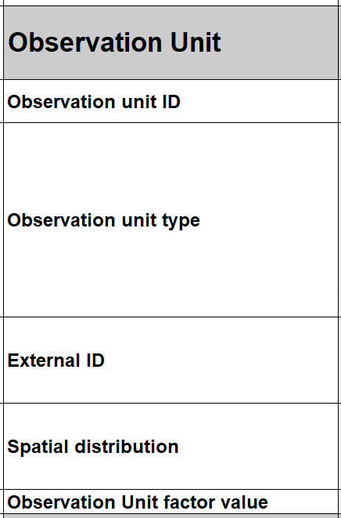
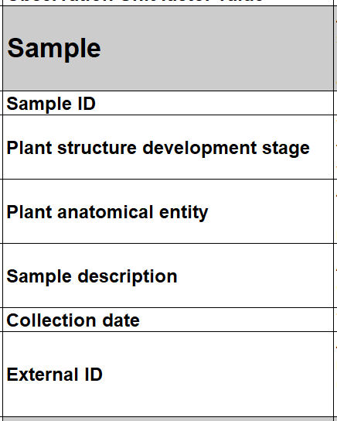
Important MIAPPE sections - Observation Unit & Samples
Observation units :
real objects (e.g. microplot) from the study on which measurements and observations are made.
virtual objects (genotype) on which variables or indices are calculated.
Typically one or more plants
Receive phenological or environmental measures
Specific metadata
=> identifiers, location, replication, treatments, ...
Sample
piece of tissue extracted from an observation unit
sub-plant observations or molecular studies.
Metadata: aligned with BioSample checklists
=> identifiers, information about processing, ...

Slide 25
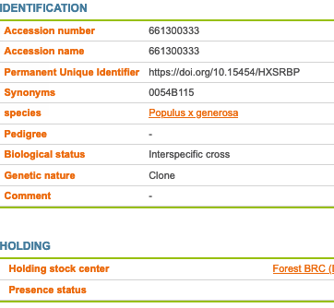
Mandatory MIAPPE sections - Biological material
Plant Material
Identification
Description
Multi Crop Passport Descriptor
Biological material
Observation Unit
Sample

Slide 26
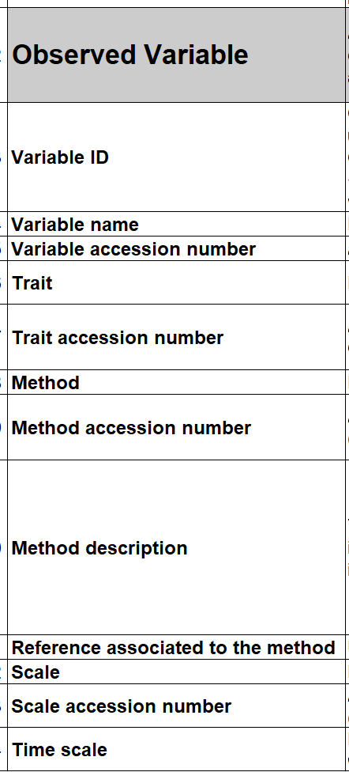
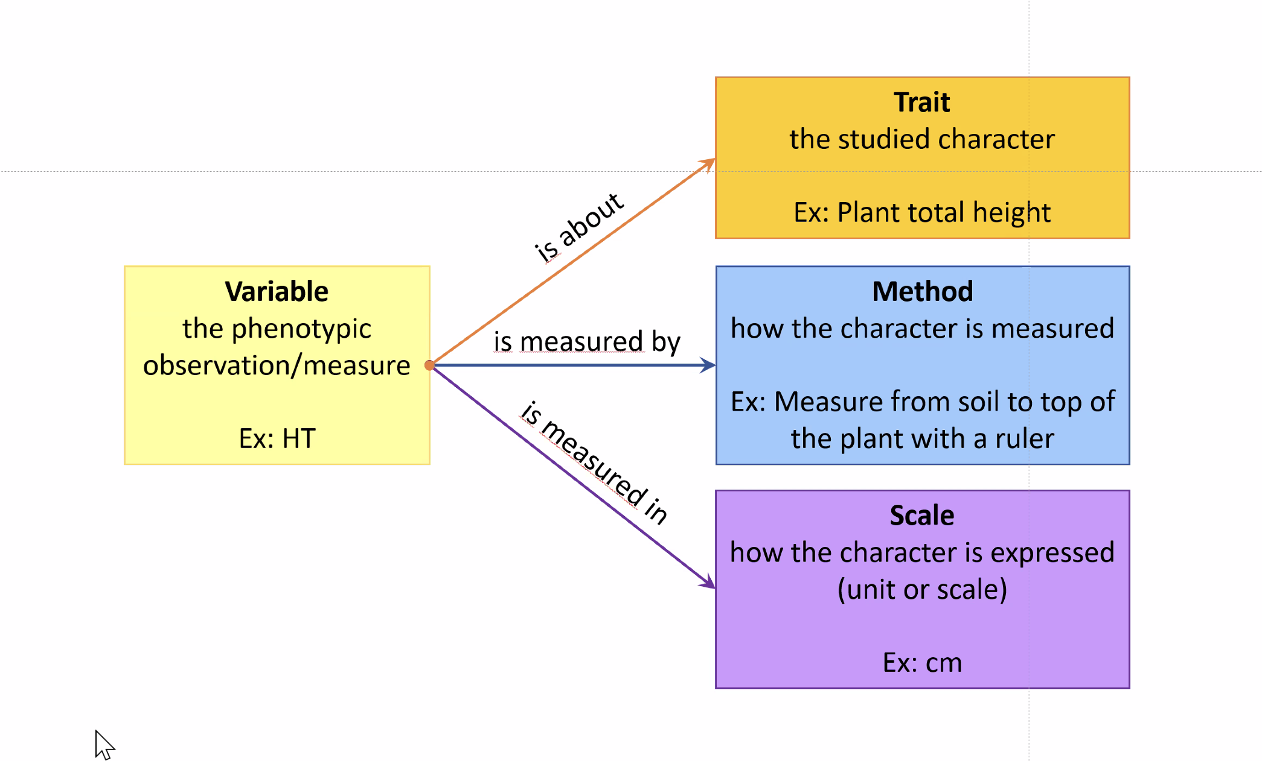
Mandatory MIAPPE sections -Observed Variable
Observed Variable (assay)
Trait → Phenotype or Environment
Measurement / computation method
Unit, Notation scale.
Metadata
Minimal :trait, method, scale
Complete : Crop Ontology Trait Dictionary

Slide 27
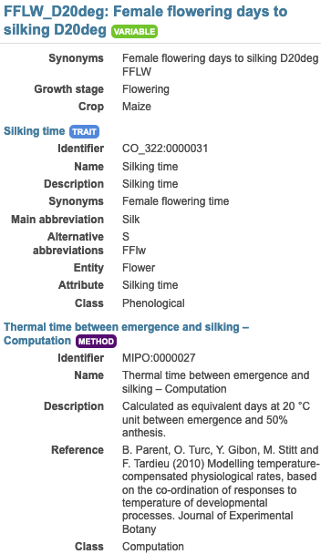
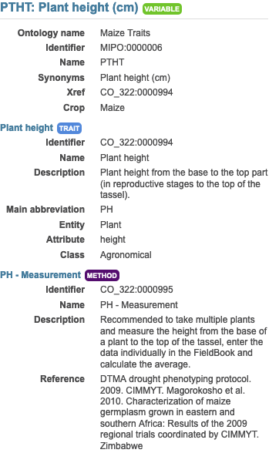
Mandatory MIAPPE sections -Observed Variable
Example:
In each study of MAIZE [1] three measurements are made:
Plant level: 20 variables
Genotype/Study level: 19 variable both phenotype and environment
Plot level: 9 variables
For instance
Female flowering days to silking D20deg
Plant height (cm)

Slide 28
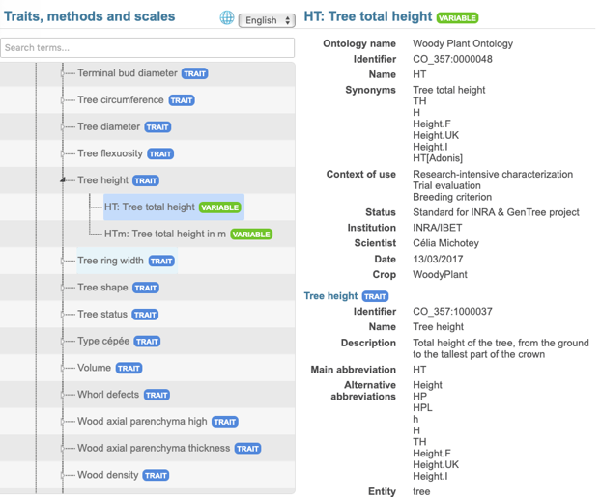
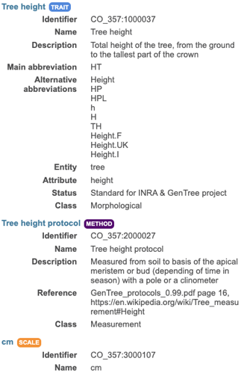
Mandatory MIAPPE sections -Observed variable
Each column: Trait + Method + Scale
Assay
(Observed variable)

Slide 29
Other important sections
Investigation
Environment
Events
Study
Biological material
Treatment
Observation Unit
Assay
(Observed variable)
Sample
Files: data,...
Notes:
Diagrams to be updated and placed in nitro on the backbone

Slide 30
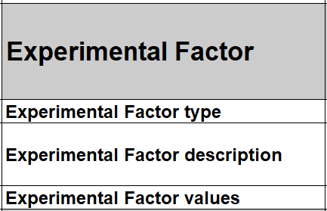
Important MIAPPE section - Experimental Factor
Experimental factor:
treatment or biotic or abiotic factor whose effect on the study is being assessed.
This is not a cultural practice.
A priori or a posteriori categorisation
Takes different values in the study
Metadata include a name, a description and a value of the treatment
Example: MAIZE [1]
Two experimental factors/treatments: Rainfed, Watered
Block organisation
Notes:
Use an example slide as before

Slide 31
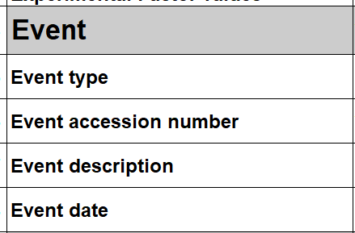
Important MIAPPE section - Event
Event
Discrete, dated or time-stamped occurrence
Natural (e.g. rain, pathogen attack)
Cultivation practices (e.g. sowing, irrigation)
Applied to the entire study or by individual observation
It's not the factor, but an additional piece of information.
Event can be used to create a factor.
Metadata: name, description and time/date
Examples: POPLAR [2]
the field establishment date, 2003
the orchard was subjected to 15mm of rain on March 15, 2012 (fiction)
Study | Event
 | Name | Description | Date
Monclus et al, 2012 | Rain | 15mm of rain on the orchard | 2012-03-15
Notes:
Use an example slide as before

Slide 32
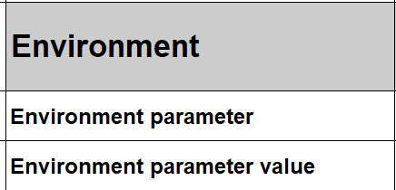
Important MIAPPE section - Environment
Environment:
"Study descriptors "
Environmental parameters, experimental conditions
Constant throughout the study
Environmental variables are treated as observed variables.
Metadata: name, description and value
Example:
Environment parameter | Environment parameter Value
Mean day air temperature | 22°C
Rooting medium composition | Ca (XEO:00058): 5 mg/L; ...
Notes:
Use an example slide as before

Slide 33
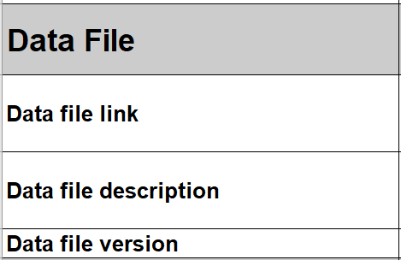
Important MIAPPE sections - Data file
Any format (Data matrix, NIRS, Images, ....)
Mostly tabular
Metadata on each column header
Notes:
An example built using Drops and popyomics

Slide 34
MIAPPE Excel template
Available on github MIAPPE
https://github.com/MIAPPE/MIAPPE/tree/master/Templates
One sheet per MIAPPE section
Documentation and examples
Notes:
Of course, all these examples fit into the picture.
Update the screen shots with Erwan's work

Slide 35
Aknowledgments & Questions
Elixir Plant community & platforms
Beier S., Gruden C., Pommier C., Coppens F, Scholz U., Lange M., Contreras B., Adam Blondon AF, Faria D, Chavez I, Miguel C, Droedsbek B, Finkers R, Papoutsoglou E, Olster R, Ramsak Z, Michotey C., …
And many more!
Emphasis
Tardieu F, Usadel B, Arend D, Junker A, Poorter H, Neveu P, Pierushka R, Shur U, Alic I, Tireau A., Kazemipour-Ricci F., …
And many more!
MIAPPE community
ELIXIR Plant Community,
Krajewsky P, Cwiek H, Tardieu F, Usadel B, Arend D, Arnaud E, Junker A, King G, Laporte MA, Poorter H, Reif J, Rocca-Serra P, Sansone SA, Kersey P,
And many more!
Breeding API
Selby P, Mueller L, Robbins K, Backlund JE, Boizet A., … ,
And many more!
Crop Ontology
Arnaud E, Laporte MA, …
H2020 AGENT
N. Stein (IPK, coord), P. Kersey (RBGK), M. Alaux (INRAE), S. Weise (IPK), C. Pommier (INRAE), M. Lange (IPK), R. Finkers (WUR), J. Destin (INRAE)

Slide 36
Questions

