Slide 1
Data Licenses
Adatation and summary
Cyril Pommier

Slide 2
Data reuse according to FAIR
To be reusable :
R1. (meta)data are richly described with a plurality of accurate and relevant attributes
R1.1. (meta)data are released with A CLEAR AND ACCESSIBLE DATA USAGE LICENSE
R1.2 (meta)data are associated with DETAILED PROVENANCE
R.1.3 (meta)data meet domain-relevant community standards »
Licenses ?
R-’ REUSABLE’ sets out the principle of distributing data
with a licence for use,
with a view to traceability and proper use

Slide 3
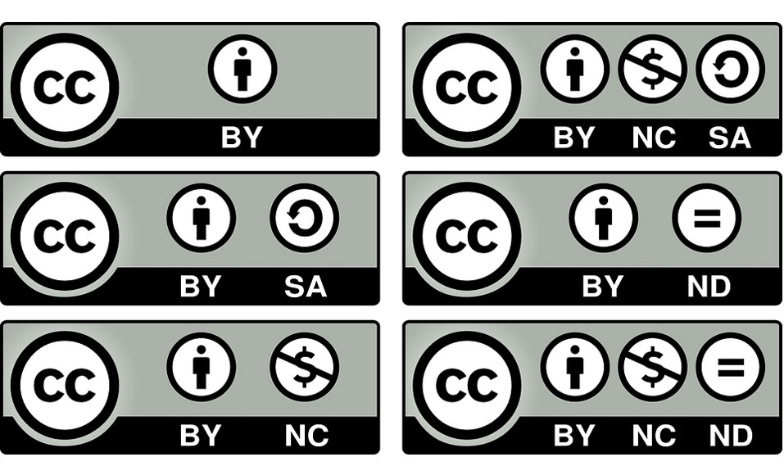
Licenses for French researchers
The free re-use of public data is formalised by a licence agreement approved by the governement (e.g.https://www.data.gouv.fr/fr/licences )
Licences for documents and data :
ODBL 1.0
http://opendatacommons.org/licenses/odbl/
ETALAB
https://www.etalab.gouv.fr/licence-ouverte-open-licence
International : Creative Commons

Slide 4
License for datasets
CC-0 : public domain, you loose all rights
Most commonly used:
CC-BY
This license enables reusers to distribute, remix, adapt, and build upon the material in any medium or format,
The license allows for commercial use.
→BY: credit must be given to the creator.
CC BY-SA
This license enables reusers to distribute, remix, adapt, and build upon the material in any medium or format,
The license allows for commercial use.
→BY: credit must be given to the creator.
→SA: Adaptations must be shared under the same terms.
More arguables
CC BY-NC : NC: Only noncommercial uses of the work are permitted.
CC BY-ND: ND: No derivatives or adaptations of the work are permitted.

Slide 5
Software licenses
Permissive licences
BSD 2 Clause + BSD 3 Clause
Apache 2
CeCILL-B
MIT
Licences with reciprocity obligation (AKA contaminating licenses)
MPL 2
GNU GPL v3
AGPL
CeCILL v2.1 + CeCILL C
EUPL
Elipse Public license

Slide 6
Some remarks
GPS data are considered personnal data
It can identify somebody’s property (field, forest, …)
Conform to European GDPR (ensure agreement)
Or fuzzy location
Public personal data can be reused
as long as their reuse remain in the frame of their original acquisition
Ex:
1989 - Havasupai Tribe diabetes study
2003 - a member of the Tribe attends a course at the University of Arizona, where she discovers that Havasupai samples have also been used to analyse :
the tribe's predisposition to psychiatric illnesses (schizophrenia)
their degree of consanguinity
the tribe's migratory route
Change of the original purpose
Juridic Trial won

Slide 7
Aknowledgments
N. GANDON
N. MORCRETTE
S. RENNES
Célia Michotey
Raphaël Flores
Frederic de Lamotte

