Slide 1
PHENET-EMPHASIS Data Management Training
Introduction to PHIS
Phenotyping Hybrid Information System
Thursday 05/12/2024
Isabelle Alic (INRAE)
Notes:
Sample elements for the creation of presentations

Slide 2
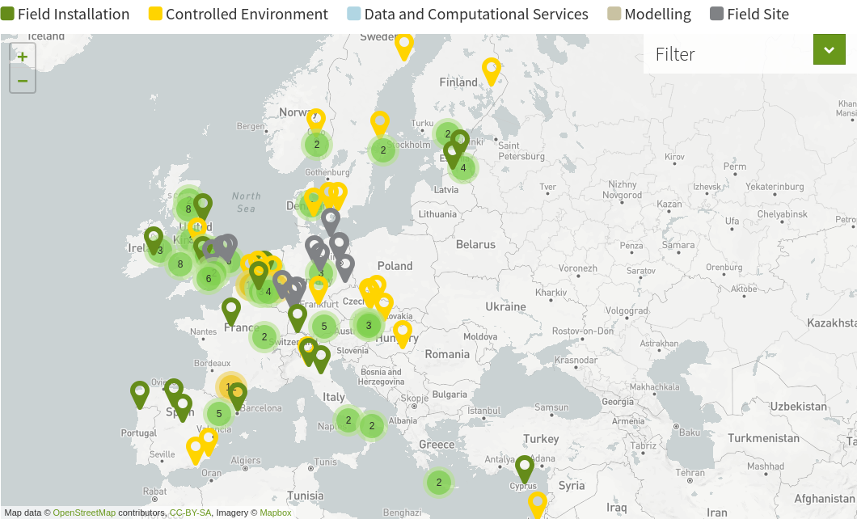
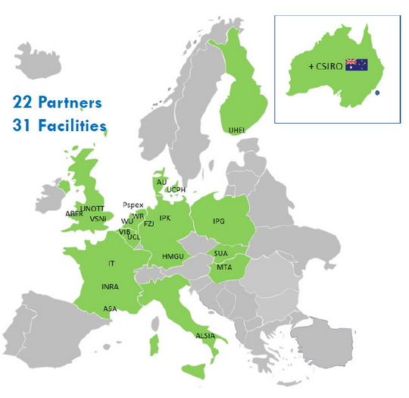
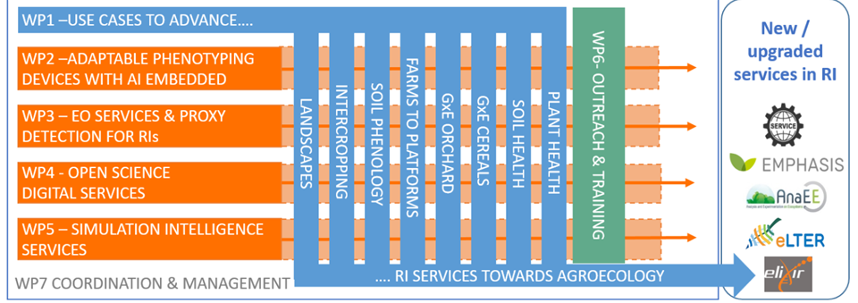
Phenotyping communities

Slide 3
Phenomics Data Challenge
Plant Phenomics Experiments
Expensive, require a lot of resources and often very hard
Cannot be reproduced
Huge and complex datasets
Strong needs of transparence: reproducibility for data analytics
Save time, make data valuable!
But re-analyses, meta-analyses and new analyses
→ impossible without rich metadata

Slide 4
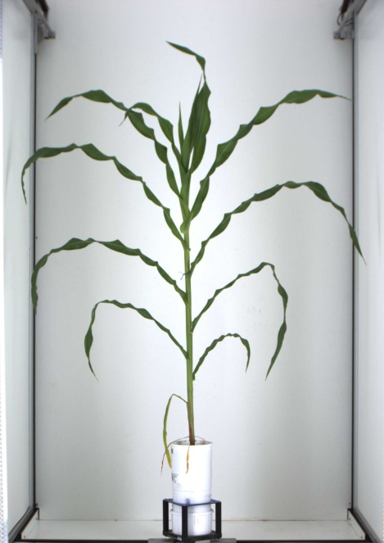
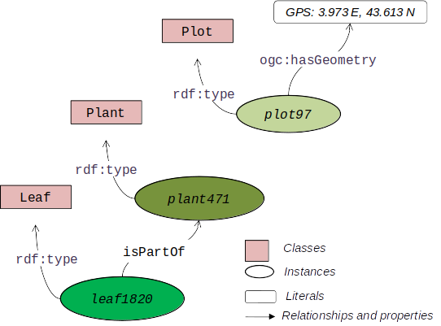
Make FAIR data, structure your data
URI of plant:
<http://phenome.fr/arch/2017/c17000118>
Identification
URI of pot:
<http://phenome.fr/arch/2013/pc13001542>
Everything can be identified: plants, experiments, sensors, events, etc.
Persistent, unambiguous, resolvable
URI of cart:
<http://phenome.fr/arch/2013/ct1300123>
URI of cabin:
<http://phenome.fr/arch/2018/ac180015>
Semantics
URI of camera:
<http://phenome.fr/arch/2018/ac180019>
Naming Conventions
Controlled vocabulary
Formalized relationships between entities
Data annotation and enrichment
URI of image: <http://phenome.fr/arch/2017/ic17002295855>

Slide 5
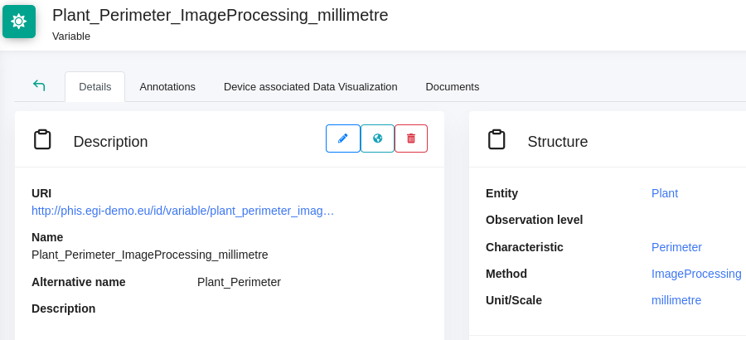
Make FAIR data, structure your data
URI of plant:
<http://phenome.fr/arch/2017/c17000118>
Identification
URI of pot:
<http://phenome.fr/arch/2013/pc13001542>
Everything can be identified: plants, experiments, sensors, events, etc.
Persistent, unambiguous, resolvable
URI of cart:
<http://phenome.fr/arch/2013/ct1300123>
URI of cabin:
<http://phenome.fr/arch/2018/ac180015>
Semantics
URI of camera:
<http://phenome.fr/arch/2018/ac180019>
Naming Conventions
Controlled vocabulary
Formalized relationships between entities
Data annotation and enrichment
URI of image: <http://phenome.fr/arch/2017/ic17002295855>
How?
PHIS, an ontology driven Information System

Slide 6
OpenSILEX Galaxy
Plant Phenotyping
Annual crops
Systems trials
Arboriculture - vines
Agro-Ecology
OpenSILEX
Environment & Processes
Viticulture Oenology
Envibis
Vitis Explorer
Instance Ressources

Slide 7
OpenSILEX Galaxy
Vine
Plant Phenotyping
LaCage
GCIE
M3P
Emphasis Ressources
Annual crops
Systems trials
Arboriculture - vines
Diaphen
Helsinki
U2E
Pheno3c
Louvain
Orchard
Phenotoul
…
Copenhague
Phenome Ressources
Agro-Ecology
OpenSILEX
Environment & Processes
Viticulture Oenology
Envibis
Vitis Explorer
Instance Ressources

Slide 8
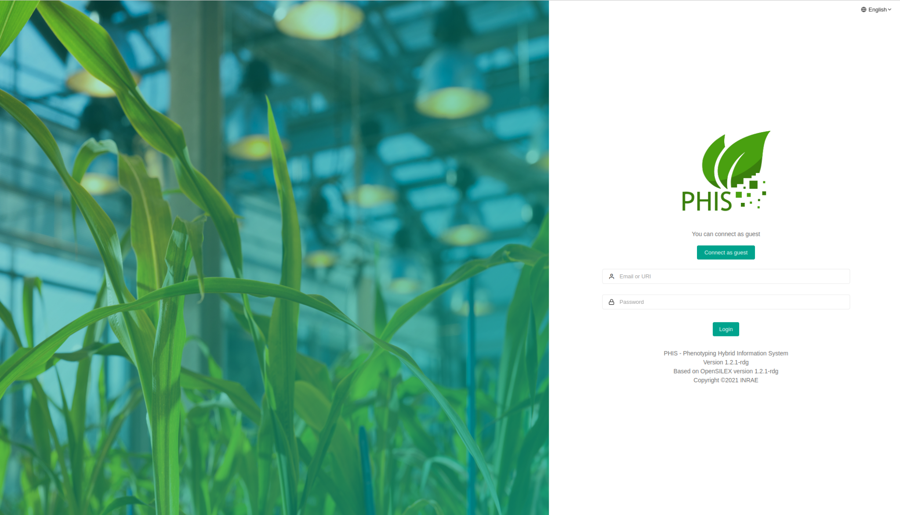
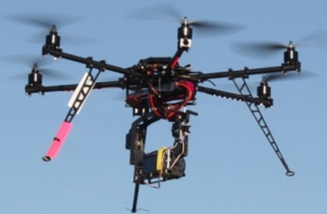
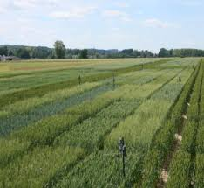
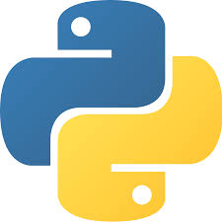
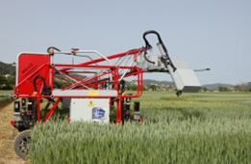
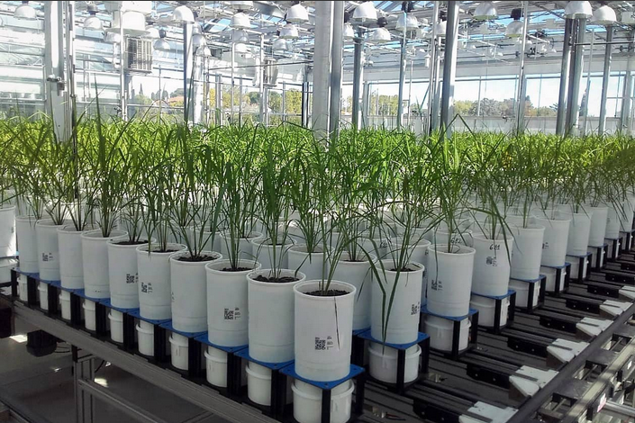
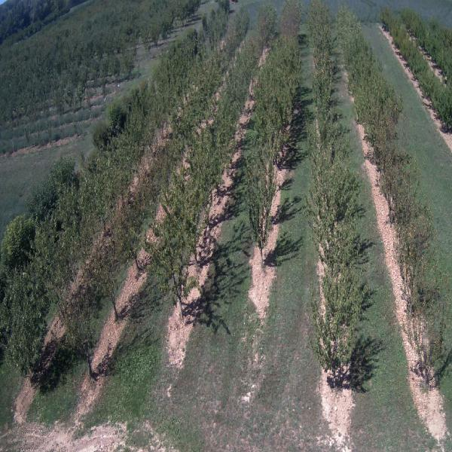
PHIS: an Ontology driven Information System for Plant Phenomics
Community - Interoperability
User interface
Environmental data
Metadata semantic description
Experiments
Plots
Factors
Sensors
Variables
Data
Phenotypic data
Scripts
Analysis, sharing, etc.
File storage system
Image processing Analysis pipeline
Image processing
Advanced data extraction
Notes:
PHIS is the open-source Phenotyping Hybrid Information System (PHIS), based on OpenSILEX, manages and collects data from Phenotyping and High Throughput Phenotyping experiments on a day to day basis. It can store, organize and manage highly heterogeneous (e.g. images, spectra, growth curves) and multi-spatial and temporal scale data (leaf to canopy level) originating from multiple sources (field, greenhouse). It unambiguously identifies all objects and traits in an experiment and establishes their relations via ontologies and semantics that apply to both field and controlled conditions. Its ontology-driven architecture is a powerful tool for integrating and managing data from multiple experiments and platforms, for creating relationships between objects and enriching datasets with knowledge and metadata

Slide 9
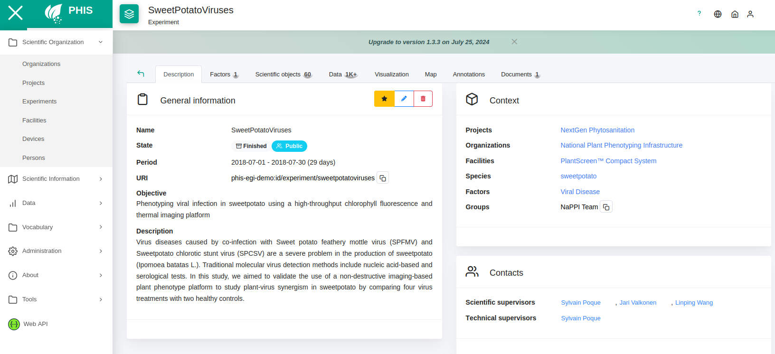
PHIS Architecture
Web Interface
Analyse
Scripts
Sensor
API, Web Services
REST / JSON
Data
NoSQL (MongoDB)
Triplestore
(RDF4J, GraphDB)
Datafiles
Infrastructure

Slide 10
An ontology driven approach
Scientific objects (plants, plant organs, plots, etc.) Identified by URI
Events (management, failures, weather, etc..) Identified by URI
Variables, Documents, Observations and Softwares are associated with these Objects and Events. Identified by URI
The organisation and linking of Objects and Events is done with controlled semantics (ontology references, vocabularies, thesauruses, taxonomies), application Ontologies and semantic web languages (RDF, OWL, SKOS)

Slide 11
Ontologies in OpenSILEX - PHIS
Standard ontologies
time Ontology: formalizes concepts related to time
SOSA: formalizes concepts related to sensor
annotation ontology (ao): formalizes concepts related to annotation
dublin core (dc): formalizes concepts related to documents
foaf: formalizes concepts related to persons

Slide 12
Ontologies in OpenSILEX - PHIS
Domain ontologies
Crop Ontology
Agro ontology, PPEO (MIAPPE)
PlantOntology + TO + PATO
Unit Ontology
Envo, etc.

Slide 13
Ontologies in OpenSILEX - PHIS
Application ontologies
oeso: Ontology of Experimental Scientific Objects (entities)
oepo: Ontology of Experimental Phenotypic Objects
main concepts: experiment objects, qualities, experimental information
oeev: ontology of experimental events
main concepts: move, device management, object management, faults, etc.

Slide 14
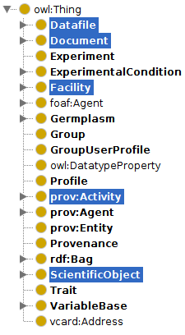
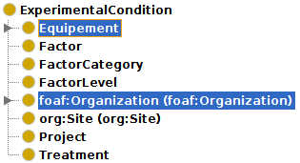
Ontologies in OpenSILEX - PHIS
ExperimentalCondition
Equipment
Device
Actuator
ControlLaw
Software
Vector
Main concepts used by the application.
Some concepts can be extended
Station
SensingDevice
ScientificObject
Population
Sample

Slide 15
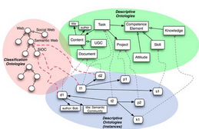
Variables model
Trait
PLANT
HEIGHT
RULER
CM
Entity
Characteristic
Method
Scale (unit)
Entity
Individual
level
Reference ONTOLOGIES
VARIETY
Notes:
Gabriel reprend la main

Slide 16
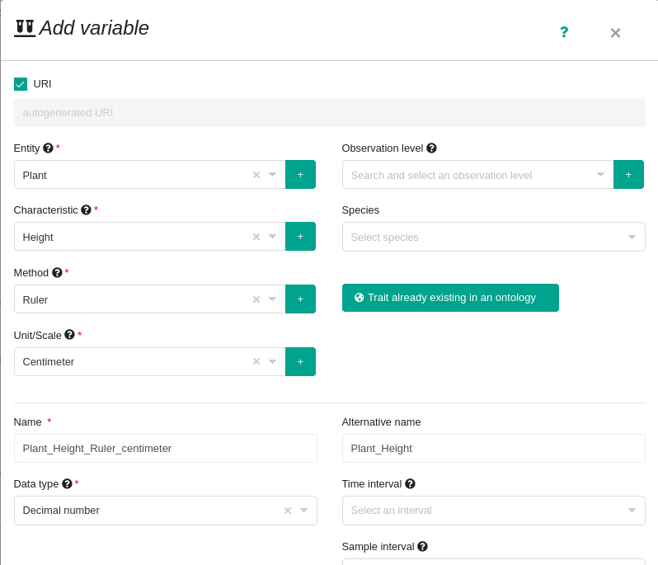
Variables model
Trait
PLANT
HEIGHT
RULER
CM
Entity
Characteristic
Method
Scale (unit)
Entity
Individual
level
Reference ONTOLOGIES
VARIETY
Notes:
Gabriel reprend la main

Slide 17
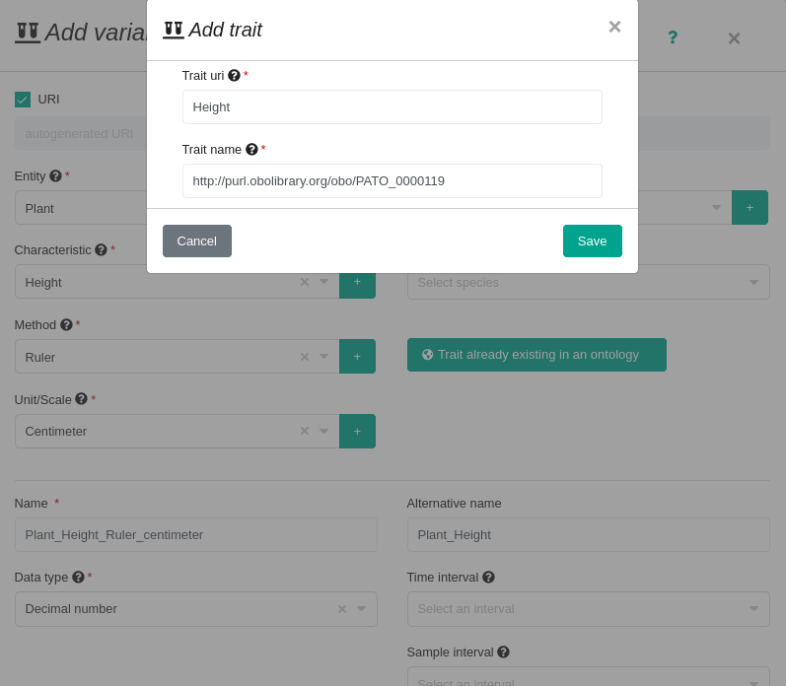
Variables model
Trait
PLANT
HEIGHT
RULER
CM
Entity
Characteristic
Method
Scale (unit)
Entity
Individual
level
Reference ONTOLOGIES
VARIETY
Notes:
Gabriel reprend la main

Slide 18
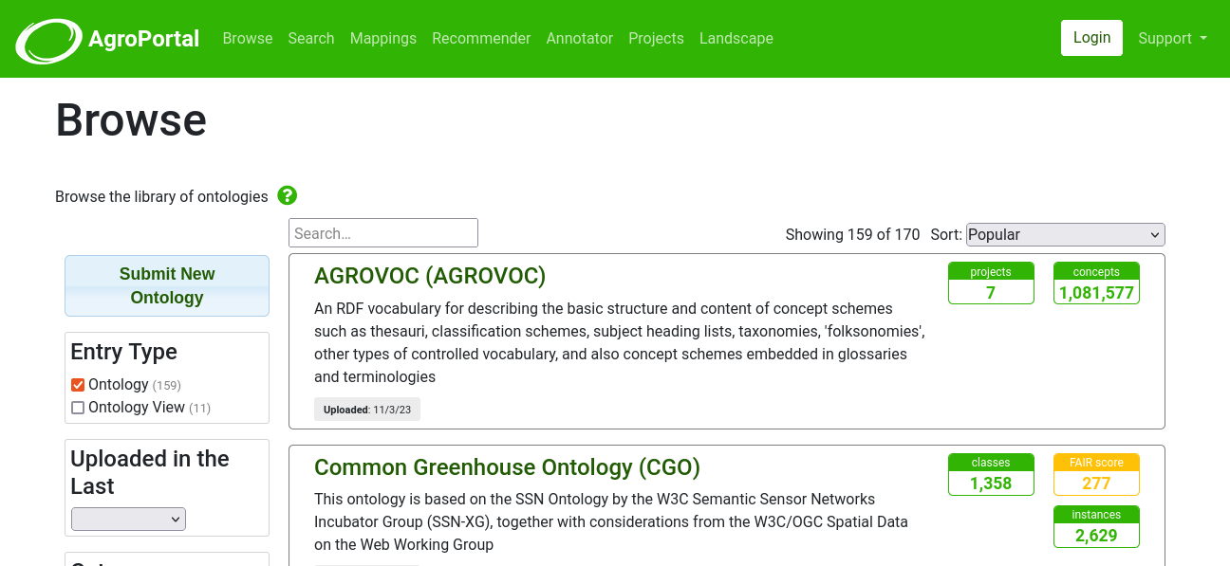
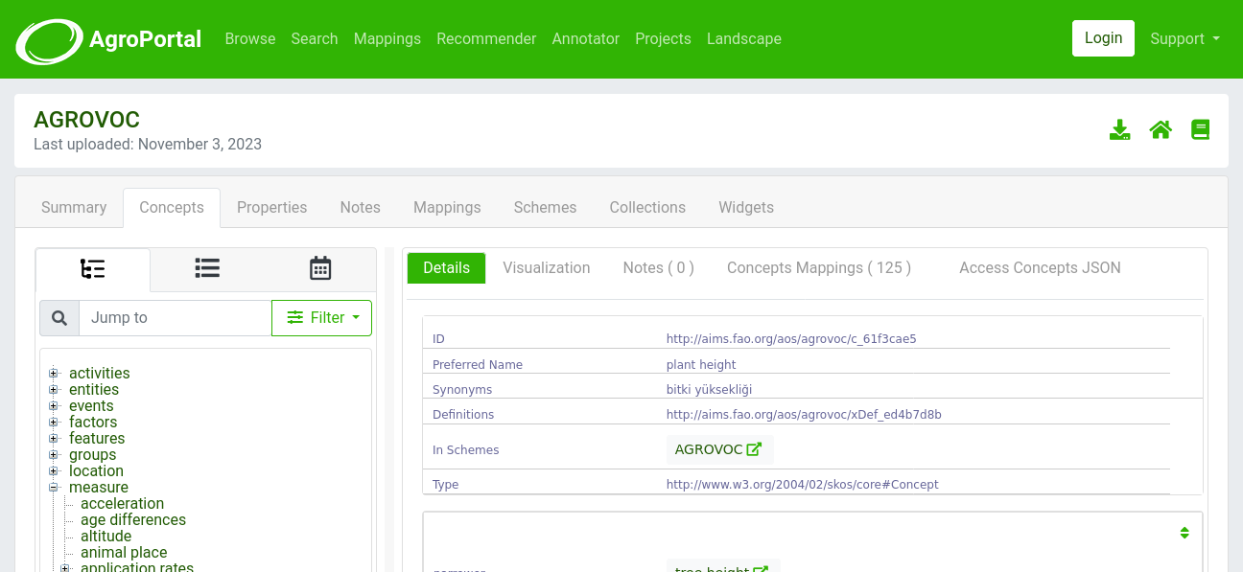
Variables Sharing
Link these elements to existing ontologies
Agroportal, The home of ontologies and semantic artefacts in agri-food and related domains.- http://agroportal.lirmm.fr/

Slide 19
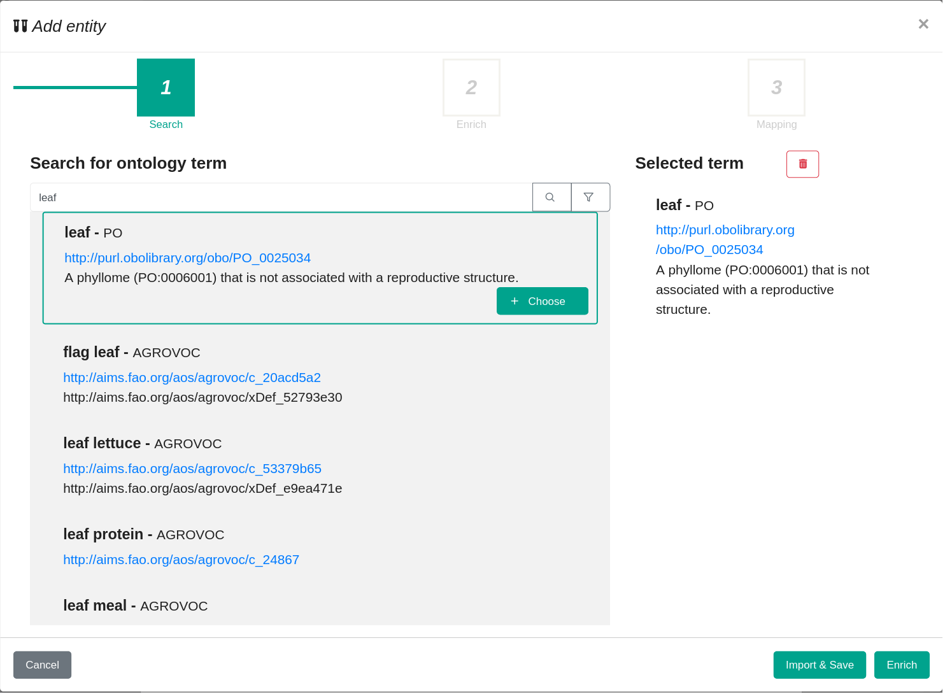
Describing a variable
Searching for an ontological concept
Trait
PLANT
HEIGHT
RULER
CM
Entity
Characteristic
Method
Scale (unit)
Reference ONTOLOGIES

Slide 20
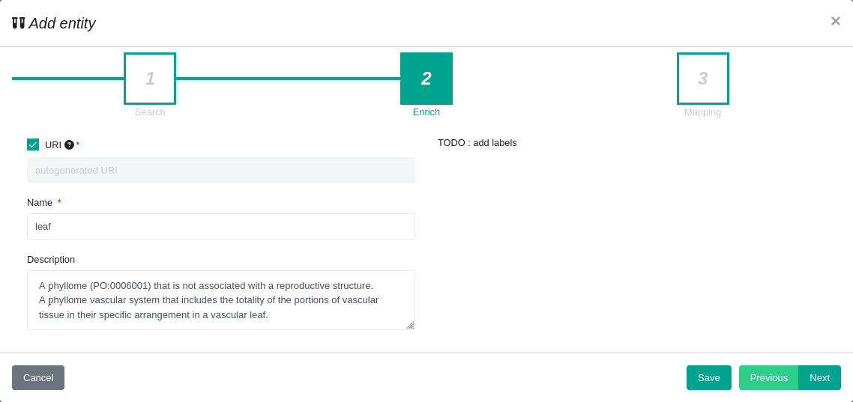
Describing a variable
Enriching the concept
Trait
PLANT
HEIGHT
RULER
CM
Entity
Characteristic
Method
Scale (unit)
Reference ONTOLOGIES

Slide 21
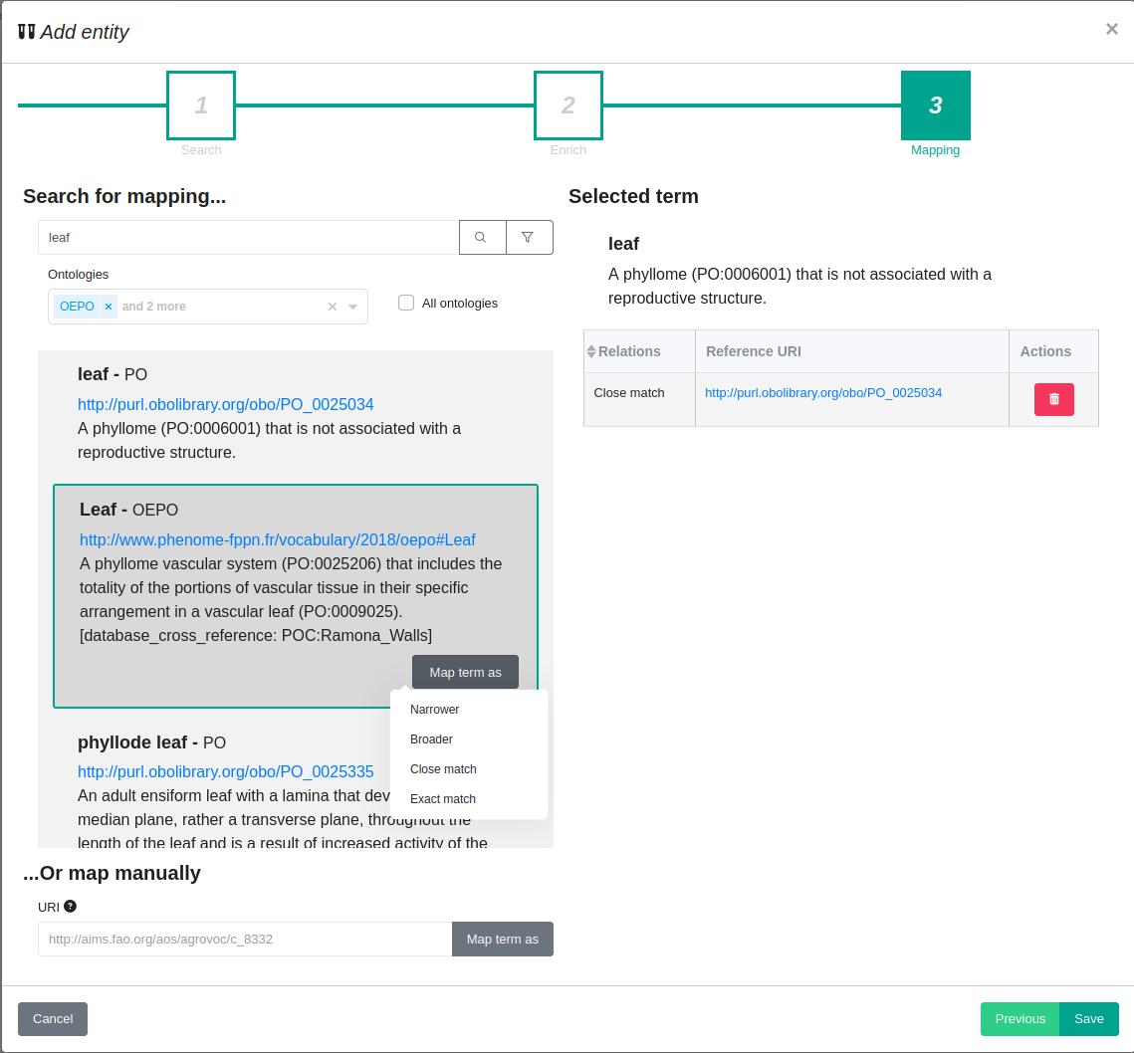
Describing a variable
Concept alignment
Trait
PLANT
HEIGHT
RULER
CM
Entity
Characteristic
Method
Scale (unit)
Reference ONTOLOGIES

Slide 22
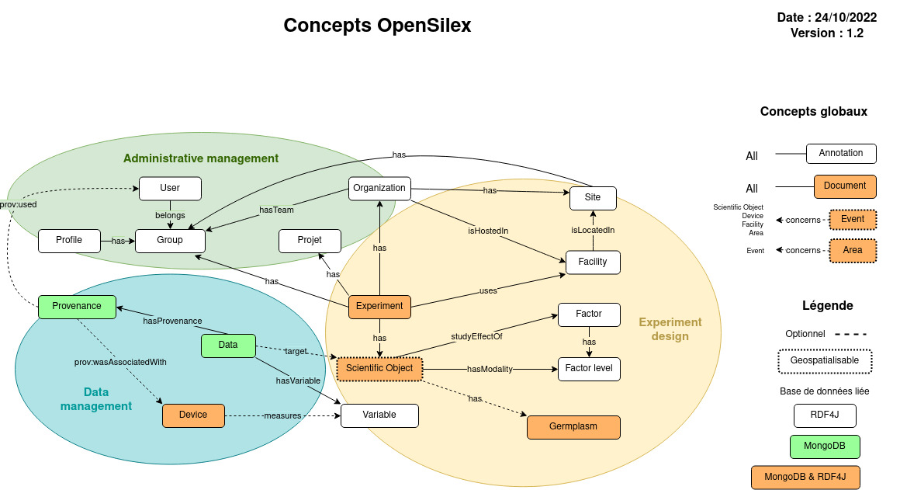
The different concepts of PHIS and their relationships

Slide 23
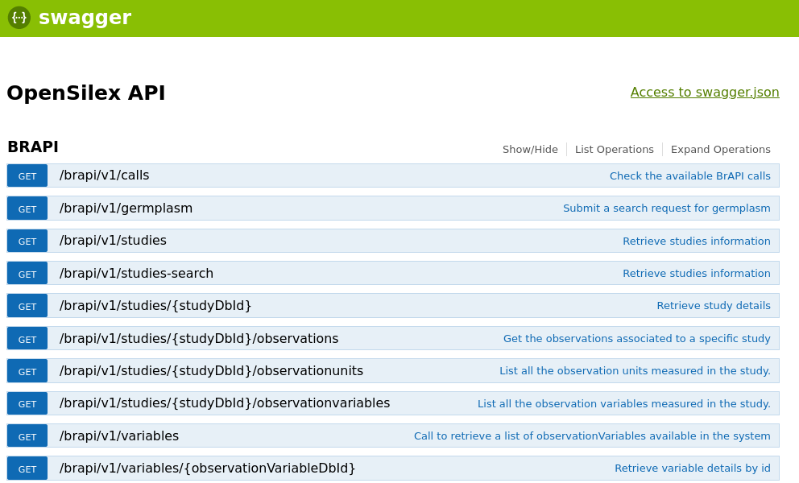
PHIS and standards - BrAPI
BrAPI - https://brapi.org/
Standardized RESTful web service API specification for communicating plant breeding data
BrAPI-Core - Organization and management: Programs, Trials, Studies, Locations, People, and Lists
BrAPI-Phenotyping - Entities related to phenotypic observations: Observation Units, Observations, Observation Variables, Traits, Scales, Methods, and Images
BrAPI-Genotyping - Entities related to genotyping analysis: Samples, Markers, Variant Sets, Variants, etc.
BrAPI-Germplasm - Entities related to germplasm management: Germplasm, Germplasm Attributes, Seed Lots, etc.
PHIS: BrAPI WebServices implemented (v1.3)

Slide 24
PHIS and standards - MIAPPE
MIAPPE - https://www.miappe.org/
Minimum Information About Plant Phenotyping Experiments
Open, community driven, data standard designed to harmonize data from plant phenotyping experiments
Mapping with other standards (ISA-Tools , BrAPI)
PHIS is MIAPPE-compliant

Slide 25
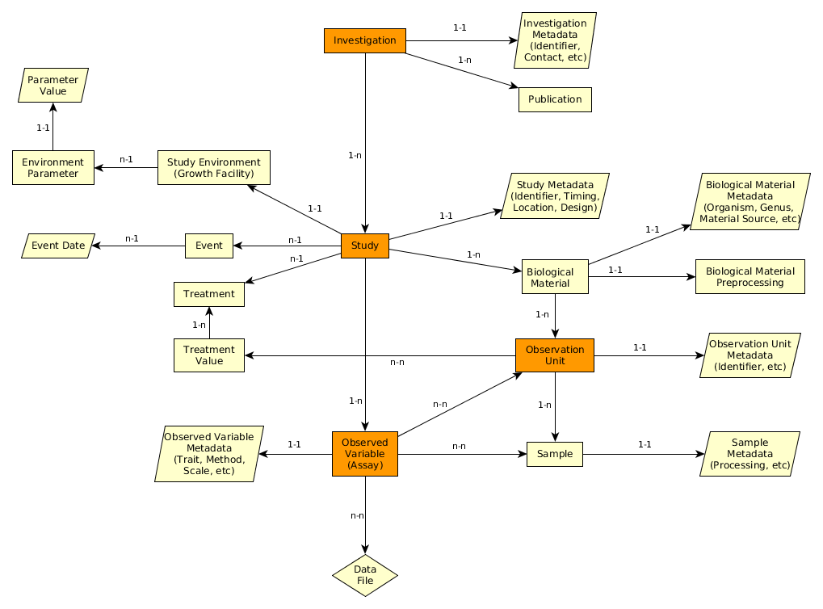
PHIS and standards - MIAPPE

Slide 26
PHIS and standards - MIAPPE

Slide 27
PHIS and standards - AgMIP / ICASA
AgMIP - https://agmip.org/
Agricultural Model Intercomparison and Improvement Project
ICASA - https://agmip.github.io/ICASA.html
International Consortium for Agricultural Systems Applications
ICASA Data Dictionary for use in AgMIP data interoperability protocols
Work in Progress: link PHIS-AgMIP/ICASA
Development of standardised, high-level data web services

Slide 28
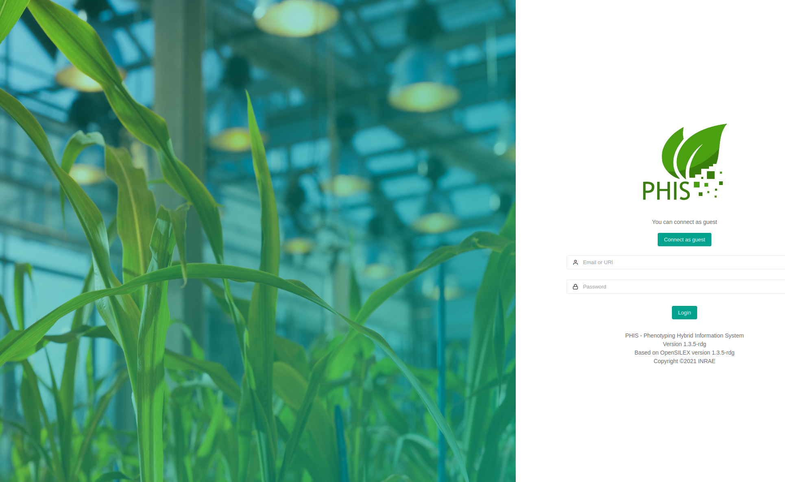
PHIS Demonstration

Slide 29
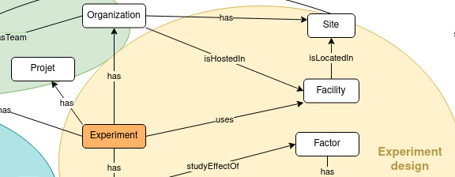
Friendly User Interfaces
PHIS Interfaces allow management of
Scientific Organization
Project information
Experimental context
Facilities
Sensors

Slide 30
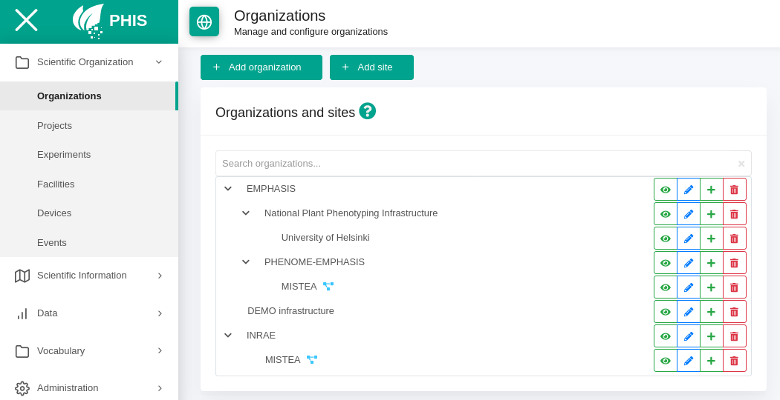
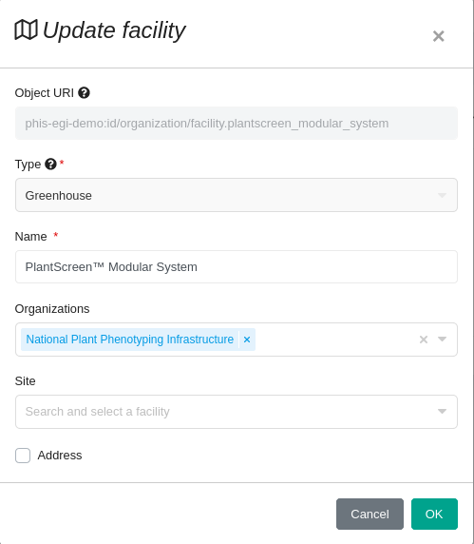
Friendly User Interfaces
PHIS Interfaces allow management of
Scientific Organization
Project information
Experimental context
Facilities
Sensors

Slide 31
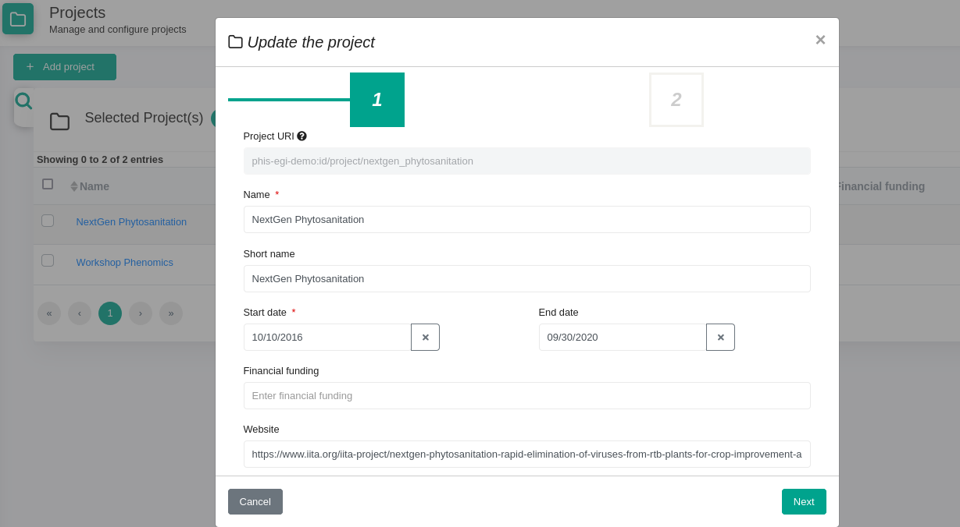
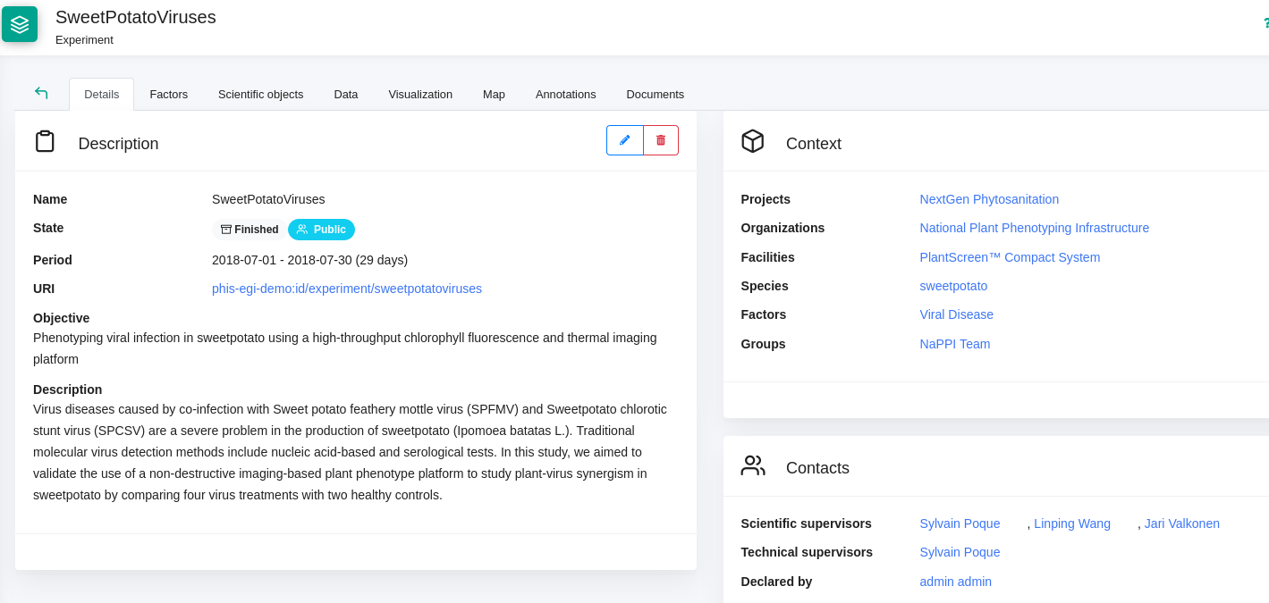
Friendly User Interfaces
PHIS Interfaces allow management of
Scientific Organization
Project information
Experimental context
Facilities
Sensors

Slide 32
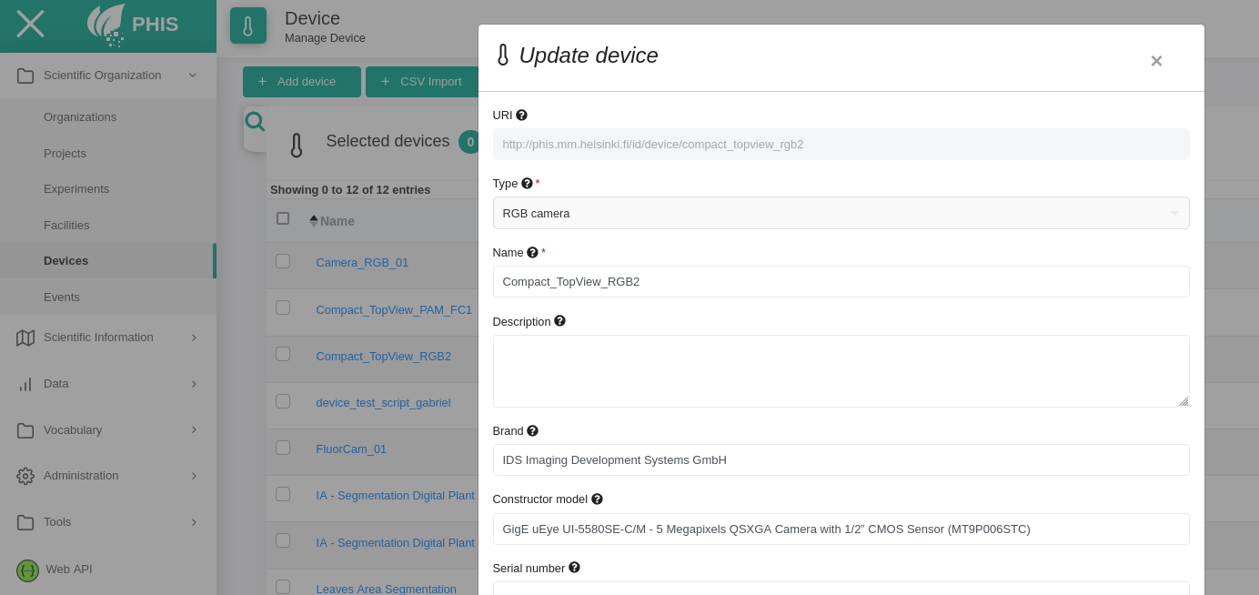
Friendly User Interfaces
PHIS Interfaces allow management of
Scientific Organization
Project information
Experimental context
Facilities
Sensors

Slide 33
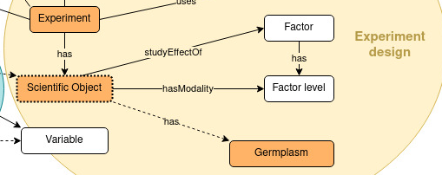
Friendly User Interfaces
PHIS Interfaces allow management of
Scientific Information
Variables
Scientific objects
Germplasm
Documents

Slide 34
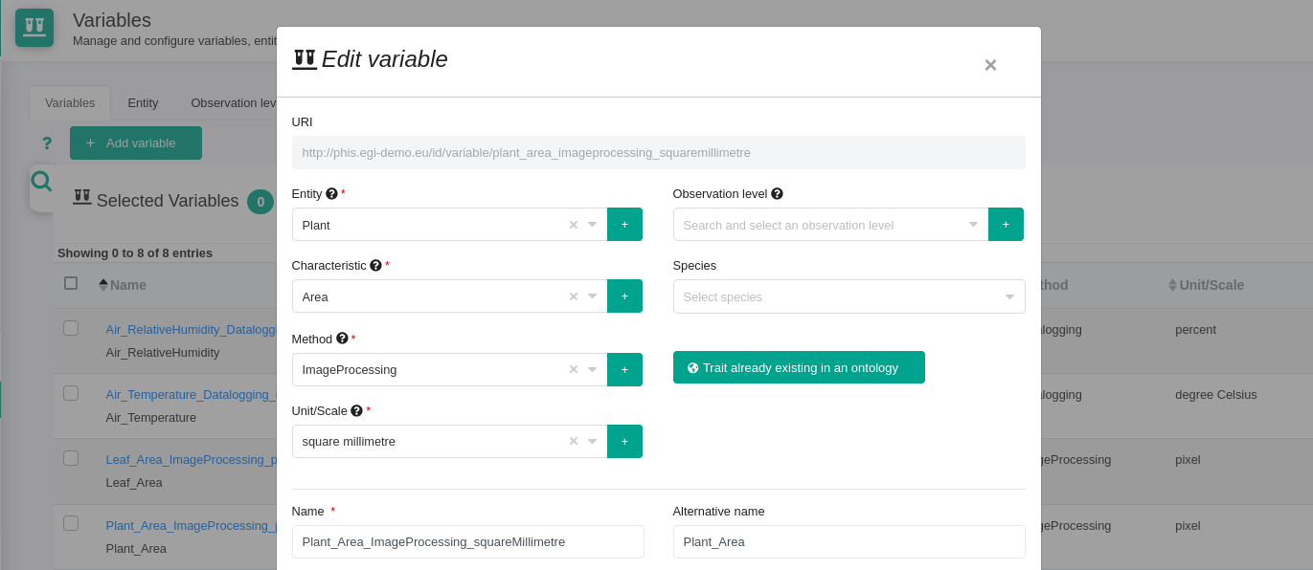
Friendly User Interfaces
PHIS Interfaces allow management of
Scientific Information
Variables
Scientific objects
Germplasm
Documents

Slide 35
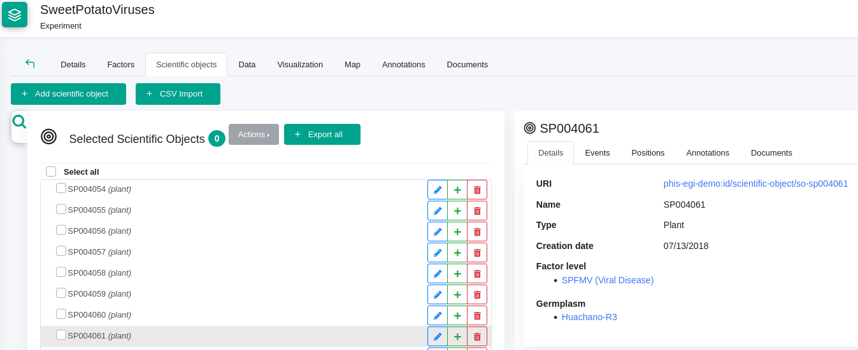
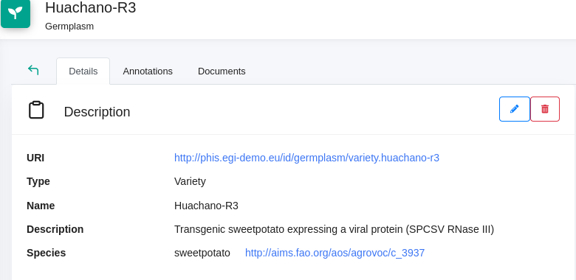
Friendly User Interfaces
PHIS Interfaces allow management of
Scientific Information
Variables
Scientific objects
Germplasm
Documents

Slide 36
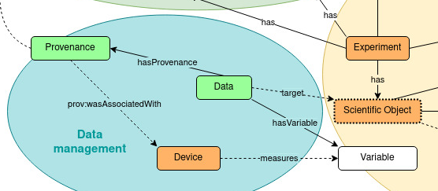
Friendly User Interfaces
PHIS Interfaces allow management of
Data
Data visualization
Data provenance
Datafiles management

Slide 37
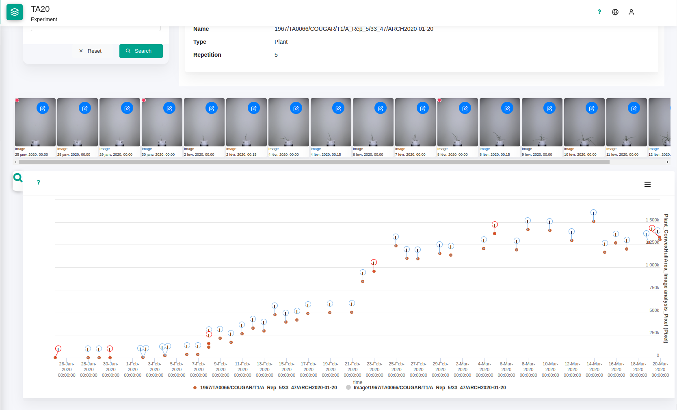
Friendly User Interfaces
PHIS Interfaces allow management of
Data
Data visualization
Data provenance
Datafiles management

Slide 38
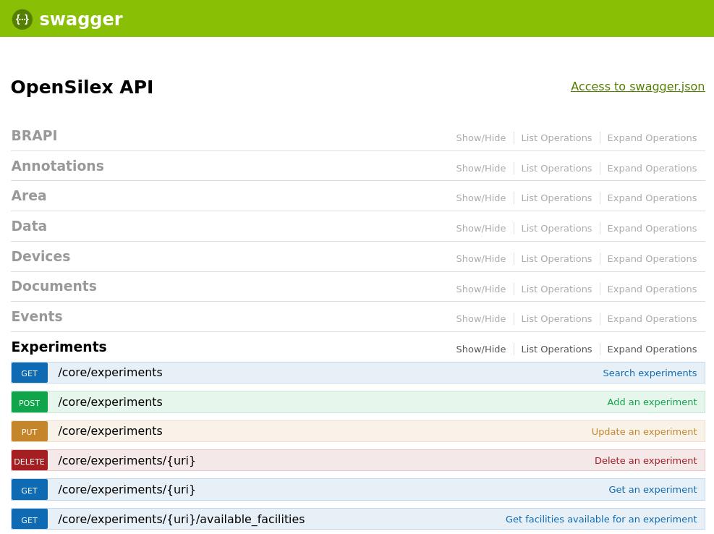
PHIS Swagger - Connection to clients
Another interface with the data
Swagger
https://phis.emphasis.fedcloud.eu/egi-demo/api-docs/
Based on OpenAPI https://www.openapis.org
Open description format for API services
Explore the different web services, and there return
Describe arguments and gives examples
Performs requests

Slide 39
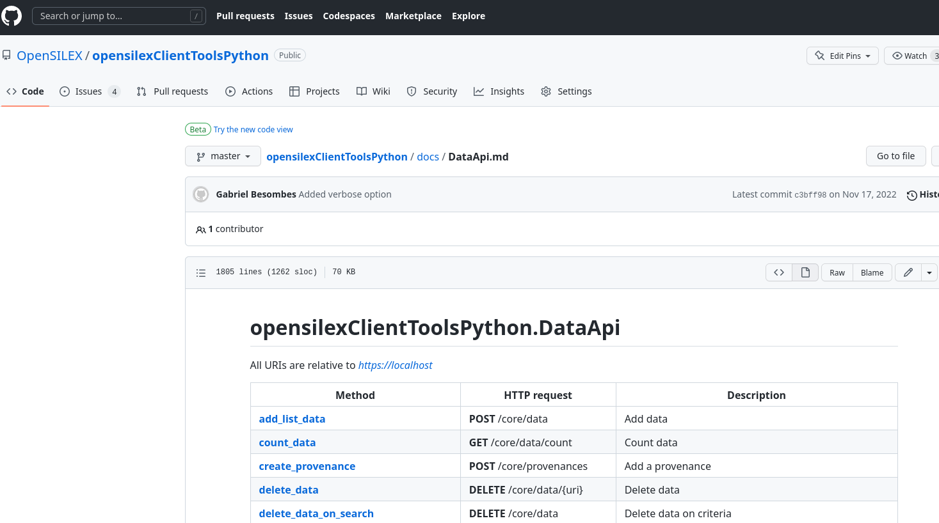
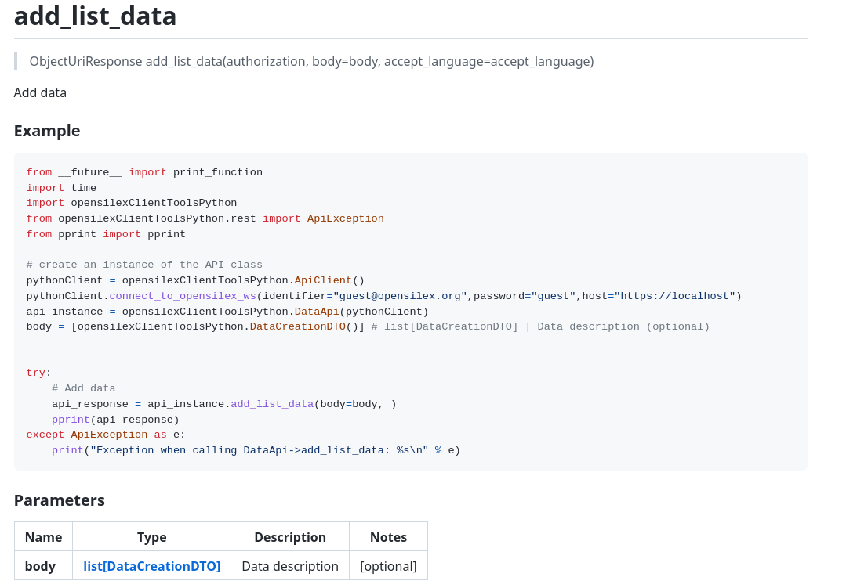
PHIS Swagger - Connection to clients
Another interface with the data
Python Client (Scripts)
Repository Github : https://github.com/OpenSILEX/opensilexClientPython
Based on autogenerated client : https://github.com/OpenSILEX/opensilexClientToolsPython
R Client (Package)
Repository Github : https://github.com/OpenSILEX/opensilexClientR
Based on autogenerated client : https://github.com/OpenSILEX/opensilexClientToolsR

Slide 40
Conclusion
PHIS: used in several phenotyping platforms
Work in conjunction with standards (BrAPI - MIAPPE)
Ongoing developments
New functionalities
Adaptation to the needs / evolution of research
Support
Link with research teams
OpenSILEX: opening to other communities
Notes:
example : investigation in study

Slide 41
PHIS-OpenSILEX useful links
OpenSILEX
OpenSILEX website: http://opensilex.org/
OpenSILEX demo: http://opensilex.org/sandbox/app/ (guest@opensilex.org / guest)
How to contribute to OpenSILEX?
Github repository: https://github.com/OpenSILEX/
Developer documentation: https://opensilex.github.io/docs-community-dev/
OpenSILEX Docker: https://github.com/OpenSILEX/opensilex-docker-compose
User documentation: https://opensilex.github.io/phis-docs-community/
PHIS
PHIS website: http://phis.inrae.fr/
Research paper: https://nph.onlinelibrary.wiley.com/doi/full/10.1111/nph.15385
Variables declaration tutorial: https://www.youtube.com/watch?v=Pvz9o-b_Mok

