Slide 1
Minimum Information for Plant Phenotyping Experiments (MIAPPE)
Standards de données pour les données de la recherche végétale en Phenomic et au delà

Slide 2
StandardS de données plant: qui

Slide 3













Interoperability in International network
National
Networks
European
Networks
Global Networks
International data standards
Web services
Minimal information
Controlled vocabularies
Trait dictionaries
MCPD
Notes:
3

Slide 4

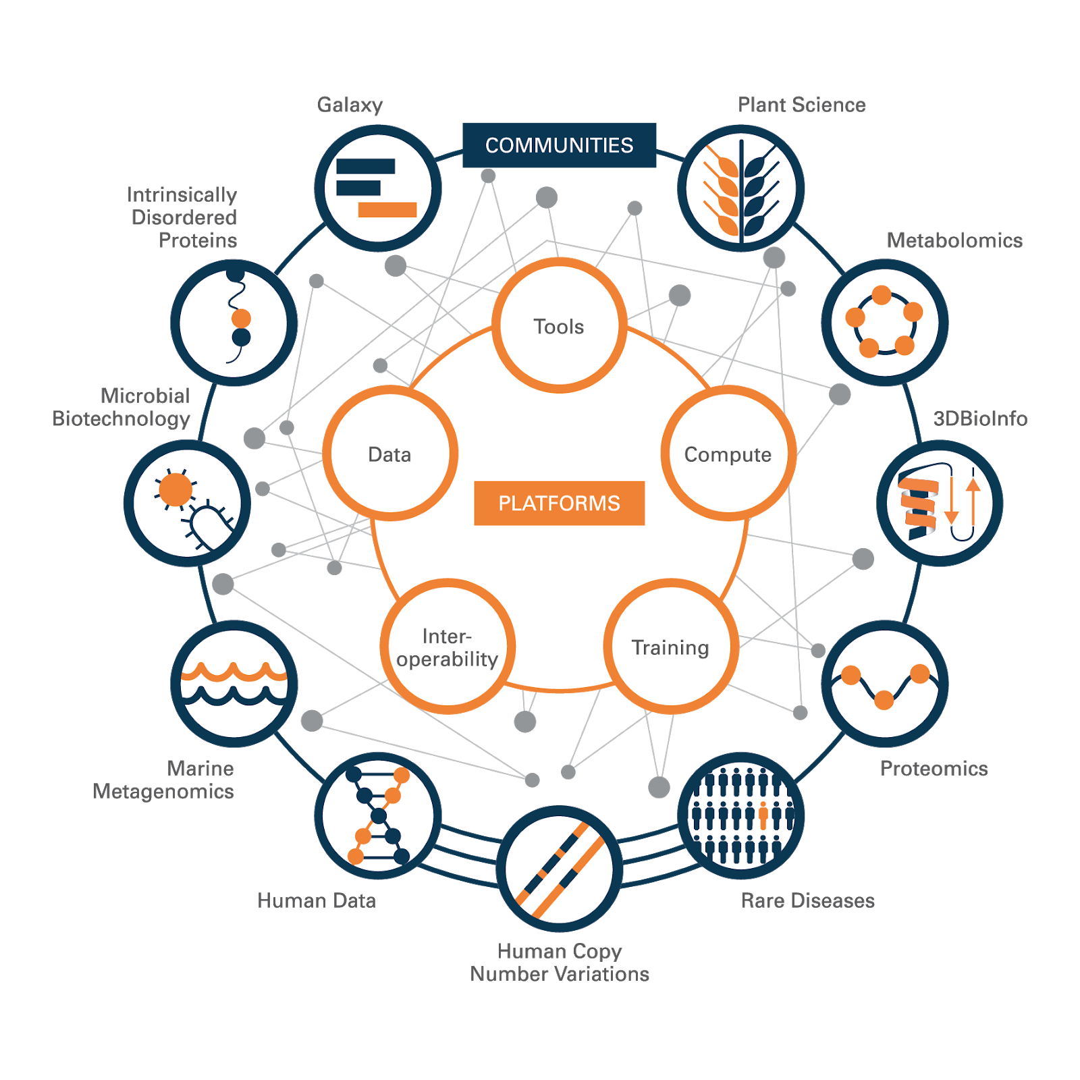
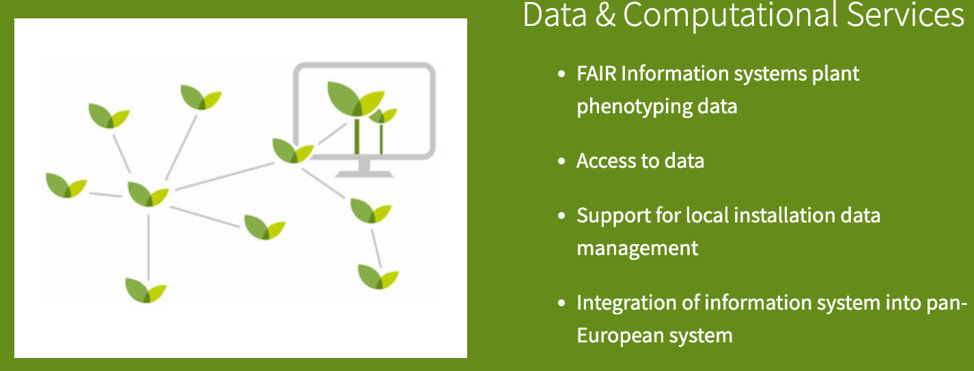
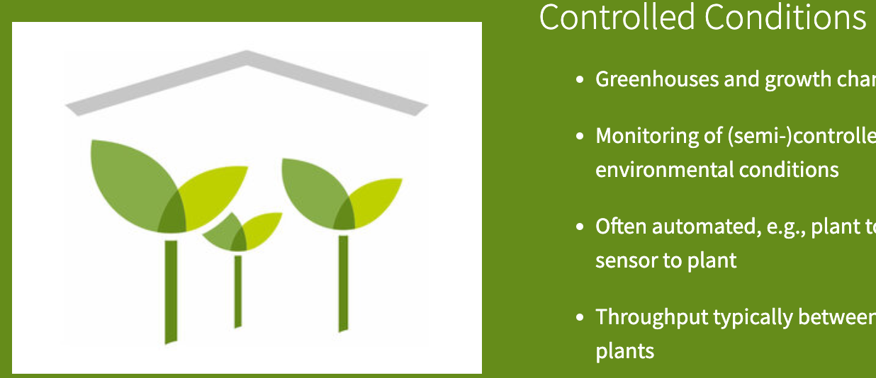
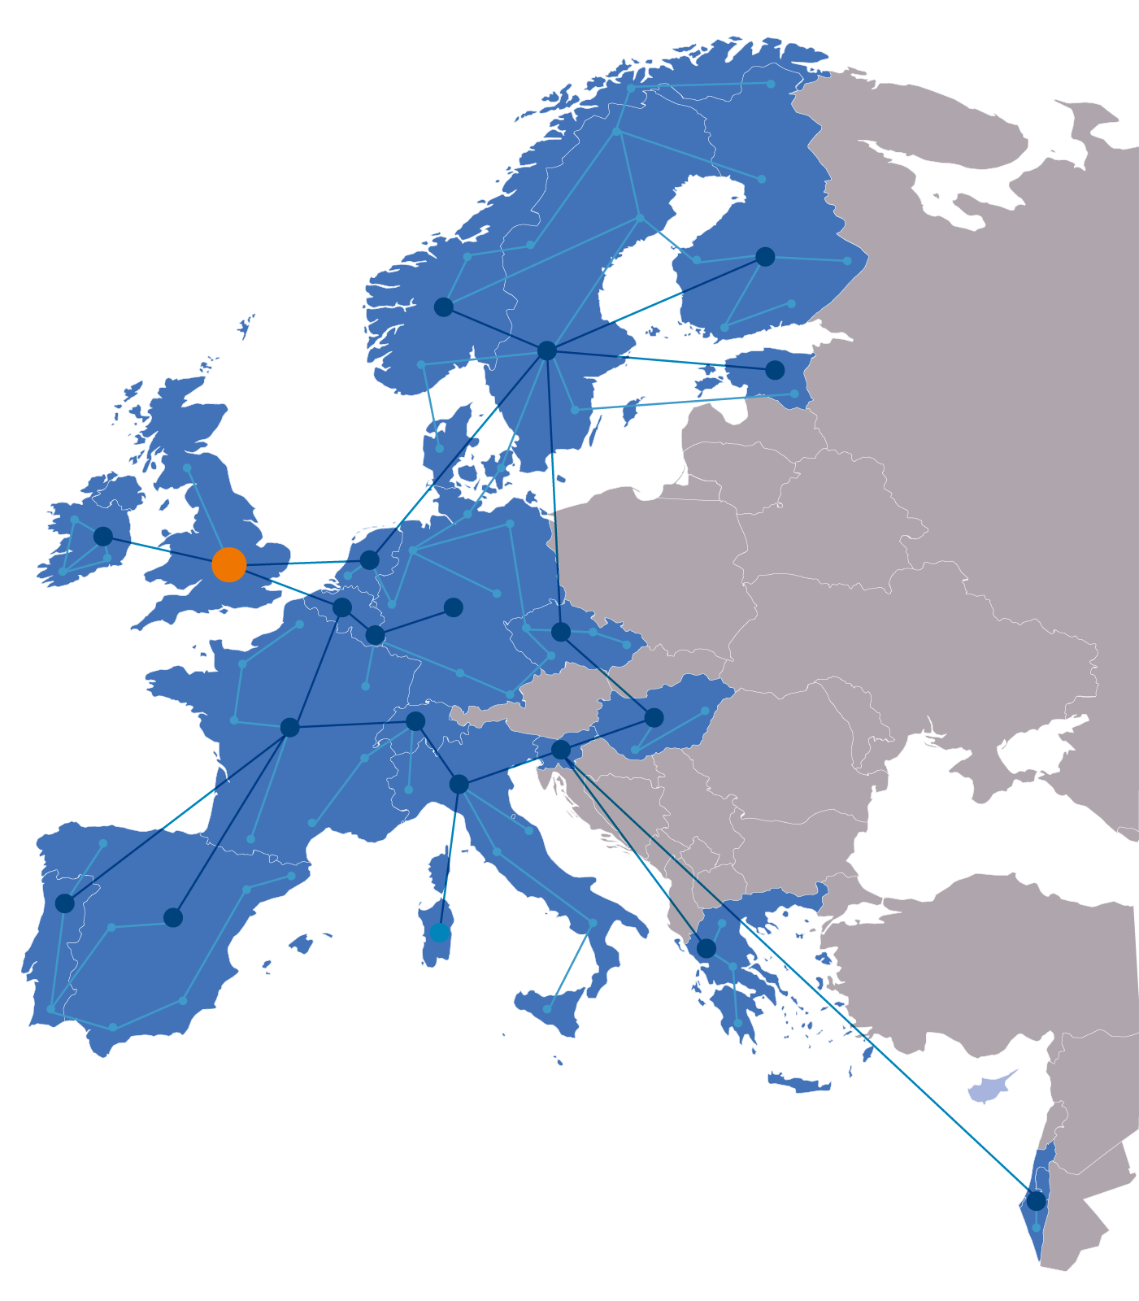
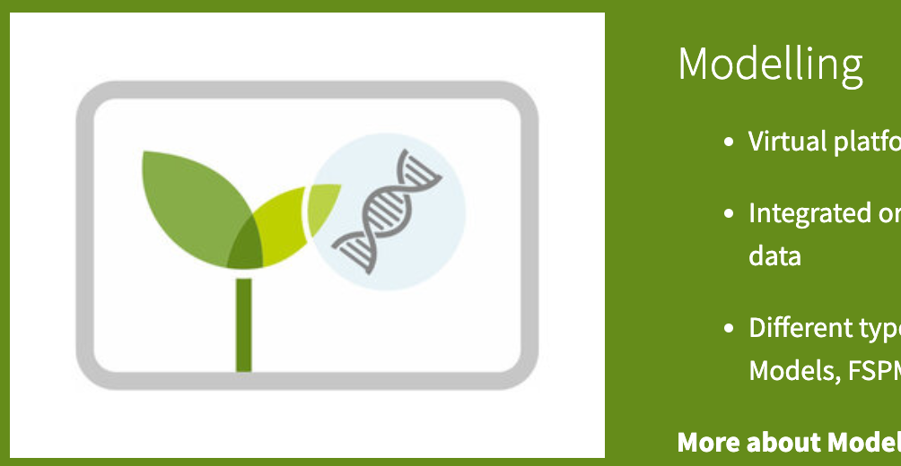
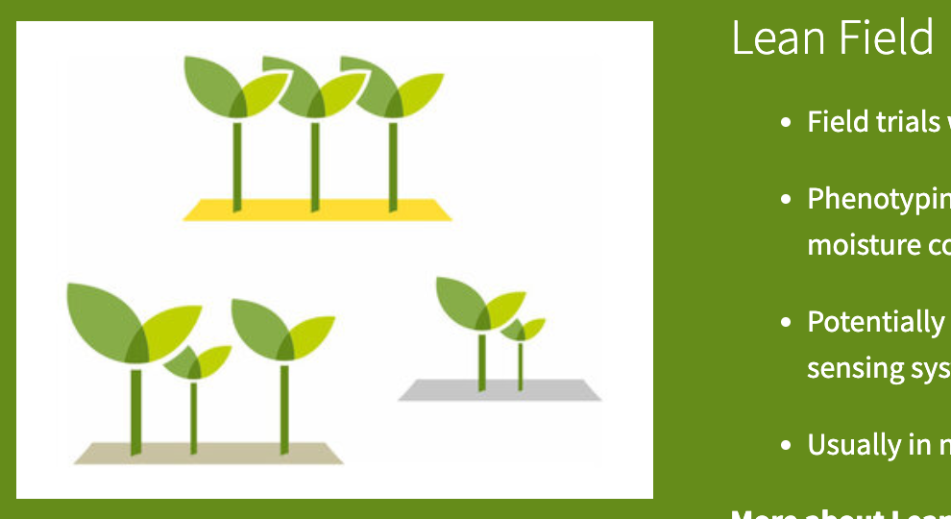
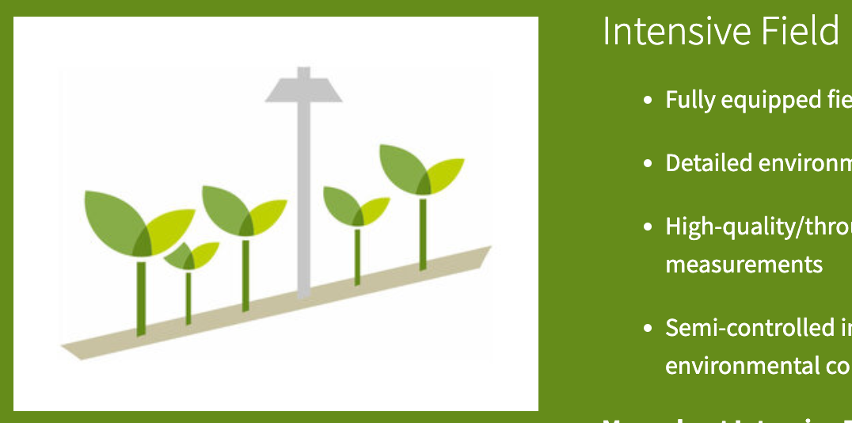
Plant data standards: contributeurs
Rassemblés pour résoudre les problèmes de données FAIR pour les plantes
ELIXIR
  European Infrastructure for life sciences
  Slovenia , France, Germany, Portugal, UK, …
  https://elixir-europe.org/communities/plant-sciences
  FAIR data management, software, training, …
EMPHASIS
  European Infrastructure for Plant Phenotyping
  France, Germany, Belgium, UK, …
  https://www.plant-phenotyping.eu

Slide 5
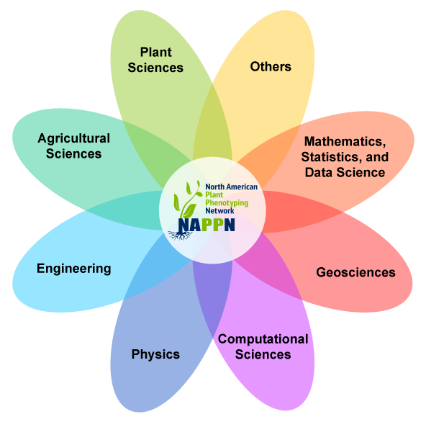

Plant data standards: contributeurs
Rassemblés pour résoudre les problèmes de données FAIR pour les plantes
CGIAR
  Consortium of International Agricultural Research Centers
  CropOntology, MIAPPE
  https://www.cgiar.org/
NAPPN
  North American Plant Phenotyping Network
  Regional partner IPPN
  https://nappn.plant-phenotyping.org/

Slide 6
Plant Phenotyping standards: WHY

Slide 7

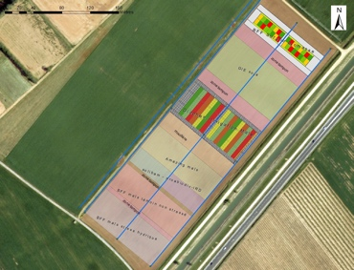
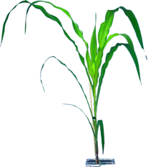


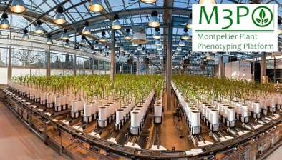
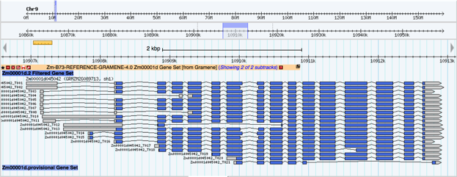


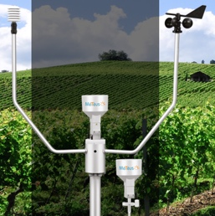
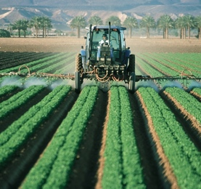
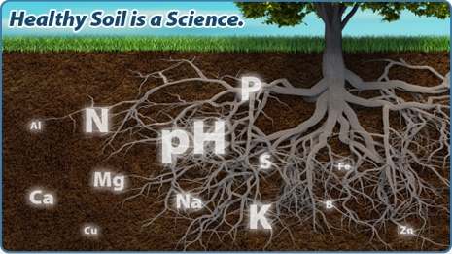
Intégration *Omics / Environment / Phenome
Phenomics
Genetics
Genomics
Omics
Plant Breeding
Genetic variations by Traits
Mostly centralized
Homogenous data
Heterogenous metadata
Dispersed
Heterogenous
Getting Standardized
Climate Change Studie
Genotype by Environment
Environment
Dispersed
Heterogenous

Slide 8

Pourquoi Standardiser les données de phenotypage?
Permettre leur réutilisation (y compris par vous !)
  Metadata/description experimentation (qui, pourquoi, où, comment)
Integration, traitements automatisés
  Linked data entre datasets via identification d’objets pivot
Phenotype 1 = measurement on a cultivar in an environment-GPS1-time1
Phenotype 2 = measurement on a cultivar in an environment-GPS2-time2
Genotype = observed marker’s alleles on a cultivar
Climate 1 = climatic data at GPS1-time1
Permetre la découverte de données et de connaissainces:
  Metadata, controlled vocabularies, ontologies

Slide 9




Integration de données entre silos
Phenomics
Interoperability pivot
Key shared resources
Genetics
Genomics
Omics
Biological Material
Biological Material
Field Experiment
Samples
Location
Omic Experiment
Ou dans l’intro de MIAPPE plutôt
Environment
Location

Slide 10
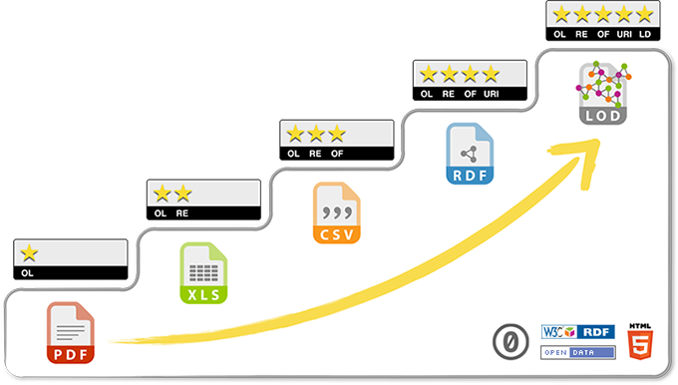
5 stars Open Data → Soyons pragmatiques !
related to other data
identified by URI
non-proprietary format
in a structured format
Data on the web, open licence
Progressing towards FAIR and Open Data requires a multidisciplinary cooperation :
Biologists
Bioinformaticians
Specialists of ontologies/semantics

Slide 11
Phenotyping data life cycle
Knowledge
Data acquisition
Data computation
« Raw » data, pheno/env measures, variables
« computed » data, reduced, indicators
Variety charger is resistant to fusariose under intensive cultural practice
Soissons x high N
Charger x high N
Charger x low input
Soissons x high N
Charger x high N
Soissons x low input
Soissons x low input
Soissons x high N
Derivation, Reduction
Publication
Soissons x low input
Charger x low input
Charger x high N
Soissons x high N
Soissons x high N
Genotype | Treatment | N input | Date | Rep | Fusariose
Soissons | low input | 15,32253129 | 15/11/2011 | 1 | 5
Soissons | low input | 15,31430556 | 16/11/2011 | 2 | 7
Genotype | Treatment | Fusariose
Soissons | low input | 6
VARIABLES
Traceability
Raw measures
Data Cleaning
Platform IS (Emphasis IS, PHIS, …)
Reproducibility & Provenance
INDICATORS
New computation for each scientific question
One raw dataset → many computed datasets
Raw data long term
conservation

Slide 12
Plant Data StandardS : Vue d’ensemble
MIAPPE, Crop ontology, MCPD

Slide 13
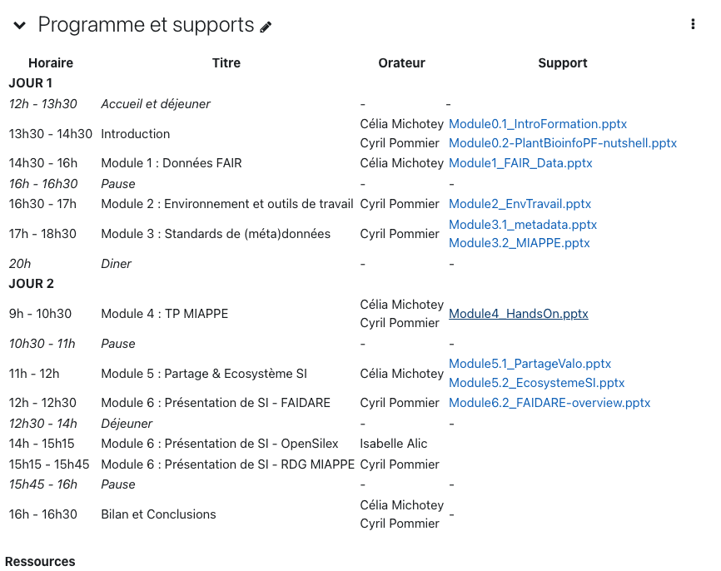
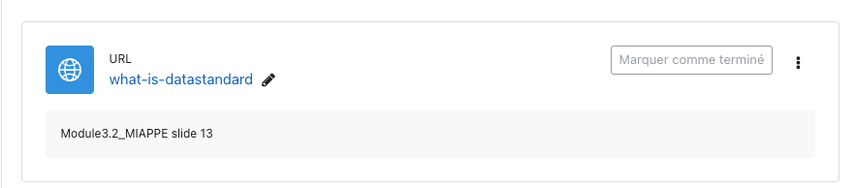
Data standards: qu’est ce que c’est pour vous ?
https://postit.colibris-outilslibres.org/a1j7pheno-rdo-2023-standard-c-quoi
https://moodle.france-bioinformatique.fr/course/view.php?id=17#section-5

Slide 14




Standard de données
Structure
  Formatting, Modelling and Organizing Data
  Standards : CSV, VCF, GFF, MIAPPE , etc…
  Dataset : greenhouse, field, multiannual, multilocal
  Variables and plant material
  Biologist & Computer scientist driven
Semantic
  Description of the data
  Controlled vocabularies: term name and definitions
  Ontologies: semantic links between terms
  Phenotyping/environment
  Biologist driven
Persistent Unique Identifiers
(sensor, gene, accessions, trait, URI, DOI,…)
Training
(guidelines, checklists, …)
Technical
  Data integration and sharing
  Interoperability : tools and systems
    GA4GH
    Breeding API www.brapi.org
  Computer scientist driven

Slide 15

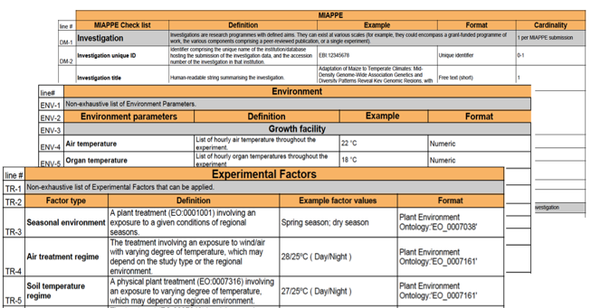
Plant Structure Standard
Minimal Information About Plant Phenotyping Experiment
www.miappe.org
Plusieurs parties prenantes
  Elixir, Emphasis, Bioversity, North American PPN
Communité ouverte:
  Request for comments
  Github Feature requests
  Mailing lists
  Réunions, groupes de travail
  Première version : 2015
Plantes annuelles (grande cultures, modèle, …)
Plantes pérennes (Vigne, arbres forestiers ou fruitiers, …)

Slide 16
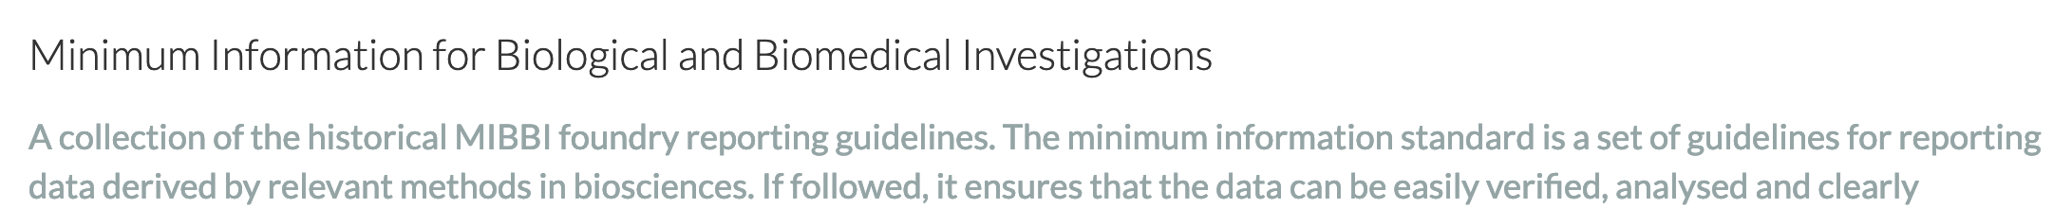
Plant Structure Standard : MIAPPE
Biologist Friendly
  Définitions et exemples claires
  Templates excel
  Trainings
List de métadonnées minimum et suffisante
Computer scientist friendly
  Modèle de données explicite : Compatibilité ISA-Tools et Breeding API (BrAPI).
  Framework de Validation et toolbox

Slide 17
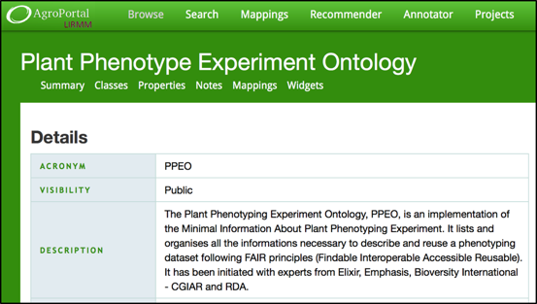




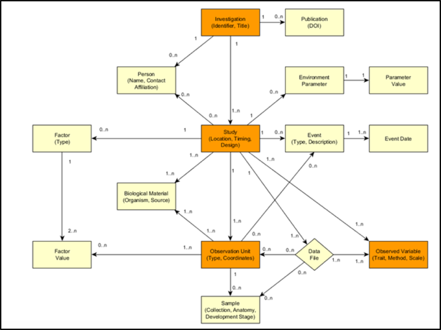
Plant Structure Standard
Inclus des standards établis
  MultiCrop Passport Descriptors (MCPD): identification matériel végétal
  Crop Ontology: description des methologies de mesure et de calcul
Spécification avec plusieurs implementations
  Semantique: Plant Phenotyping Experiment Ontology
  Web Service: Breeding API
  File template Excel
  File Archive: ISA Tab
  Systèmes d’information: GnpIS, data.inrae.fr, BrAPI compliant databases(PHIS, …)

Slide 18






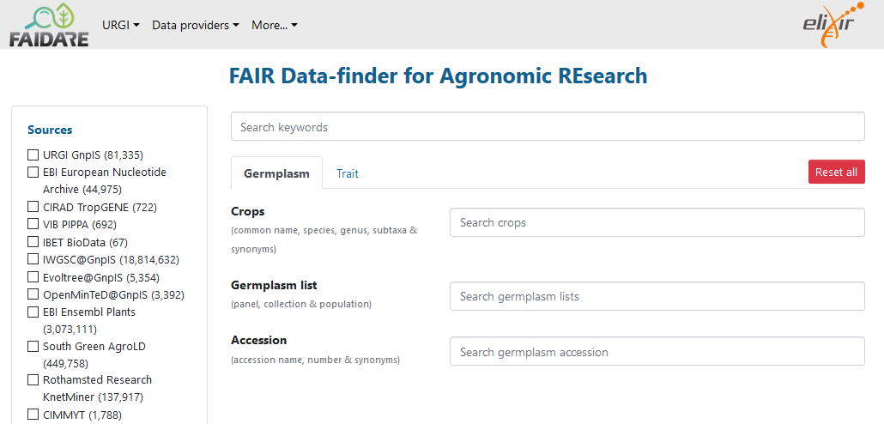
Data Integration between silos, From Phenotyping to Genotyping
Phenotyping DB
Material Source IDs
Material Source DOI
Material Source latitude
Infraspecific name (Riesling, Chasla, …)
Biological Material ID
Alternate IDs (project)
Material Source IDs
Material Source DOI
Material Source latitude
Infraspecific name (Riesling, Chasla, …)
Biological Material ID
Alternate IDs (project)
https://urgi.versailles.inrae.fr/faidare/
Community data discovery portals

Slide 19



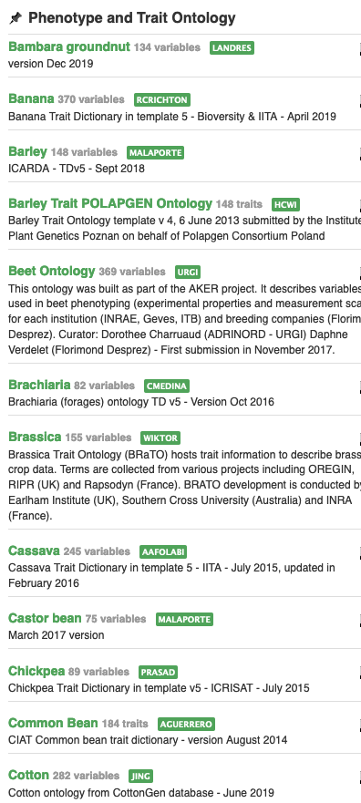
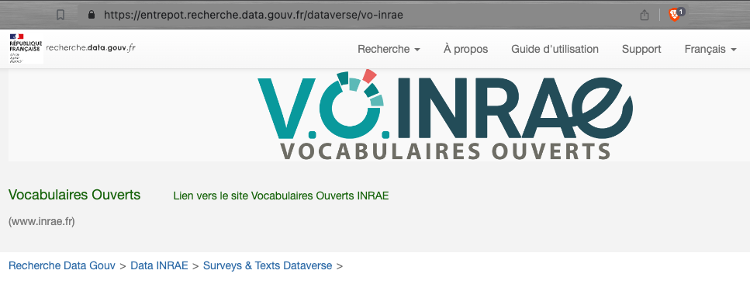
Phenotype Semantic Standard: Ontologies
www.cropontology.org
Description des traits et caractéristiques des plantes
Modèle de représentation, ie Framework
  Trait + Method + Scale
  Scale: unité, échelle de notation
  Trait: Entité (ex: feuille) + Characteristic (surface)
Collection ontologies par espèces
Création d’ontologie par communauté possible
  Recommandée dans certains cas
  Contribution aux ontologies potentiellement chronophage
  Publication
    https://entrepot.recherche.data.gouv.fr/dataverse/vo-inrae
  Vitis Organ ontology
  Wheat Crop Ontology
  Walnut Trait Ontology
  Woody Plant Ontology

Slide 20
MIAPPE: Implementations
Excel template
ISA Tab
Breeding API
Systèmes d’informations
Ontologie formelle

Slide 21
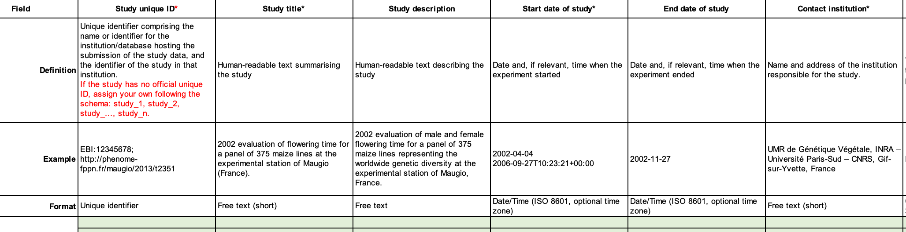
MIAPPE Excel template
Disponible sur github MIAPPE
  https://github.com/MIAPPE/MIAPPE/tree/master/MIAPPE_Checklist-Data-Model-v1.1/MIAPPE_templates
One sheet per MIAPPE section
Documentation et exemples

Slide 22
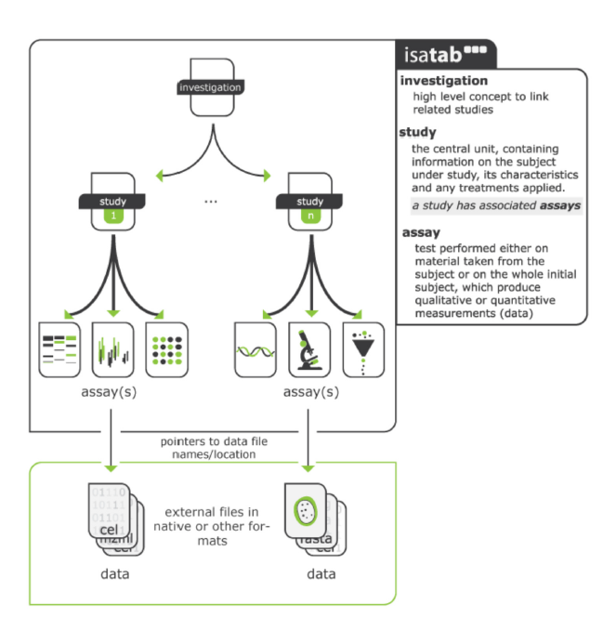
MIAPPE File Archive
ISA Tab for Phenotyping
  Investigation/Study/Assay
  Zip Archive
    MIAPPE Metadata
    Raw data
      CSV
      Images or binary files
      Reference to image archive (URI/URL)
    Elaborated data
      CSV
      Provenance
Training and improvements
  File and metadata curation
    Elixir
    Célia Miguel & Anne Françoise Adam Blondon
  BrAPI to IsaTab portable tool
    Elixir implementation study for MIAPPE Validation
Data files

Slide 23
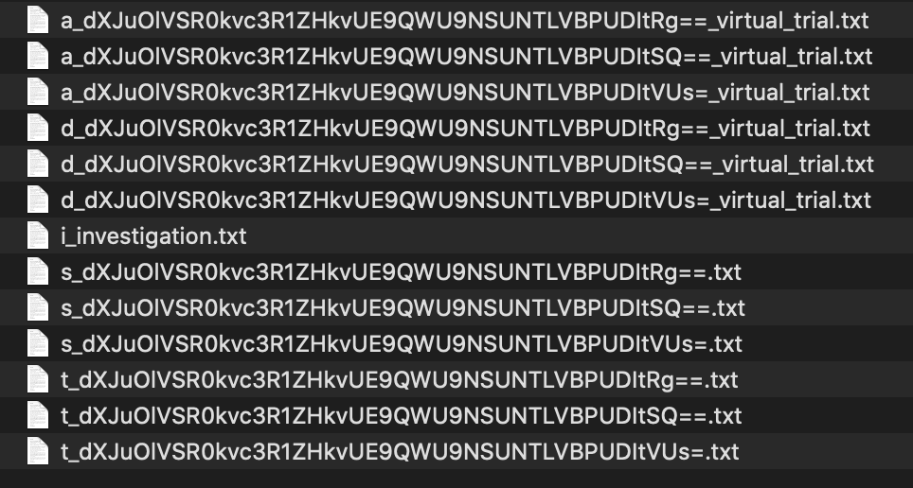
MIAPPE File: Poplar Phenology dataset
Zip archive
1 investigation
  i_Investigation.txt : initial file
3 Studies
  3 s_*.txt file
1 level per study
  3 a_*.txt
3 trait definition file
  Crop ontology format
  T_*.txt files
3 data files
  D_*.txt file

Slide 24








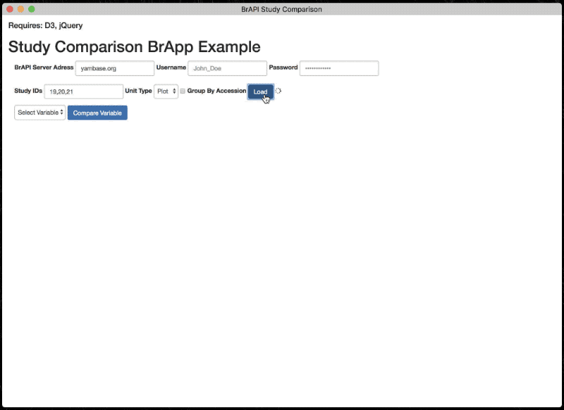
Plant Technical Standard
Breeding API http://brapi.org/
International collaboration
  Standard Open Web Service API
  Information Exchange, Main target: Breeding
  Excellence in Breeding platform (CGIAR, Peter Selby)
Major Elixir, Emphasis Contribution
  Phenotyping specification
Connect data repositories and tools:
  Genotype visualization (Flapjack)
  Studies graph preview and filtering
    BrAPPS : Tools integrable in any BrAPI compliant System
    https://www.brapi.org/brapps.php
  R analysis environment
  Field data capture
  FAIR Data discovery → Elixir FAIDARE
T3
CIRAD
GOBII
Wageningen
Cornell
iPlant
Selby et al. Bioinformatics (2019),
doi.org/10.1093/bioinformatics/btz190

Slide 25
Standardized Specification
BrAPI has defined a Standardized set of data model structures to communicate the basic information of plant breeding
BrAPI is a technical Specification which software developers can easily turn into code which communicates using the Standard.
BrAPI 101 Slides, P. Selby

Slide 26

BrAPI data model
MIAPPE compliant
MIAPPE Investigation → BrAPI Trial
MIAPPE Study → BrAPI Study
Biological Material Germplasm MCPD dedicated BrAPI calls
Observation variable BrAPI calls
Datafile or Observation Unit
Phenotyping
Studies
Genotyping
Studies
Germplasm
Permanent Unique Identifier (DOI)
AccessionNumber
Taxon
Institute (→ Namespace)
Observation Units
(Plants, Plots, …)
Observations
(Env, Pheno, …)
Observation Variables
Trait
Methode
Scale

Slide 27
Adoption
Standard d’échange de données communauté Resources végétales Nationale (Florilège, Olga, GnpIS, FAIDARE)
Standard d’échange de données plantes ELIXIR (indexation FAIDARE)
Standard d’indexation Phenome-EMPHASIS.fr
Adoption dans les CGIAR

Slide 28
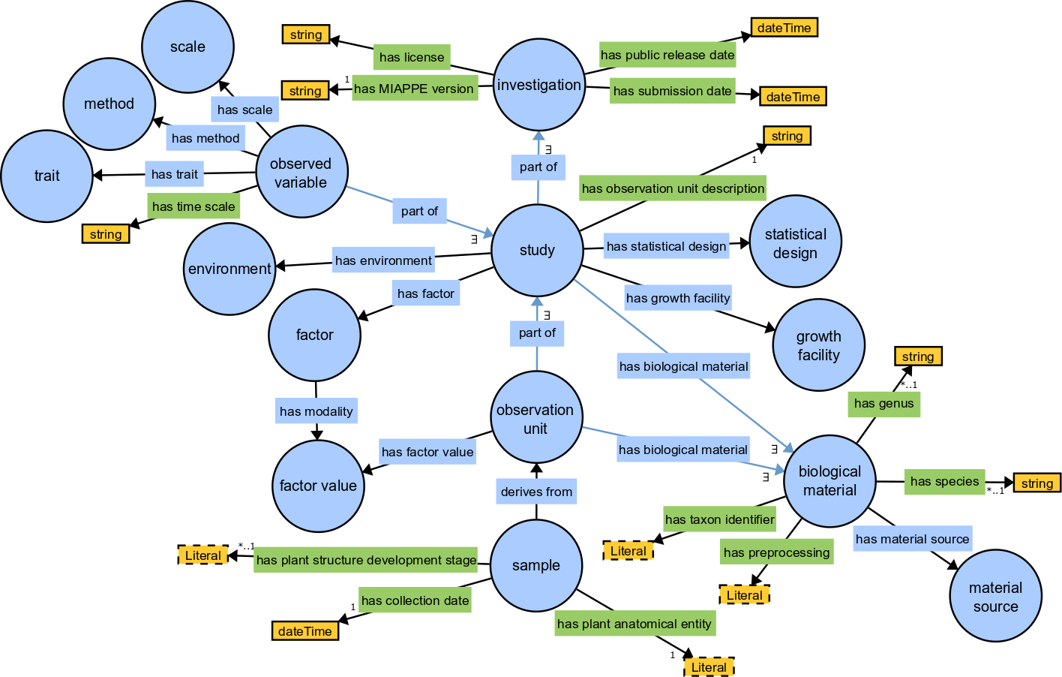
MIAPPE Semantic: PPEO
MIAPPE OWL Implementation
  https://github.com/MIAPPE/MIAPPE-ontology
  http://agroportal.lirmm.fr/ontologies/PPEO
Data model representation
Formal concepts and constraints
Ontology for Computer scientists, not for biologists

Slide 29
MIAPPE databases & Information System
Transparents pour les utilisateurs
Implementation BrAPI = Implementation MIAPPE
FAIDARE (incl GnpIS)
PHIS/Sixtine
SI Européens ELIXIR et EMPHASIS
  VIB, NIB, ITQB, WUR, …
CGIAR
  Breedbase
  Solegenomics
  …
FAIRDOM-Seek
…

Slide 30
MIAPPE Specifications

Slide 31

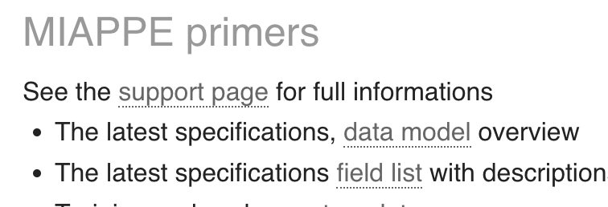
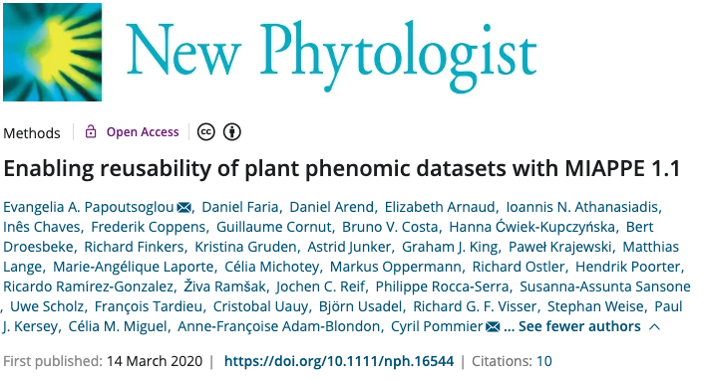
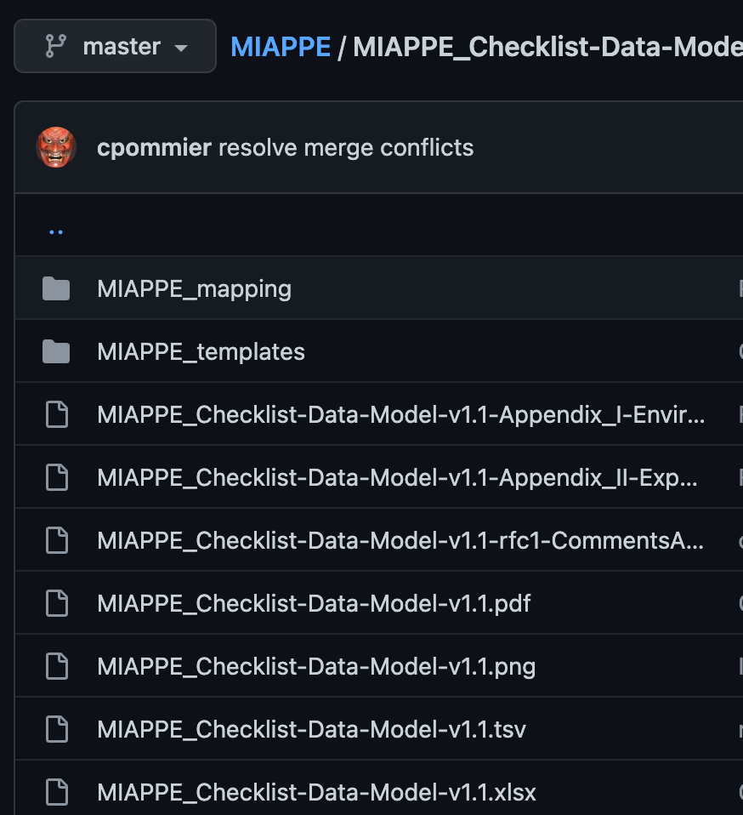
MIAPPE Specifications
www.miappe.org
Github
  https://github.com/MIAPPE/MIAPPE/tree/master/MIAPPE_Checklist-Data-Model-v1.1

Slide 32

Quelles metadonnées pour décrire une experience de phénotypage ?
https://www.menti.com/alomgvao7pwn

Slide 33
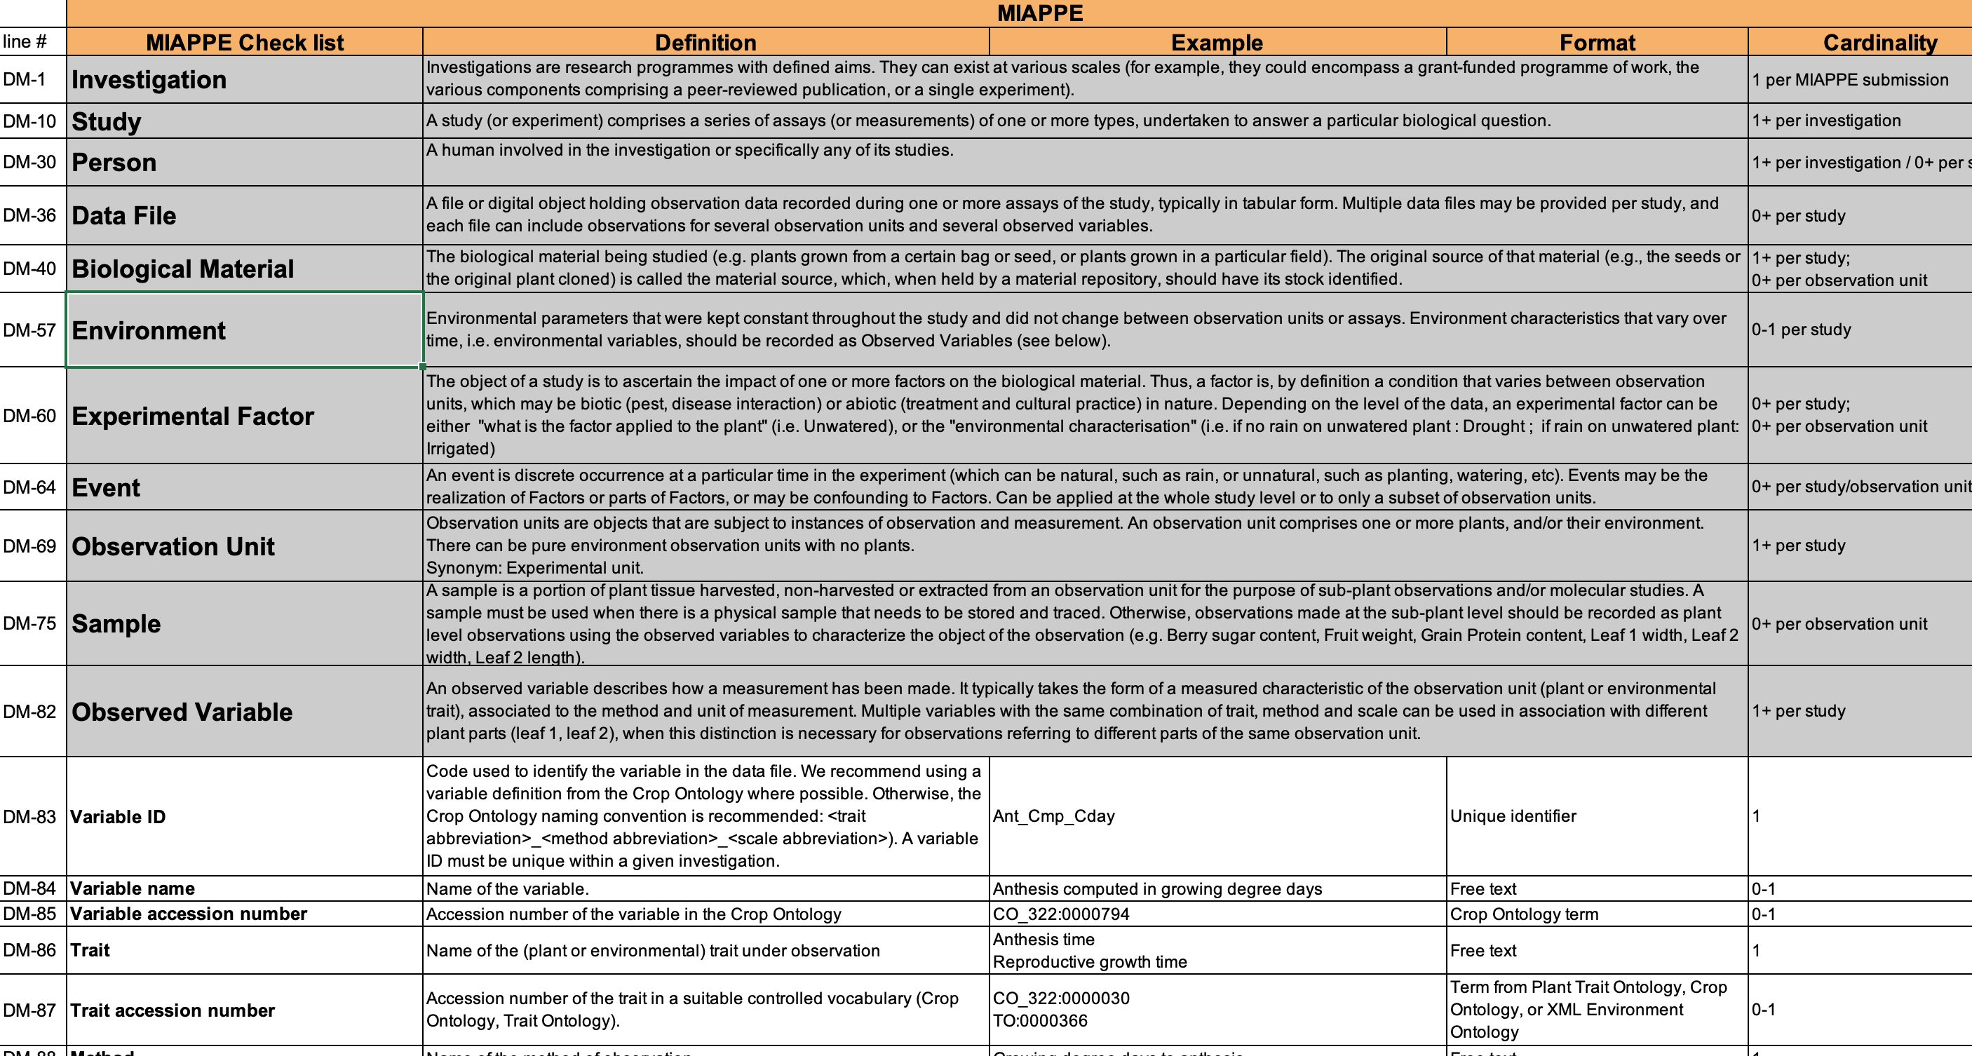
MIAPPE Specifications
Tableau de spécifications
11 Sections
Metadata Fields
Définitions
Exemples
Cardinalités

Slide 34
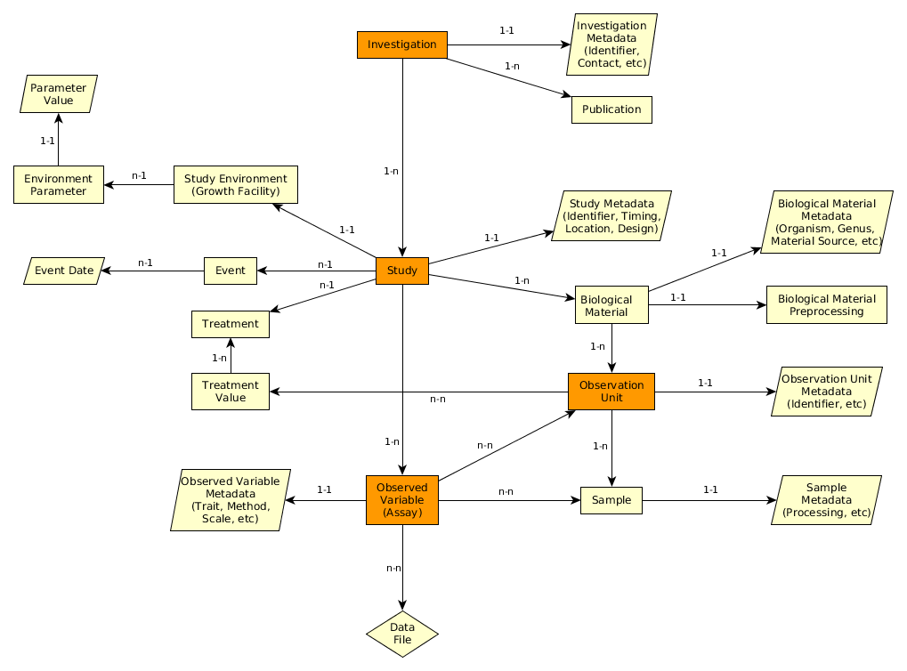
MIAPPE Specifications
Tableau de spécifications
11 Sections
Metadata Fields
Définitions
Exemples
Cardinalitées
Liens entre sections/concepts

Slide 35
Vue d’ensemble MIAPPE V1.1 (ISA)
Investigation: dataset complet
  champs, serre, …
  One to many location
  One to many years
Study : une experience dans une location pendant une à plusieurs années
Assay:
  trait ou indice (Pheno or Env)
  Level + Trait + Method + Scale/Unit
Level:
  Plant
  Microplot
  Block
  Trial/Study
  …
Investigation
Study
Assay
(Observed variable)
Data file

Slide 36
Examples en MIAPPE
Deux illustrations montrant la documentation experimentation de phenotypage:
MAIZE: [1] Millet et al. 2019 (https://doi.org/10.15454/IASSTN): A multi-site experiment in a network of European fields for assessing the maize yield response to environmental scenarios.
POPLAR: [2] Monclus et al. 2012 (http://dx.doi.org/10.1186/1471-2229-12-173): Integrating genome annotation and QTL position to identify candidate genes for productivity, architecture and water-use efficiency in Populus spp

Slide 37
Millet et al 2019 [1] - Material&methods section on phenotyping experiments
A panel of 256 maize hybrids was grown with two water regimes (irrigated or rainfed).
Location: seven fields in 2012 and 2013, plus one site in Chile in 2013
This resulted in 29 experiments defined as the combination of one year, one site and one water regime, with two and three repetitions for rainfed and irrigated treatments, respectively.
A detailed environmental characterisation was carried out, with hourly records of micrometeorological data and soil water status, and associated with precise measurement of phenology.
« grain.yield»: yiel adjusted at 15% grain moisture, in ton per hectare (t ha-1). «grain.number»: number of grain per square meter. «grain.weight»: individual grain weight (mg). «anthesis»: male flowering (pollen shed), in thermal time cumulated since emergence (d20°C). «silking»: female flowering (silking emergence), in thermal time cumulated since emergence (d20°C). «plant.height»: plant height, from ground level to the base of the flag leaf (highest) leaf (cm). «tassel.height»: plant height including tassel, from ground level to the highest point of the tassel (cm). «ear.height»: ear insertion height, from ground level to ligule of the highest ear leaf (cm).

Slide 38
Monclus et al 2012 [2] - Material&methods section on phenotyping experiments
3 Field trial established in April 2003 located in France (Ardon, 47°49’41''N, 1°54’39''E, 110 m),Italy Cavallermaggiore ((44° 43' 0'' N) , (7° 41' 0'' E)), UK Headley ((51° 7' 0'' N) , (-1° 10' 0'' W) )
The biological material consisted of a cloned 336 F1 progeny from an interspecific cross between the female Populus deltoides (Bartr. Ex Marsh.) ‘73028-62’ from Illinois and the male P. trichocarpa (Torr. and Gray) ’101-74’ from Washington State.
The trial was established from 25 cm- homogenous hardwood cuttings planted at a plant density of 6670 trees per ha. The trial was and consisted in 6 randomized complete blocks where each F1 genotype and each parent was represented by one replicate.
Circumference and stem height were measured at the end of the first (winter 2003–2004) and second (winter 2004–2005) as described in Dillen et al. Forest Ecol Manag. 2007, 252 (1–3): 12-23). Growth increment in height and circumference during the second growing season were calculated.
Leaf traits where measured in 2003: one fully illuminated mature leaf was collected on each tree according to Monclus et al. http://doi.org/10.1111/j.1469-8137.2005.01407.x ). Six calibrated discs of lamina were cut from this leaf, dried at 50 °C during 48 °C and weighed, and specific leaf area (SLA, cm² g⁻¹) was computed. Leaf discs were ground to fine powder for analysis of leaf carbon isotope composition (δ¹³C), carbon (C_{M}) and nitrogen (N_{M}) contents. One-milligram subsamples of ground material were used for measuring the CO₂ produced by combustion and its ¹³CO₂/¹²CO₂ ratio by a continuous flux isotope ratio mass spectrometer. The discrimination between atmospheric CO₂ and plant material was calculated.

Slide 39
Dispositif experimentaux pérenne en MIAPPE
Typical Dataset: Monclus et al., 2012, [2]
Populus deltoïdes
INRA:73028-62
doi:10.15454/1.4921786081024297E12
Data file
Data file
Data file
Data file
6 randomized blocks
1 observation unit = one tree
No treatment
6 replicates defined by their position in each block: row and column

Slide 40
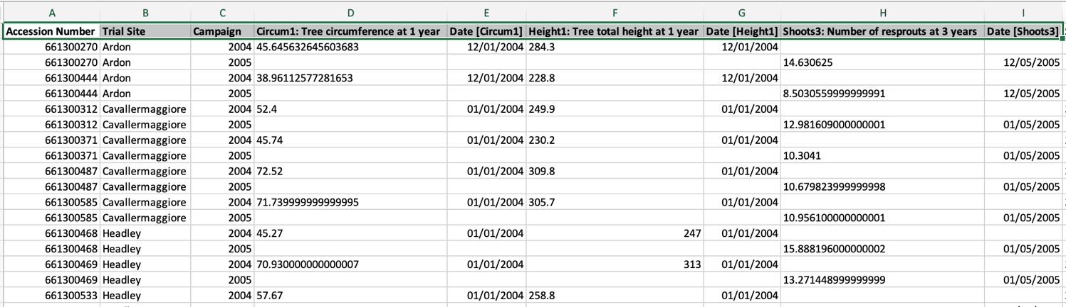
Dispositif experimentaux pérenne en MIAPPE
Fichier de données
Format libre(Near Infra Red Spectrum, Images, Image Archives references, ….)
  Mais un format recomandé est en cours de validation, voir github issue 71
Principalement tabulé
Metadata sur chaque en tête de colonne

Slide 41
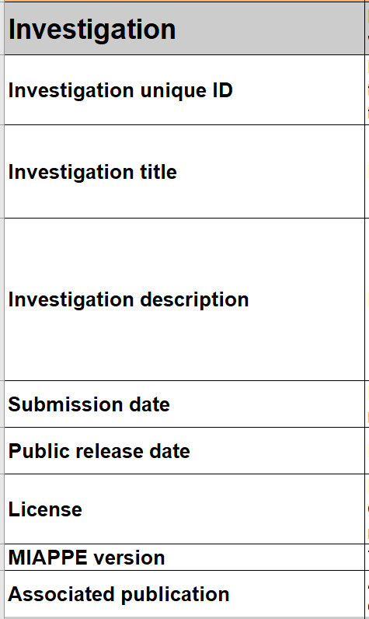
Sections obligatoires MIAPPE – Investigation
Investigations = Dataset
Ou Programmes de recherche avec des objectifs définis.
Exemples:
Unique experience,
Réseau multilocal
Projet finance
=> Une investigation contient une ou plusieurs studies.
Metadata: Information de publication de papier ou de jeux de données:
=> titre, description, keywords, auteurs, DOI, ...
Examples:
MAIZE [1]: ensemble des experiences multilocal anuelles.
POPLAR [2]: Ensemble des mesures multilocalles sur trois ans

Slide 42
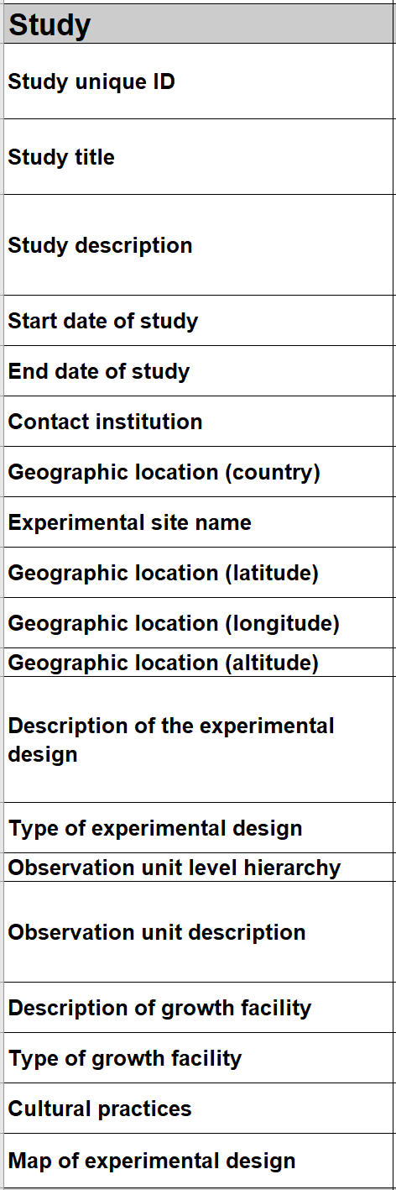
Sections obligatoires MIAPPE– Study
"study" (ou experiment)
Inclus des assays (ie analyses ou mesures)
Une study = une location
Metadata: description de l’ensemble de l’experience
=> timing, location, statistical design, cultural pratices, etc...
Examples:
MAIZE [1] : 29 studies => 2 years x 7 locations x 2 treatments (Gaillac 2012 rain, Gaillac 2013 watered, …)
POPLAR [2] : 6 studies => 3 locations over 2 years (Ardon_2003-2004, Ardon_2004-2005)

Slide 43
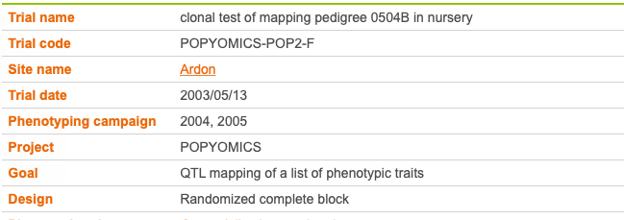
Sections obligatoires MIAPPE: Study Metadata
Poplar Study
Study = Trial
Study

Slide 44
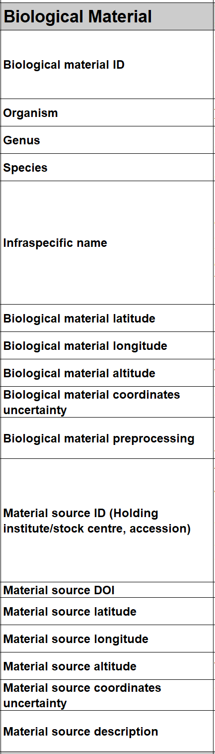
Sections obligatoires MIAPPE– Biological material
Liste varietal, accessions, variétées, …
Identifiant plus source (stock center, gen bank, etc…).
Crucial pour intégration de données pheno-genomic or genetic
Metadata
  Champs minimaux du Multicrop Passport Descriptor (MCPD) standard
  GPS location for forest tree / in situ material provenance
Material source: accession, cultivar/variety, region of provenance, laboratory cross, ...
MCPD identification system:
Genebank/Lab + Species + accession number (mandatory)
DOI
Biological material: seed lot, cuttings, plant in the study, …
Lab + internal accession number (mandatory)
URI
Plant Samples: partie prélevée d’une plante, detached leaves, ...
Lab + internal accession number (mandatory)
BioSample ID

Slide 45
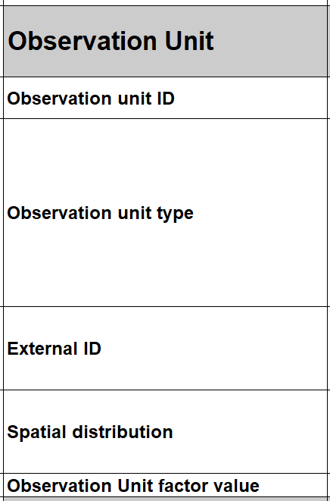
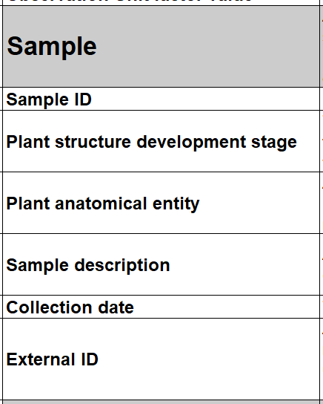
Section importante MIAPPE – Observation Unit & Samples
Observation units :
objets réels (ex: microplot) de la study sur lesquels les mesures et observations sont faites.
objets virtuels (genotype) sur lesquels des variables ou indices sont calculés.
Typiquement une ou plusieurs plantes
Recoivent des mesures pheno ou environmentales
Metadata specifiques
=> identifiers, location, replication, treatments, …
Sample
morceau de tissu extrait from d’une observation unit
sub-plant observations ou étude moleculaire.
Metadata : alignées avec with BioSample checklists
=> identifiers, information about processing, …

Slide 46

Quelle type de matériel biologiques manipulez vous ?
https://www.menti.com/ale1bo7kkijz

Slide 47
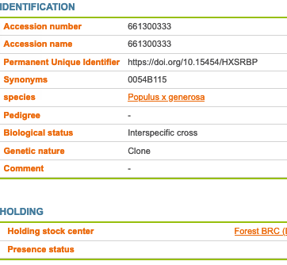
Sections obligatoires MIAPPE– Biological material
Plant Material
  Identification
  Description
Multi Crop Passport Descriptor
Biological material
Observation Unit
Sample

Slide 48
MIAPPE main sections – Biological Material & Observation Unit
[Biological material]
Populus deltoïdes
INRA:73028-62
doi:10.15454/1.4921786081024297E12
Example: POPLAR [2]
[observation unit]
Populus deltoïdes
INRA:73028-62
Block1-Row4-Col4
6 randomized blocks
1 observation unit = one tree
No treatment
6 replicates defined by their position in each block: row and column

Slide 49
MIAPPE main sections – Observation Unit & Samples
Example: Monclus et al., 2012, [2]
Populus deltoïdes
INRA:73028-62
doi:10.15454/1.4921786081024297E12
[observation unit] : Block1-Row4-Col4
Set of samples
One leaf
For each tree of each block
= for each observation unit
6 leaf disks
Different types of processing of the leaf disks depending on the measurement: can be captured by different sets of samples (e.g. if subsampling generates repetitions) or in the method of the observed variable.
Notes:
Leaf traits where measured in 2003: one fully illuminated mature leaf was collected on each tree according to Monclus et al. http://doi.org/10.1111/j.1469-8137.2005.01407.x ). Six calibrated discs of lamina were cut from this leaf, dried at 50 °C during 48 °C and weighed, and specific leaf area (SLA, cm² g⁻¹) was computed. Leaf discs were ground to fine powder for analysis of leaf carbon isotope composition (δ¹³C), carbon (C_{M}) and nitrogen (N_{M}) contents. One-milligram subsamples of ground material were used for measuring the CO₂ produced by combustion and its ¹³CO₂/¹²CO₂ ratio by a continuous flux isotope ratio mass spectrometer. The discrimination between atmospheric CO₂ and plant material was calculated.

Slide 50
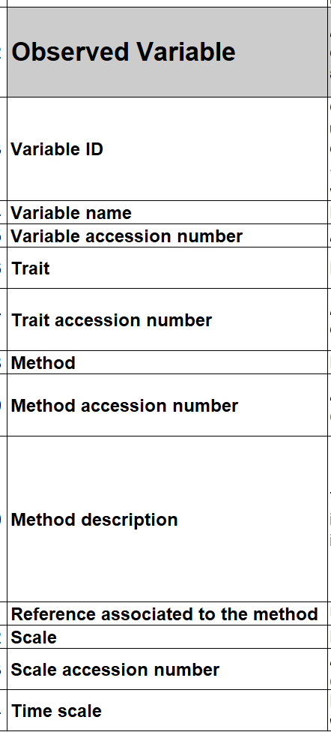
Sections obligatoires MIAPPE–Observed Variable (Assay)
Observed Variable (assay)
  Trait
  Measurement / computation method
  Unité, echelle de notation.
  Trait: Phenotype or Environment
Metadata
  Minimal :trait, method, scale
  Complete : Crop Ontology Trait Dictionary

Slide 51
Crop Ontology Trait Dictionary Standard
Variable = trait + method + scale
The phenotypic observation
Trial | Genotype | CIR | HT | SUR
Domaine de Valcros | 6579 | 600 | 17 | 1
Domaine de Valcros | 6580 | 482 | 14 | 1
Variable | Variable ID
 | Variable name
 | Variable synonyms
 | Context of use
 | Growth stage
 | Variable status
 | Variable Xref
 | Institution
 | Scientist
 | Date
 | Language
 | Crop

Slide 52
Crop Ontology Trait Dictionary Standard
Variable = trait + method + scale
What is the studied character?
Trial | Genotype | CIR | HT | SUR
Domaine de Valcros | 6579 | 600 | 17 | 1
Domaine de Valcros | 6580 | 482 | 14 | 1
Trait | Trait ID
 | Trait
 | Trait class
 | Trait description
 | Trait synonyms
 | Main trait abbreviation
 | Alternative trait abbreviations
 | Entity
 | Attribute
 | Trait status
 | Trait Xref
Circumference of the tree
Total height of the tree
Survival state of the tree

Slide 53
Crop Ontology Trait Dictionary Standard
Variable = trait + method + scale
How is it observed?
Trial | Genotype | CIR | HT | SUR
Domaine de Valcros | 6579 | 600 | 17 | 1
Domaine de Valcros | 6580 | 482 | 14 | 1
Method | Method ID
 | Method
 | Method class
 | Method description
 | Formula
 | Method reference
Measured at breast height with a graduated ribbon
Measured from soil to crown with a pole or a clinometer
Visual assessment with a reference scoring scale

Slide 54
Crop Ontology Trait Dictionary Standard
Variable = trait + method + scale
How is it expressed (unit or scale)?
Trial | Genotype | CIR | HT | SUR
Domaine de Valcros | 6579 | 600 | 17 | 1
Domaine de Valcros | 6580 | 482 | 14 | 1
Scale | Scale ID
 | Scale name
 | Scale class
 | Decimal places
 | Lower limit
 | Upper limit
 | Scale Xref
 | Category 1
 | Category 2
 | …
 | Category n
cm
mm
0 = Alive
1 = Dead
2 = Doubtful

Slide 55
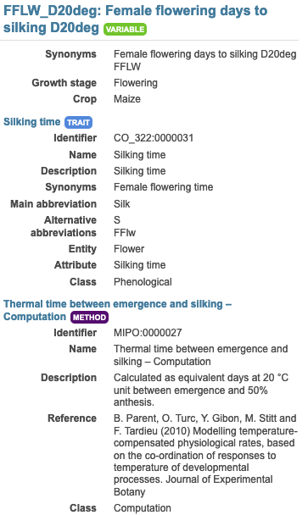
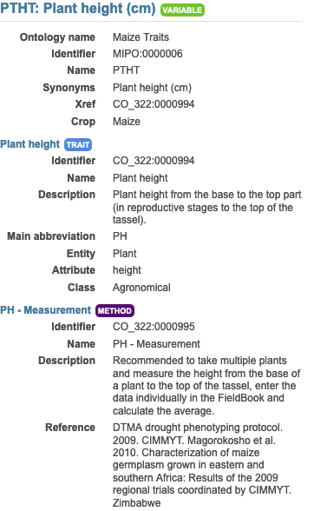

MIAPPE main sections – Observed Variable (Assay)
Example:
In each study of MAIZE [1] three measurements are made:
Plant level: 20 variables
Genotype/Study level: 19 variable both phenotype and environment
Plot level: 9 variables
For instance
  Female flowering days to silking D20deg
  Plant height (cm)

Slide 56
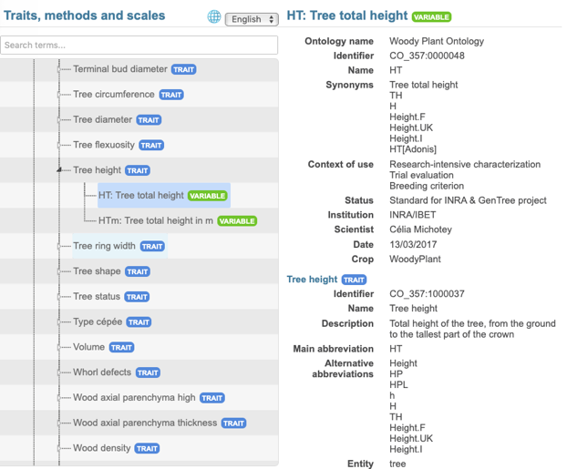
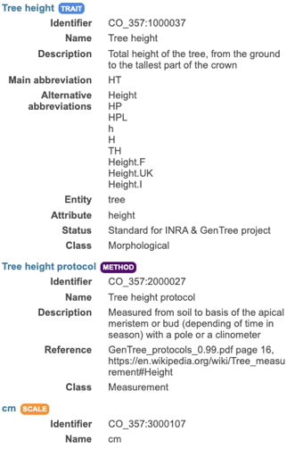
Sections obligatoires MIAPPE–Observed variable
Chaque colonne : Trait + Method + Scale
Assay
(Observed variable)

Slide 57
Autres section importantes
Investigation
Environment
Events
Study
Biological material
Treatment
Observation Unit
Assay
(Observed variable)
Sample
Files: data,…

Slide 58
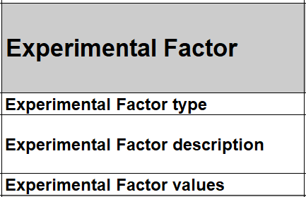
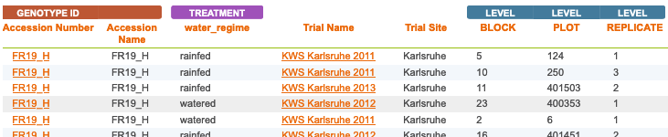
Section importante MIAPPE – Experimental Factor
Experimental factor:
traitement ou facteur biotique ou abiotique dont on évalue l’effet dans la study.
Ce n’est pas un pratique cultural.
Catégorisation à priori ou à postériori
Prend différente valeurs dans la study
Metadata include a name, a description and a value of the treatment
Example: MAIZE [1]
Two experimental factors/treatments: Rainfed, Watered
Block organisation

Slide 59

Section importante MIAPPE – Event
Event
Occurrence discrete, datée ou horodatée
Naturel (ex: pluie, attaque pathogen)
Pratique Culturale (ex: semis, irrigation)
Appliqué à toute la study ou par observation unit
Ce n’est pas le facteur, mais une information supplémentaire.
Event peuvent permettre de réaliser un facteur.
Metadata : nom name, description et time/date
Examples: POPLAR [2]
the field establishment date, 2003
the orchard was subjected to 15mm of rain on March 15, 2012 (fiction)
Study | Event
 | Name | Description | Date
Monclus et al., 2012 | Rain | 15mm of rain on the orchard | 2012-03-15

Slide 60

Section importante MIAPPE – Environment
Environment:
Environmental parameters, conditions experimentales
Constant sur l’ensemble de la study
“Descripteurs” de la study
Les variables environmentales sont traitées comme des observed variables.
Metadata : nom, description et valeur
Example:
Environment parameter | Environment parameter Value
Mean day air temperature | 22°C
Rooting medium composition | Ca (XEO:00058): 5 mg/L; ...

Slide 61

Sections obligatoires MIAPPE– Data file
Any format (Data matrix, NIRS, Images, ….)
Mostly tabular
Metadata on each column header

Slide 62
Crop ontology
En détails

Slide 63


Standard model
Variable = trait + method + scale
The phenotypic observation
Trial | Genotype | CIR | HT | SUR
Domaine de Valcros | 6579 | 600 | 17 | 1
Domaine de Valcros | 6580 | 482 | 14 | 1
Variable | Variable ID
 | Variable name
 | Variable synonyms
 | Context of use
 | Growth stage
 | Variable status
 | Variable Xref
 | Institution
 | Scientist
 | Date
 | Language
 | Crop

Slide 64
Standard model
Variable = trait + method + scale
What is the studied character?
Trial | Genotype | CIR | HT | SUR
Domaine de Valcros | 6579 | 600 | 17 | 1
Domaine de Valcros | 6580 | 482 | 14 | 1
Trait | Trait ID
 | Trait
 | Trait class
 | Trait description
 | Trait synonyms
 | Main trait abbreviation
 | Alternative trait abbreviations
 | Entity
 | Attribute
 | Trait status
 | Trait Xref
Circumference of the tree
Total height of the tree
Survival state of the tree

Slide 65
Standard model
Variable = trait + method + scale
How is it observed?
Trial | Genotype | CIR | HT | SUR
Domaine de Valcros | 6579 | 600 | 17 | 1
Domaine de Valcros | 6580 | 482 | 14 | 1
Method | Method ID
 | Method
 | Method class
 | Method description
 | Formula
 | Method reference
Measured at breast height with a graduated ribbon
Measured from soil to crown with a pole or a clinometer
Visual assessment with a reference scoring scale

Slide 66
Standard model
Variable = trait + method + scale
How is it expressed (unit or scale)?
Trial | Genotype | CIR | HT | SUR
Domaine de Valcros | 6579 | 600 | 17 | 1
Domaine de Valcros | 6580 | 482 | 14 | 1
Scale | Scale ID
 | Scale name
 | Scale class
 | Decimal places
 | Lower limit
 | Upper limit
 | Scale Xref
 | Category 1
 | Category 2
 | …
 | Category n
cm
mm
0 = Alive
1 = Dead
2 = Doubtful

Slide 67



Controlled Vocabulary Challenge
Phenotyping/environment variable = Trait + Method + Unit/Scale
+
+
Trait
Method
Unit
M1: Total height
M2: First tassel branch
M3: Last expanded leaf
M4: Youngest growing leaf
U1: cm
U2: mm
We need Species specific CV/Ontologies
BUT
Near infinite number of combination
T1: Plant Height
M5: Highest pixel corresponding to plant
U3: pixel
L Cabrera

Slide 68
Controlled Vocabulary Challenge
Variable annotation
Using MIAPPE for minimal variable description
  Optional reference to existing crop ontology
  Ad hoc Trait or Method or Scale in MIAPPE dataset
  Focus on Trait for interoperability

Slide 69




Controlled Vocabulary Challenge
Variable annotation Example 1
Trait | Trait description
L98AR1 | Latent Period for strain 98AR1
L93CV1 | Latent Period for strain 93CV1
Canker_LL | Canker lesion length

Slide 70






Controlled Vocabulary Challenge
Variable annotation Example 2
Trait | Trait description
L98AR1 | Latent Period for strain 98AR1
L93CV1 | Latent Period for strain 93CV1
Canker_LL | Canker lesion length
70

Slide 71
Controlled Vocabulary Challenge
Trait decomposition to Entity/Attribute
Trait = Leaf Area ➔ Entity = Leaf, Attribute = Area
Enables ad hoc controlled vocabulary + Trait Interoperability
Formalized by Mungal et al 2009
Existing in crop ontology
EMPHASIS proposition : Use for easy Variable creation and interoperability

Slide 72



Tree Variable example1 https://urgi.versailles.inra.fr/ontologyportal#termIdentifier=CO_357:0000019
1 Trait
3 Variables
3 methods

Slide 73




Tree Variable example2 https://urgi.versailles.inra.fr/ontologyportal#termIdentifier=CO_357:0000082

Slide 74


Environnemental Variable example
Variable annotation

Slide 75


Crop Variable example
Ad Hoc Variable
Trait: reference Crop Ontology Maize

Slide 76





















Acknowledgments
Elixir Plant community & platforms
Beier S., Gruden C., Pommier C., Michotey C, Coppens F, Scholz U., Lange M., Contreras B., Adam Blondon AF, Faria D, Chavez I, Miguel C, Droedsbek B, Finkers R, Papoutsoglou E, Olster R, Ramsak Z, …
H2020 AGENT
N. Stein (IPK, coord), P. Kersey (RBGK), M. Alaux (INRAE), S. Weise (IPK), C. Pommier (INRAE), M. Lange (IPK), R. Finkers (WUR), J. Destin (INRAE)
MIAPPE community
ELIXIR Plant Community,
Krajewsky P, Cwiek H, Tardieu F, Usadel B, Arend D, Arnaud E, Junker A, King G, Laporte MA, Michotey C, Poorter H, Reif J, Rocca-Serra P, Sansone SA, Kersey P,
And many more!
Crop Ontology
Arnaud E, Laporte MA, …
Breeding API
Selby P, Mueller L, Robbins K, Backlund JE, … ,
And many more!
Emphasis
Tardieu F, Usadel B, Arend D, Junker A, Poorter H, Neveu P, Pierushka R, Shur U…
And many more!

Slide 77
Questions

