Slide 1
PhLeGrA: Graph Analytics in Pharmacology over the Web of Life Sciences Linked Open Data
ETBII 19/01/2023
Ombeline / Andreas

Slide 2
Context
Adverse drug reactions = ADRs
Leading cause of death (USA)
ADRs mostly due to polypharmacy
Drug-drug interactions (DDIs) are poorly characterized
Prediction of DDIs/ADRs ⇒ better understanding of the underlying biological mechanisms
ETBII 2023

Slide 3
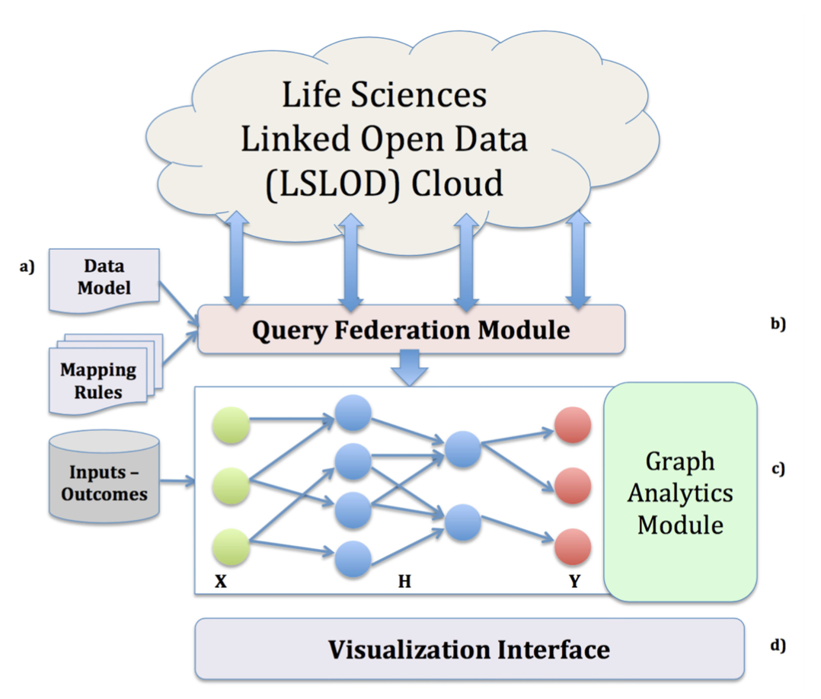
PhLeGrA overview
Given one or more drug predict the probability to have a given adverse drug reaction
{Drug}_{n} -> ADR
DrugBank
KEGG
PharmKGB
CTD
"Graph analytics module" ⇒ probabilistic graph model: hidden conditional random field
FAERS
ETBII 2023

Slide 4
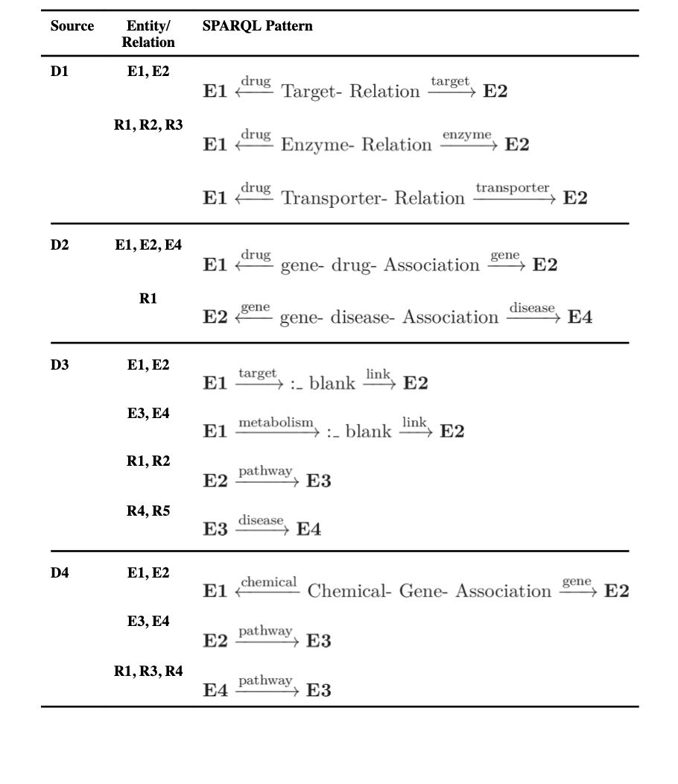
PhLeGrA data integration
Drug
Protein
Pathway
Phenotype
R1: hasTarget
R4: isPresentIn
R2: hasEnzyme
R5: isImplicatedIn
R3: hasTransporter
ETBII 2023

Slide 5
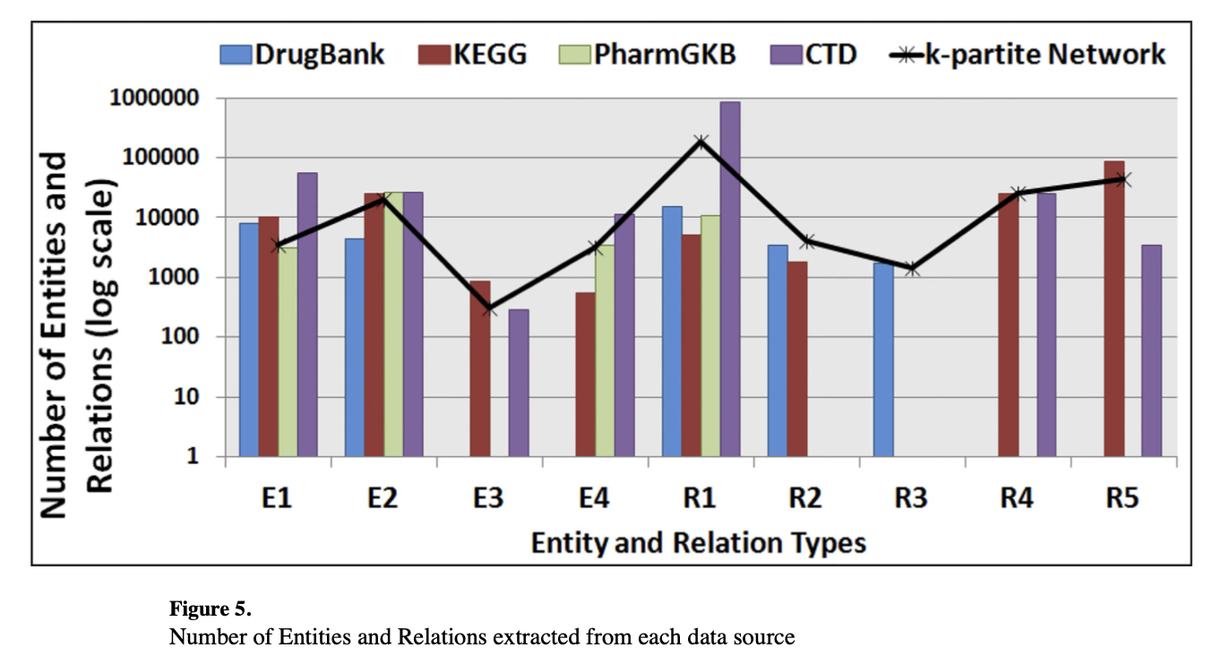
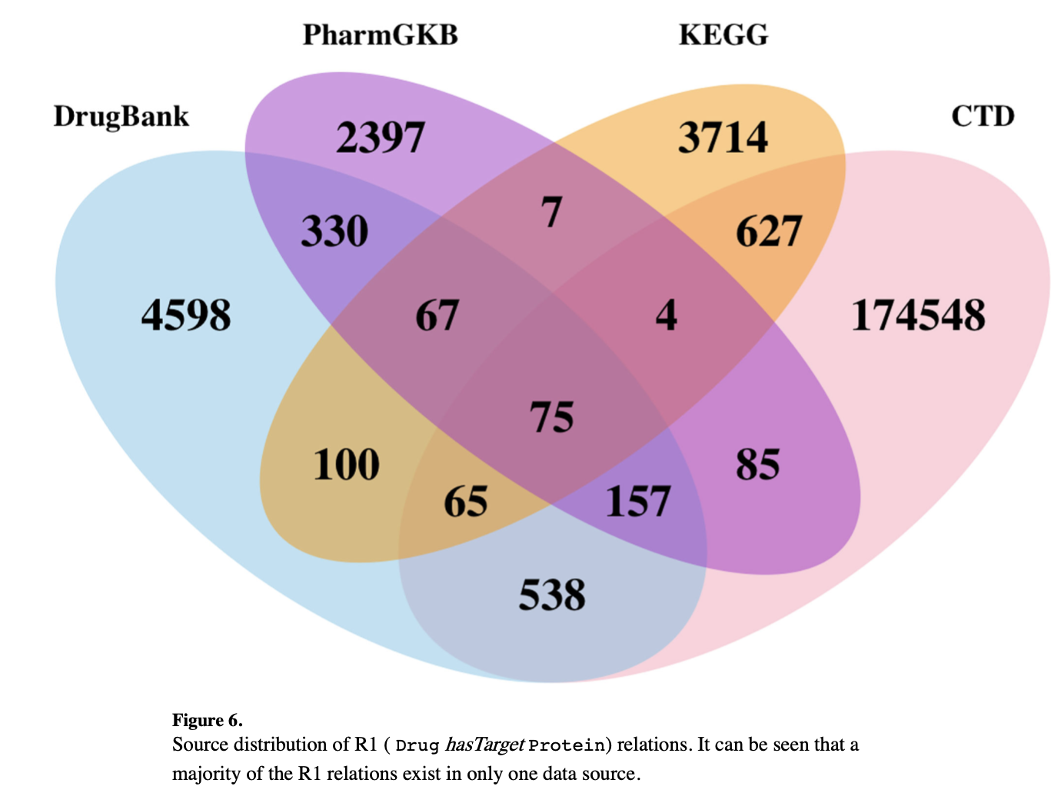
PhLeGrA some statistics
Heterogeneity of DB content
False Positive Rate
ETBII 2023

Slide 6
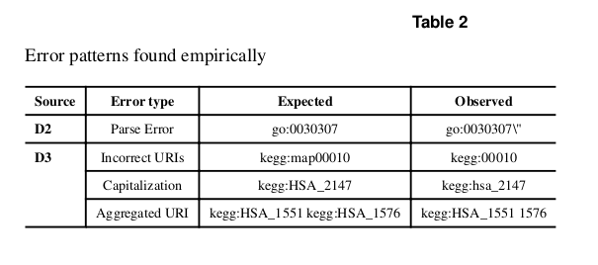
Semantic Web: issues and troubleshooting
Non-uniform SPARQL pattern
⇒ Query specific to each database
Name error
⇒ manual debugging OR
⇒ lost resources OR
⇒ error propagation
ETBII 2023

Slide 7
Conclusion & Challenges
Semantic web technologies allow to bring together pharmacological knowledge bases that are isolated.
Open Data issues: missing links and heterogeneity. Need of manual intervention.
PhLeGrA: "proof of concept", the model is not generic. Lack of a gold standard set of Drug-ADR associations with underlying mechanisms (in 2017).
Good performances on 146 Drug-ADR pairs
(total pairs: 3.2 millions)
ETBII 2023

