Slide 1
Integrated Genomic Characterization of Pancreatic Ductal Adenocarcinoma
Journal club, 19 January 2023
Authors : The Cancer Genome Atlas Research Network
Speakers : Ghislain Bidaut
Chaker Aloui
Isabel Brito
Nicolas Viart

Slide 2
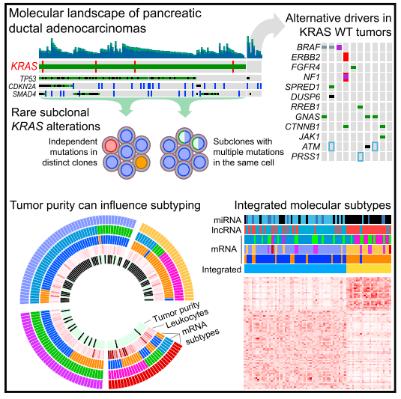
Summary
Objective of the paper: multi-omic profiling of pancreatic ductal adenocarcinoma (PDAC)
Analyzed data (n=150):
Germline and somatic genomic data (SNVs; InDels, CNVs)
mRNA
DNA methylation
miRNA
lncRNA
Protein expression
Notes:
Identify KRAS mutational heterogeneity and alternate drivers in KRAS wild-type tumors
Identify proteomic subtypes with prognostic significance and therapeutic implications
Integrated analysis of mRNA and non-coding RNA suggests onsensus subtypes

Slide 3
Single omics analyses: Unsupervised clustering & comparison with litterature
Recurrent Somatic Mutations
Germline Variants in Pancreatic Cancer
Mutational Signatures
Somatic Copy Number Aberrations
Clinically Relevant Mutations
Mutational Heterogeneity of KRAS Alterations
Landscape of KRAS Wild-Type Samples
mRNA Subtypes
DNA Methylation
Copy Number Clustering
Non-coding RNA; miRNA;
Protein Expression
Redondant conclusions: two subtypes of cancers (basal like; classical)

Slide 4
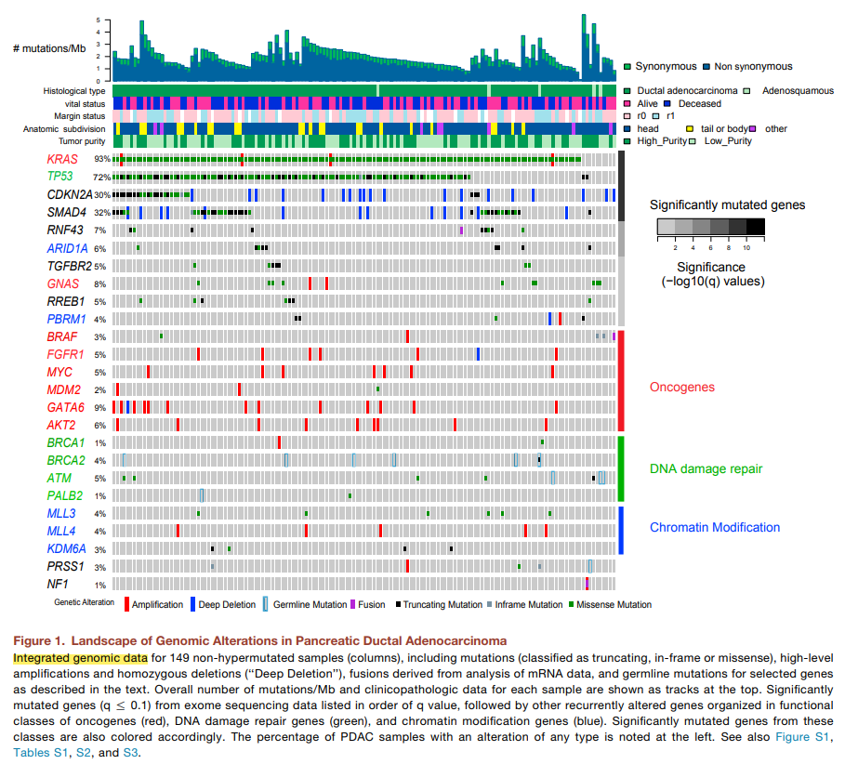
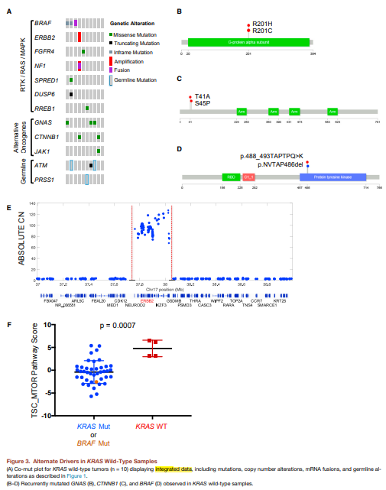
Data integration 1/3: Genomic data : (Somatic, germline, SNV, CNV… )
Notes:
Mutational Heterogeneity of KRAS Alterations in Pancreatic Cancer
Landscape of KRAS Wild-Type Samples

Slide 5
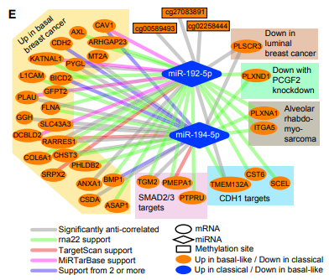
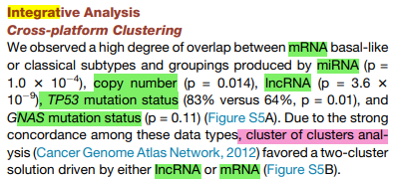
Data integration 2/3: Integrative Quantitative Analysis (IQA)
mRNA-miRNA; miRNA-LncRNA; miRNA-DNA_methylation; mRNA-LncRNA-DNA_methylation
Integration of data from many databases

Slide 6
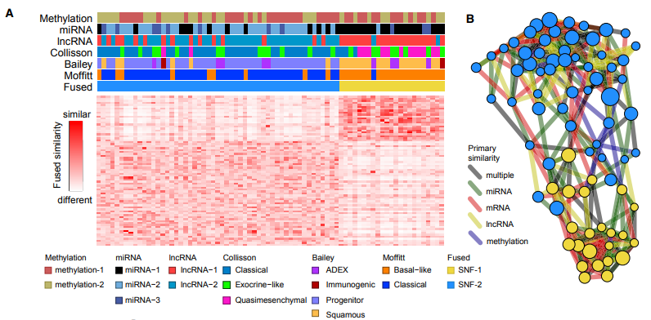
Data integration 3/3: Similarity Network Fusion (SNF)
miRNA, mRNA, lncRNA, and DNA methylation data from 76 indiv (high purity)
(Proteome data excluded, many missing data)

Slide 7
Key points of interests
Lots of analyses
Deep characterisation of alterations found in pancreatic cancers.
Good starting point for an integrative analysis (supposed to be done) with all data available in TCGA
SNF results validates published signatures of previous papers
Highly oriented toward clinical readers with actionable mutations described

Slide 8
Questions, difficulties
Very descriptive of mutations found in pancreatic cancers but no interpretation
General objective of the paper but no sub-objectives
Few description of the the integration methods
SNF used but no more conclusion from this analysis
« INTEGRATED » in title but no real integration of the different modalities
=> « integration » term extensivelly used compared to the real work

