Slide 1
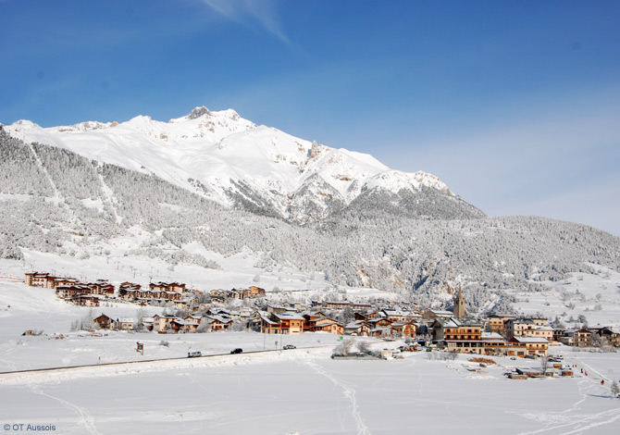
Summer School “Multi-Omics Data Analysis & Integration”
3-8 September 2023
Aussois, France

Slide 2
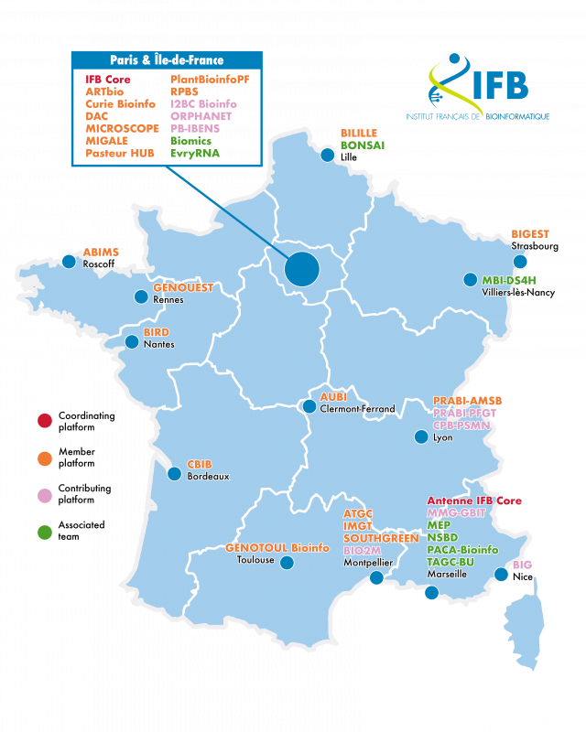
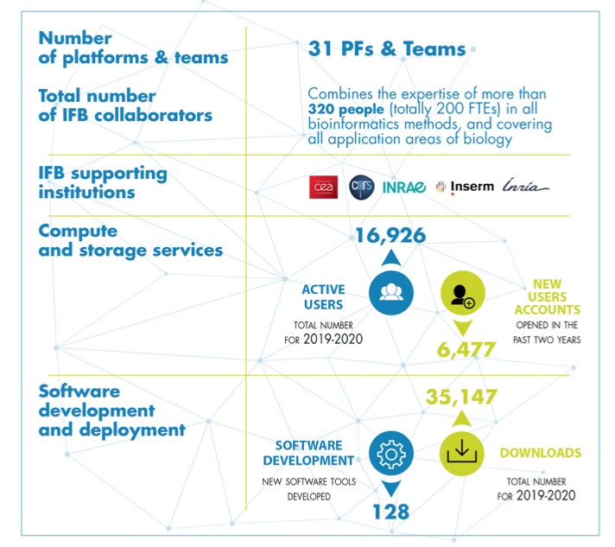
IFB – Institut Français de Bioinformatique
6

Slide 3
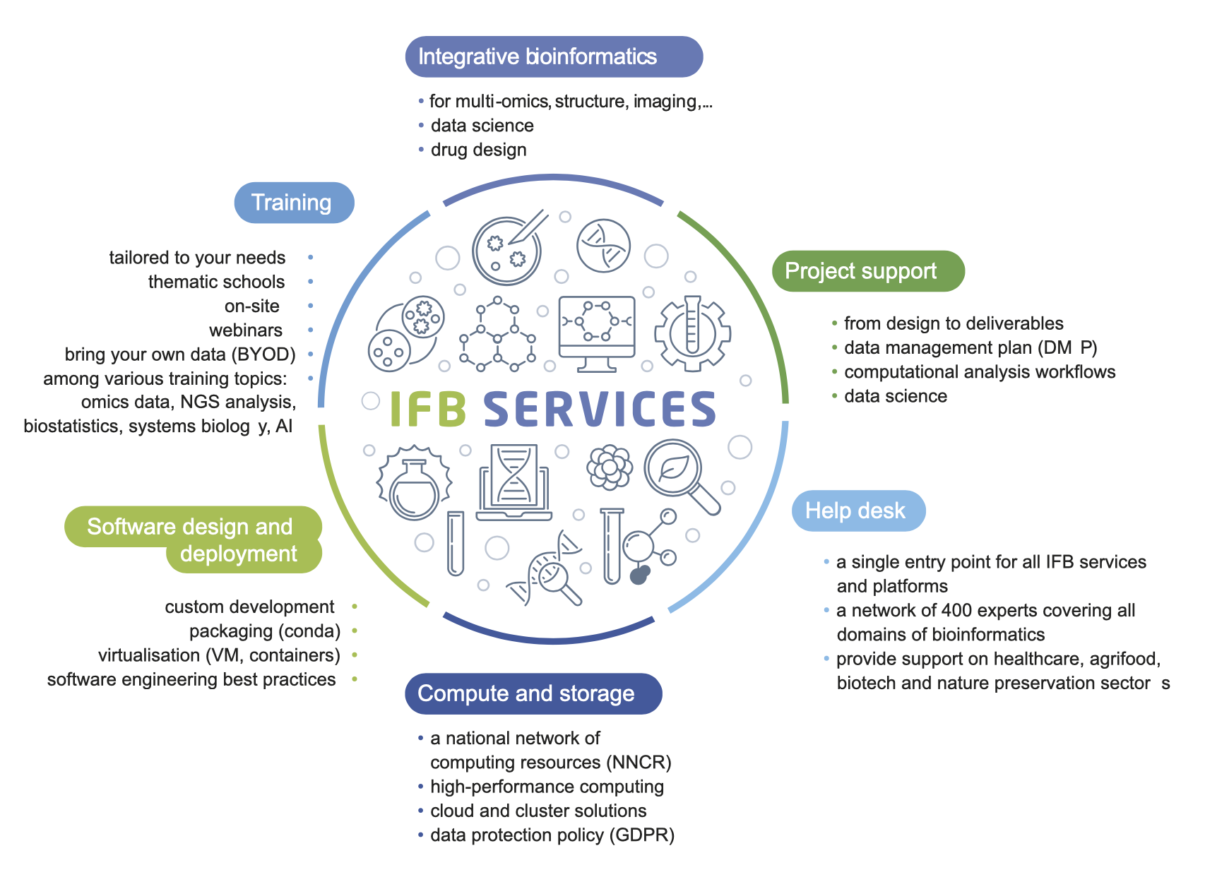
IFB – Institut Français de Bioinformatique

Slide 4
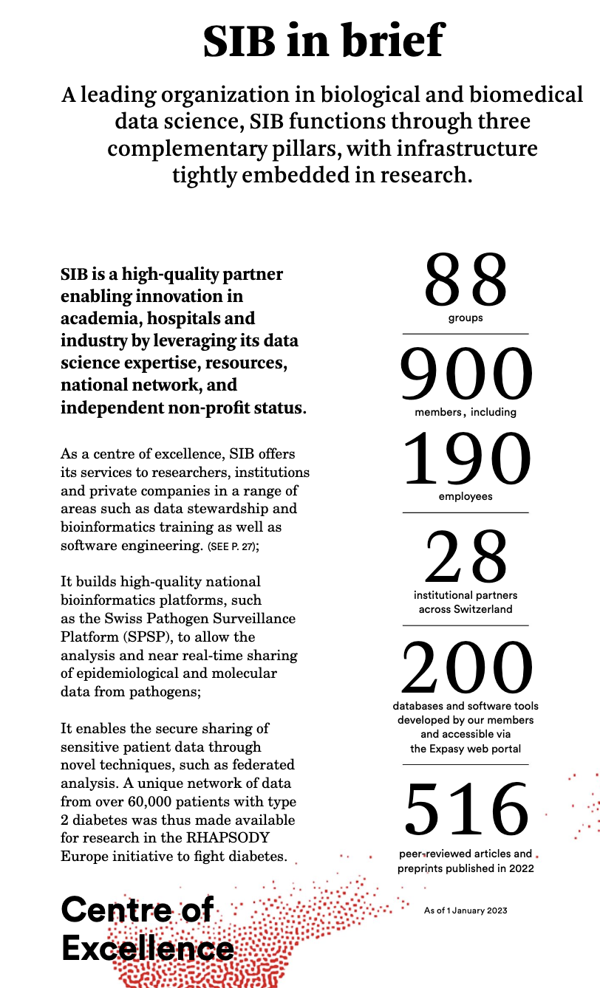
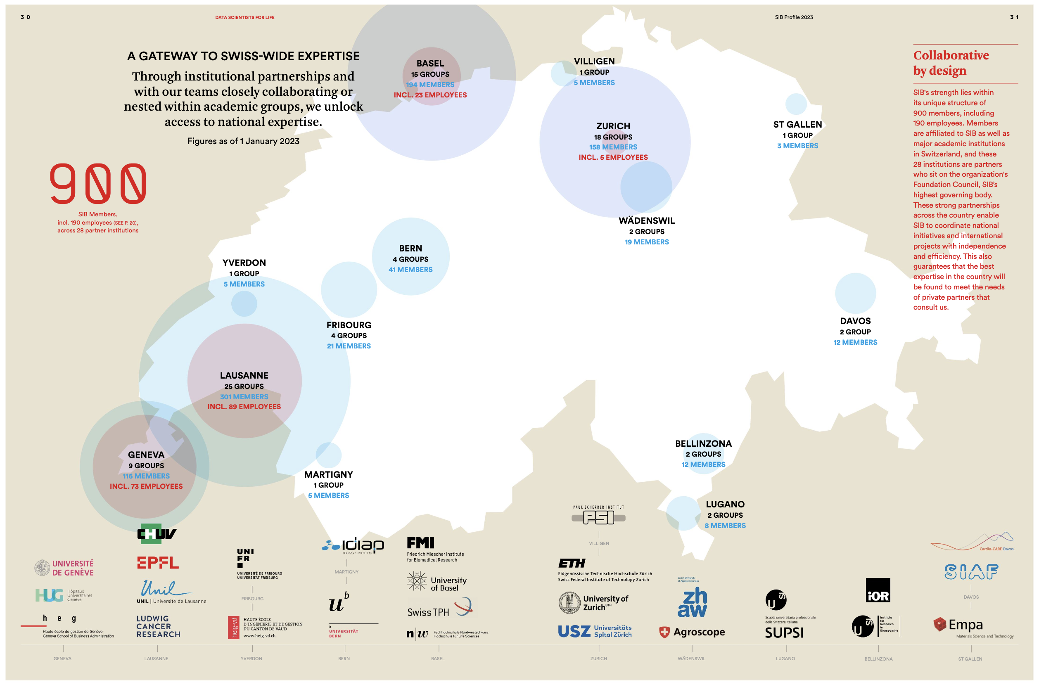
SIB Swiss Institute of Bioinformatics

Slide 5
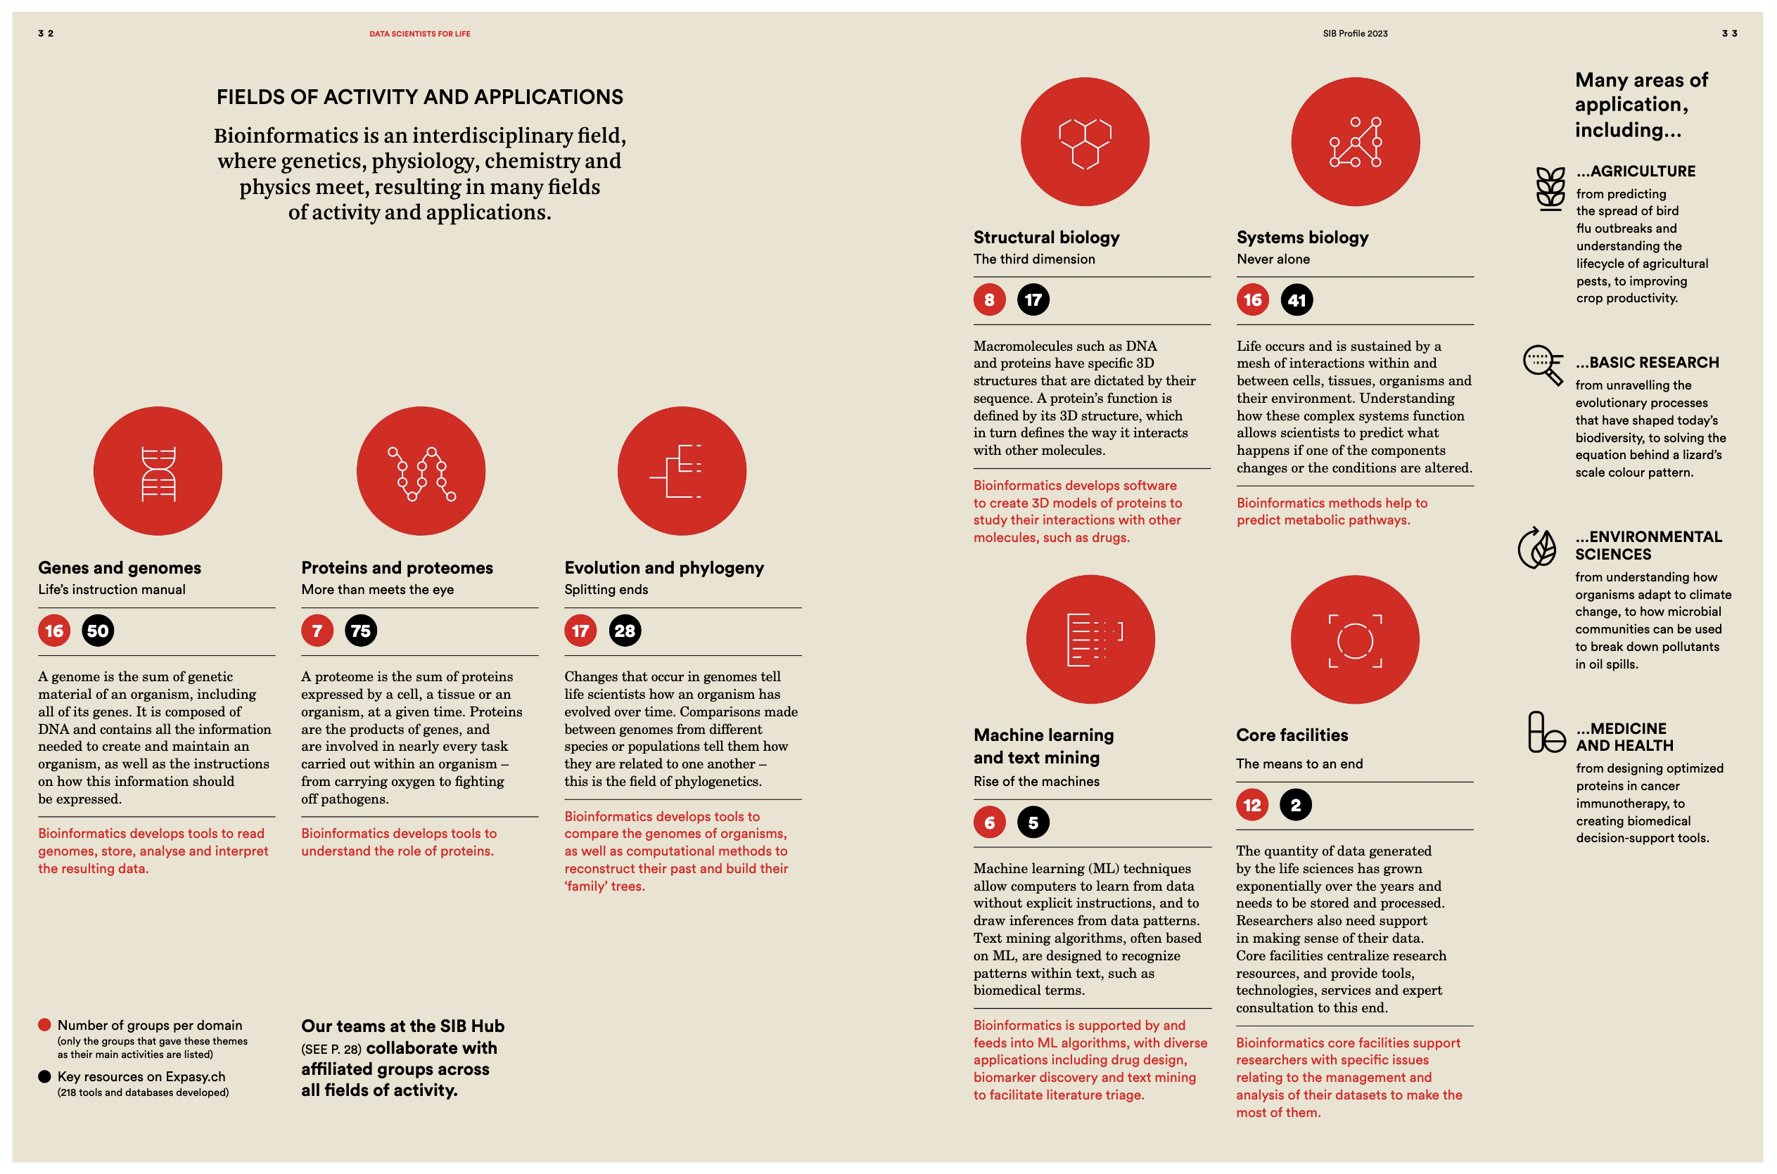
SIB Swiss Institute of Bioinformatics

Slide 6
Organization
Organizers
Olivier Sand, Training Coordinator, IFB
Grégoire Rossier, Training Manager, SIB
Florence Mehl, Computational Biologist, SIB
Scientific Committee
Guillemette Marot (University of Lille)
Marija Buljan (EMPA/SIB)
Anaïs Baudot (Marseille Medical Genetics)
Julien Boccard (University of Geneva)

Slide 7
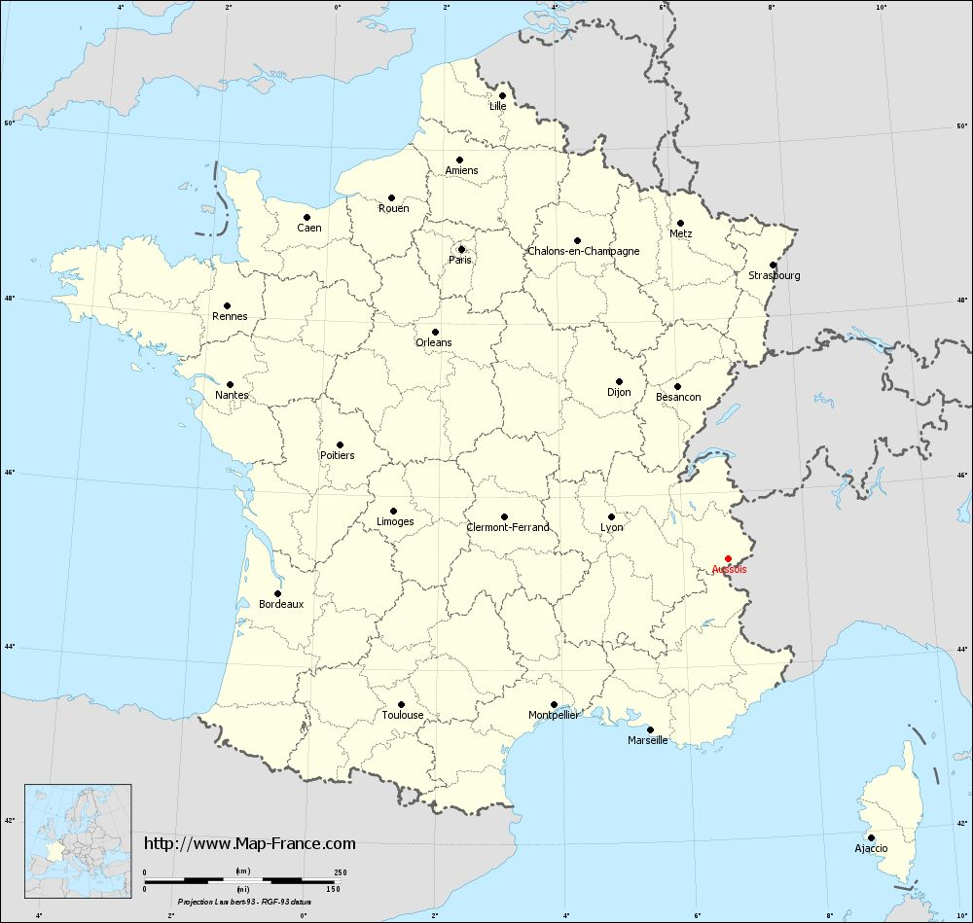
Aussois
Department of Savoie
Vanoise National Park
Ski resort
Altitude: 1500 m
Population: ~700 (6500 in winter)
Lozes Archeologic site
More interesting sites: https://www.aussois.com/decouvrir-le-village/les-incontournables/
Rarely rockslides…

Slide 8
Meals and breaks
Breakfast ? – ?
Morning coffee breaks 10h30 – 11h00
Lunches 12h30 – 14h00
Afternoon coffee breaks 15h30 – 16h00
Dinners 19h30

Slide 9
Friday transport
More information soon…we do our best so that you can enjoy the week without any stress about your return

Slide 10
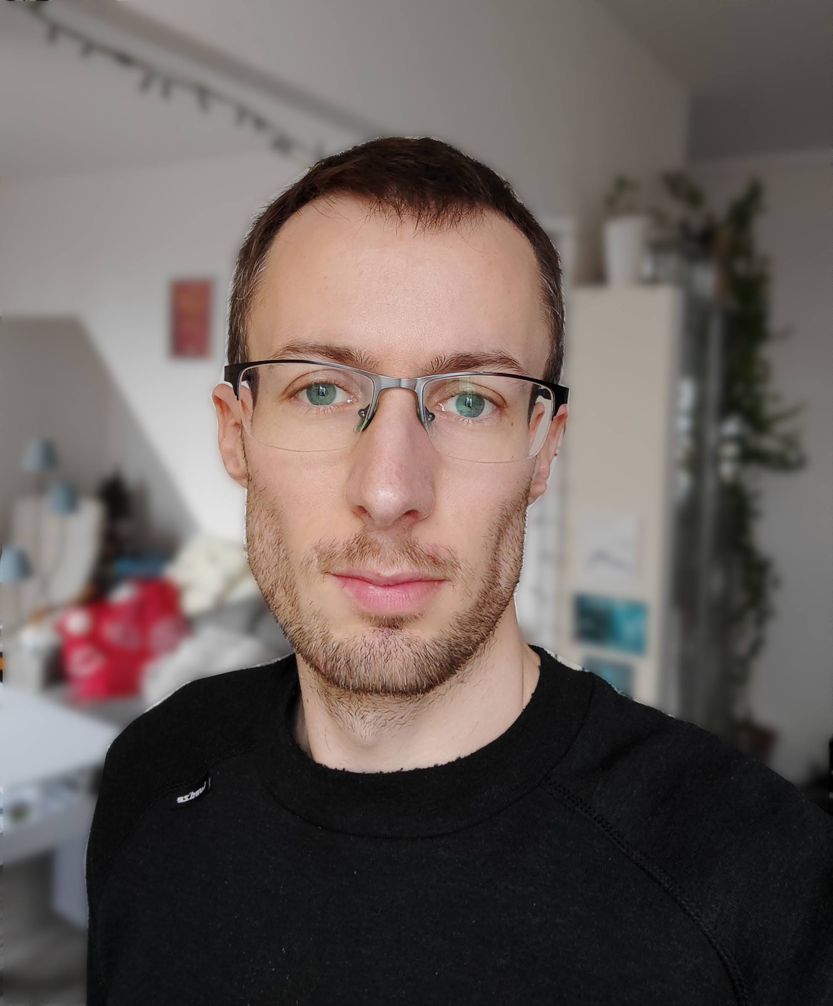
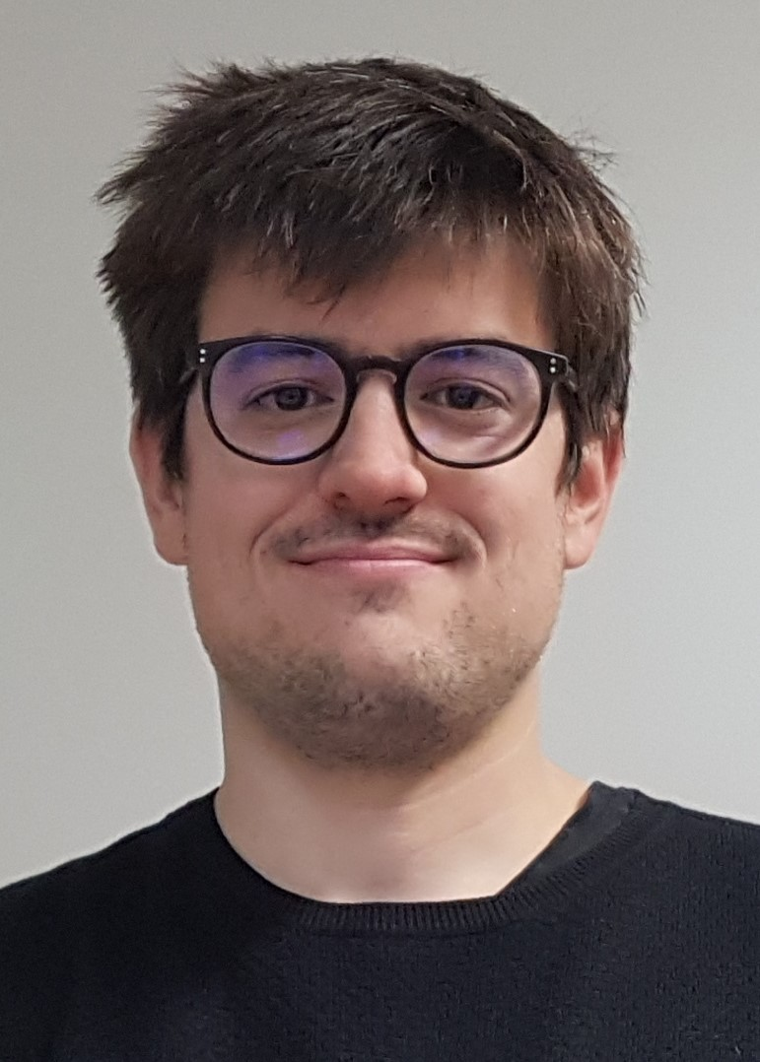
Programme
Monday 4 September
09:00 Welcome, introduction and instructions
10:30 Coffee break
11:00 Topic 0 - Statistics introduction – Theory
12:30 Lunch
14:00 Topic 1 - Multivariate Statistical Analyses
- Theory - Hands-on MOFA & RGCCA
17:15 End of day 1
19:30 Dinner
Jimmy Vandel
Arnaud Gloaguen

Slide 11
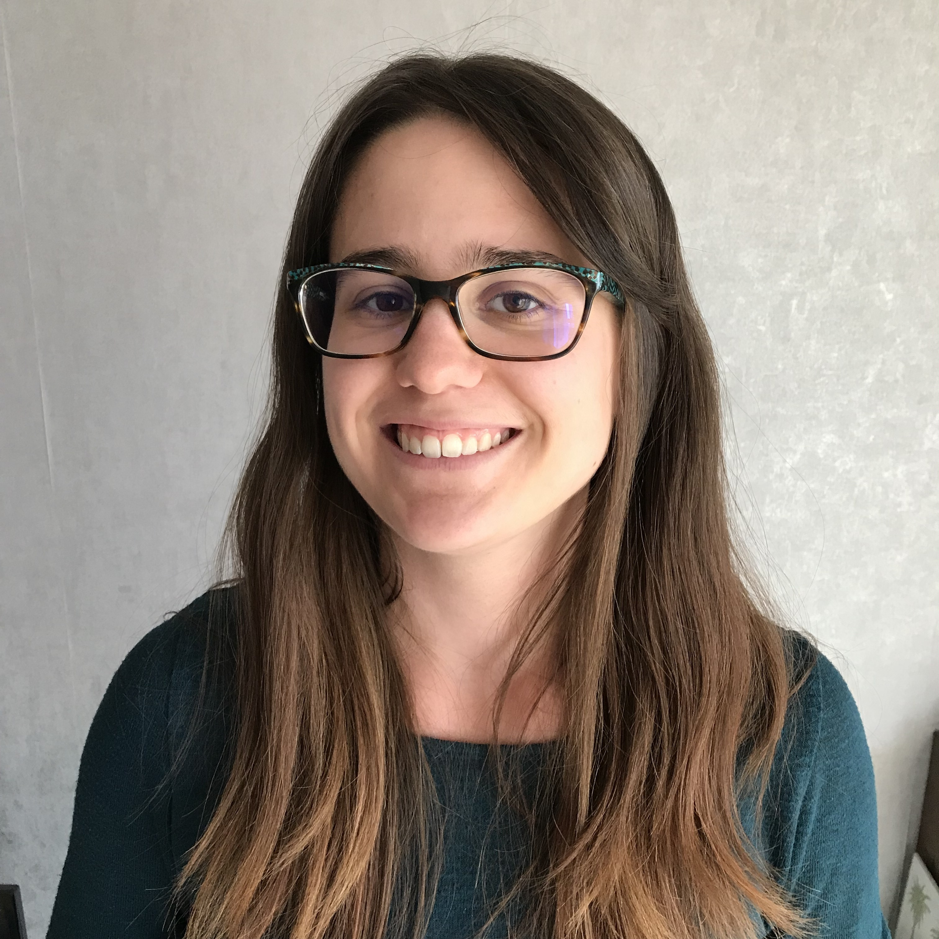
Programme
Tuesday 5 September
09:00 Topic 1 - Multivariate Statistical Analyses
- Hands-on MOFA & RGCCA
12:30 Lunch
14:00 Topic 2 - Network-based Approaches
- Theory
- Hands-on WGCNA
17:15 End of day 2
19:30 Dinner
Gadradriel Brière
Morgane Terezol

Slide 12
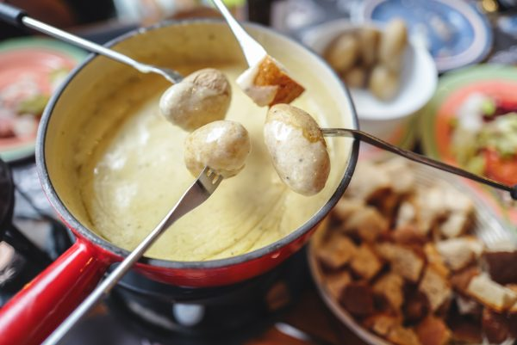
Programme
Wednesday 6 September
09:00 Topic 2 - Network-based Approaches
- Hands-on WGCNA (Integrative part)
- Hands-on SNF
12:30 Lunch
14:00 Hiking
18:45 Savoyard aperitif
19:30 Special dinner

Slide 13
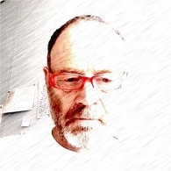
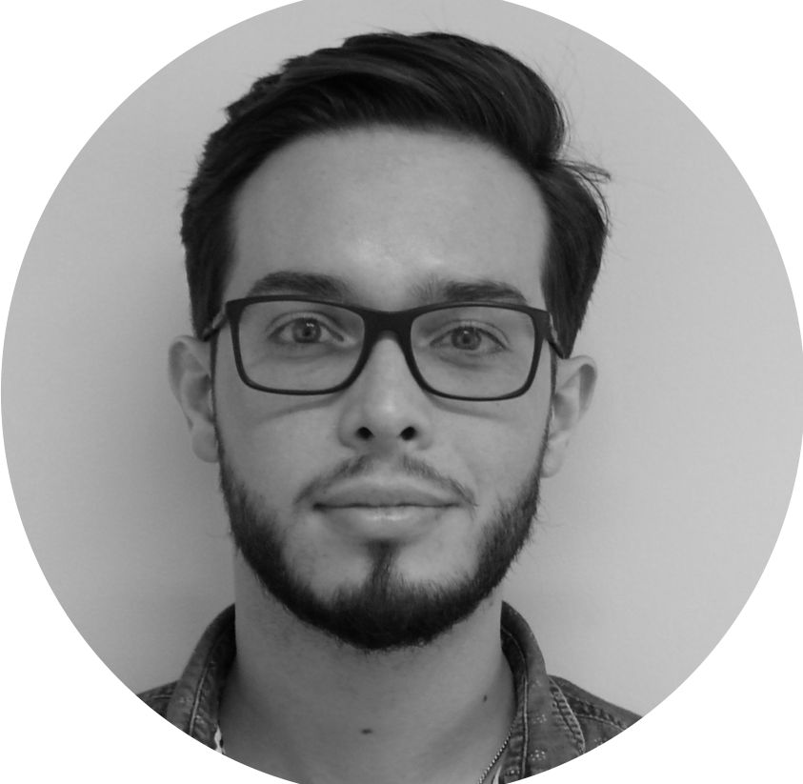
Programme
Thursday 7 September
09:00 Topic 3 - Results contextualisation: an introduction to metabolic models, web semantic and knowledge graphs
12:30 Lunch
14:00 Topic 3 - Results contextualisation: an introduction to metabolic models, web semantic and knowledge graphs
17:15 End of day 4
Marco Pagni
Maxime Delmas
Jean-Clément Gallardo

Slide 14
Programme
Friday 8 September
09:00 Presentations of the projects (groups 1 to 3)
10:30 Coffee break
11:00 Presentation of the projects (group 4)
11:30 Conclusion
12:00 End of the official part of the School
12:15 Lunch (optional)
Course web page
https://github.com/sib-swiss/summer-school-multiomics-data-analysis-and-integration

Slide 15
Datasets
Name | Description | Data
BreastCancer_WGCNA | Human breast, subset of data generated by The Cancer Genome Atlas Network | mRNA, miRNA, proteomics
CLL | Chronic lymphocytic leukaemia | Mutations, mRNA, methylation, drug response
NCI_60 | cancer cell lines from different tissue origins | Metabolomics, transcriptomics, proteomics
TaraOceans | TARA Oceans expedition, plankton communities | metagenomics, phylogeny, taxonomy
Tomato | Tomato fruit development | Transcriptomics, proteomics
https://github.com/sib-swiss/summer-school-multiomics-data-analysis-and-integration/tree/master/general/datasets

Slide 16
Groups
email address | Domain of application - organism (ex. Cancer - Mice, or ecotoxicology - Bacteria) | Career status | organism | field | data |  |  |  | group
kenneth.kim@unil.ch | Arthropod evolution | PhD student | arthropod | evolution | Genomics | transcriptomics |  |  | 1
thomas.vial@pasteur.fr | Virology - Mosquito | Postdoc | mosquito | virology |  | transcriptomics | metabolomics | proteomics | 1
Omar.keshk@epfl.ch | Bacteria | PhD student | bacteria |  |  | transcriptomics | metabolomics |  | 1
n.gioti@hcmr.gr | environment-microbes (fungi, bacteria) | Postdoc | fungi / bacteria |  | Genomics |  |  |  | 1
kumar.singh@wur.nl | insects and plants biosynthetic pathways | Postdoc | insects / plants |  | Genomics | transcriptomics | metabolomics |  | 1
edith.garot@univ-reunion.fr | Plants | Associate professor | plants |  | Genomics |  | metabolomics |  | 1
Jahn.nitschke@unige.ch | Infection biology, amoeba & mycobacteria | PhD student | amoeba & mycobacteria | infection |  | transcriptomics |  |  | 1
damir.zhakparov@uzh.ch | Allergy/Atopic Dermatitis - Human | PhD student | human | allergy |  |  |  | proteomics | 2
t.karp@rug.nl | Complex disease (asthma) phenotypes - Human | PhD student | human | asthma |  | transcriptomics |  |  | 2
valerie.amarger@univ-nantes.fr | cell differention- Neurogenesis- Nutrition-rat-human | Researcher | human | nutrition? | Genomics/epigenomics | transcriptomics |  |  | 2
v.v.odintsova@vu.nl | humans, psychiatry, twinning | Postdoc | human | psychiatry | epigenomics |  | metabolomics |  | 2
margot.derouin@inserm.fr | Psychiatry - Human | PhD student | human | psychiatry | epigennomics | transcriptomics |  |  | 2
walther.zoebel@posteo.co | Toxicology, diseases, treatments - Human | Postdoc | human | toxicology? |  | transcriptomics | metabolomics |  | 2
raphael.blanchet@univ-nantes.fr | cardiovascular - human | PhD student | human | cardiovascular | Genomics |  |  |  | 2
eva.price.22@ucl.ac.uk | Cell Line Engineering | PhD student | human | cell engineering | Genomics/epigenomics | transcriptomics | metabolomics | proteomics | 2
akshay.akshay@unibe.ch | Benign Human and Mouse | PhD student | human | ? |  | single cell transcriptomics | metabolomics | proteomics | 3
sabina.licholai@gmail.com | Human genetics, hematology, immune disfunctions | MD | human | immunology | Genomics |  |  |  | 3
valeriia.timonina@epfl.ch | Infectious diseases and Immunity - Human | PhD student | human | immunology | Genomics | transcriptomics |  |  | 3
z.sultana@uke.de | Immunology - Human , Mice | Postdoc | human | immunology |  | single cell transcriptomics |  |  | 3
berenice.schell@gmail.com | Immuno-oncology (hematology) - human | PhD student | human | immunology |  | single cell transcriptomics |  |  | 3
roxannealice.pretzsch@usb.ch | neuroimmunology - human cells | MD | human | immunology |  | single cell transcriptomics |  |  | 3
nicholas.kueng@extern.insel.ch | molecular diagnostics - human | PhD student | human | diagnostic? | Genomics/epigenomics | transcriptomics |  |  | 3
matilde.malcorps@uantwerpen.vib.be | Peripheral neurology - patient derived material, Drosophila | PhD student | human / drosophila |  |  | transcriptomics |  |  | 3
Flavio.lombardo@unibas.ch | Cancer | Postdoc | human | cancer |  | transcriptomics |  |  | 4
federica.bellerba@ieo.it | Cancer - humans | PhD student | human | cancer |  | transcriptomics |  |  | 4
ali.hashemi@unibe.ch | Human and mouse, cancer and non-cancer | Researcher | human | cancer | Genomics | single cell transcriptomics |  | proteomics | 4
nirajkhe@gmail.com | Cancer - Mice | Postdoc | human | cancer |  | transcriptomics | metabolomics | proteomics | 4
anthoula.gaigneaux@uni.lu | cancer, microbiome | Postdoc | human | cancer | metagenomics | single cell transcriptomics | metabolomics |  | 4
sharma.animesh@gmail.com | Cancer - Human | Engineer/technician | human | cancer |  |  |  | proteomics | 4
Matin.salehi@ior.usi.ch | Lymphoma, human and mice | PhD student | human | cancer | Genomics |  |  |  | 4
elise.amblard@univ-grenoble-alpes.fr | Cancer - human | Postdoc | human | cancer |  | transcriptomics |  |  | 4

Slide 17
Friday
Each group will present feedback from their week’s work, their own journey in multiomics data analysis
15 minutes presentation + 15 minutes discussion

